Slide 1
Office Fire Safety
HSEQ Campaign

Slide 2
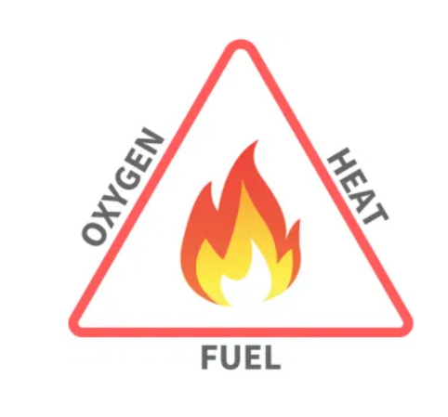
Back to Basics: The Fire Triangle
The fire triangle is a simple model for understanding the necessary components for a fire to ignite and sustain itself. It consists of three things:
Heat: This is the energy source that raises the temperature of the fuel to ignition point. There are a number of sources heat can come from on a worksite such as a match, a lighter, a spark, or friction.
Fuel: This is any combustible material that can burn. Common fuels include wood, paper, gasoline and flammable gases. The fuel must be in a form that allows it to combine with oxygen and reach its ignition temperature.
Oxygen: Fire needs oxygen to sustain combustion. It’s typically found in the air we breathe, but in some cases, it can come from other sources, like pure oxygen tanks.
If you remove one of them, the fire will be extinguished. Understanding the fire triangle is essential for understanding the risks and prevention of fire.

Slide 3
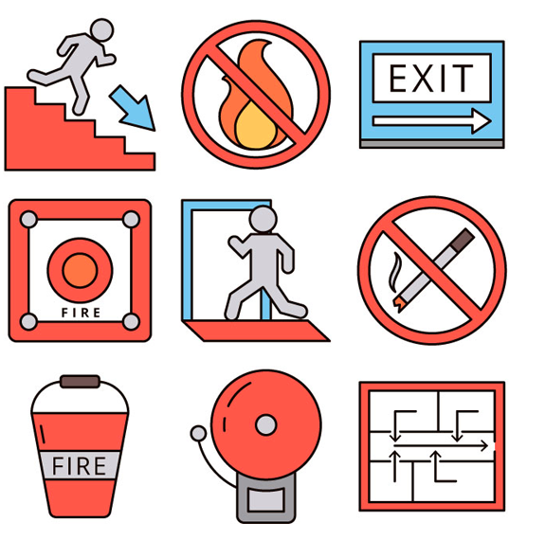
Office Fire Risk Arrangements
Dedicated fire risk assessments are carried out for every premises and reviewed every 2 years or when there is a significant physical or legislative change. The purpose of these is to:
Identify all fire hazards and assess their potential to cause a fire.
Document what current preventative measures are being taken and if they are adequate. This includes fire alarm arrangements, emergency lighting, fire extinguishers and fire exits.
Give details of people present or likely to be on-site and makes an assessment of the likely consequences to people in the event of a fire.
Fire specific emergency arrangements are documented in Emergency Fire Action Plans. These outline the procedures for fire prevention, detection and emergency evacuation arrangements. A Fire Exit Map is displayed at various points around each site and show the location of firefighting equipment, evacuation routes and muster points.
Fire arrangements are communicated to all employees and visitors during their mandatory site induction. Hard copies of the Fire Action Plans are also available at all reception areas.

Slide 4

Aberdeen Fire Arrangements
On discovery of a fire, personnel should make their way to the nearest exit and activate the fire alarm using the break glass point prior to exiting the building. The break glass points are located at the fire exit in the Business Support office, at the main door in Reception, at the fire exit in the staff canteen and at the roller doors in the Stores area.
On hearing the alarm, all staff should immediately evacuate via the nearest available exit:
The main door at the front of the building
The fire exit at the back of the canteen at the rear of the building
The fire exit next to roller door within the stores area
The fire exit in the Business Support office at the front of the building
The fire exit in the training area
Those competent in the use of fire extinguishers may attempt to control the fire as long as they
do not put themselves in unnecessary danger. Locations of fire extinguishers:
Reception (foam & CO2)
TRAC Energy open plan office (foam & CO2)
Canteen (CO2)
Stores (foam & CO2)
Server room (CO2)
Business Support office (foam & CO2)
Training area (foam & CO2)
The Fire Action Plan is available on site and documented in TRACINFO C10.07.

Slide 5
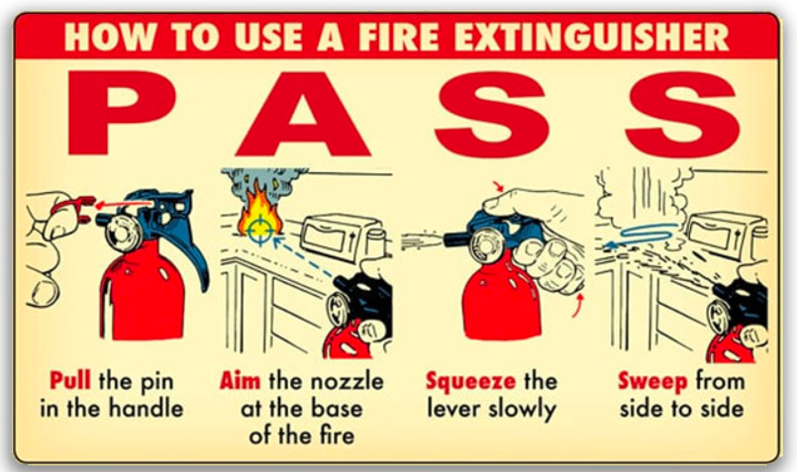
Fire Extinguishers
Using the right fire extinguisher is crucial for effectively putting out a fire. Fire extinguishers are classified based on the type of fire they are designed to combat. Using the wrong type can make a fire worse or be ineffective.
Location - On site fire extinguishers are listed in the Emergency Fire Action Plans. They are located throughout each site and in all staff vehicles.
Maintenance - Extinguishers should be inspected annually. They must be recharged after use.
Storage - They should be easily accessible and placed in stands to protect from damage. Extinguishers stored in vehicles should be kept in the boot away from direct sunlight. They can be kept in temperatures between +50 and -40 degrees.
Use - Those competent in the use of fire extinguishers may attempt to control a fire but should never put themselves in unnecessary danger.
*https://firechiefglobal.com/how-to-use-a-fire-extinguisher/

Slide 6
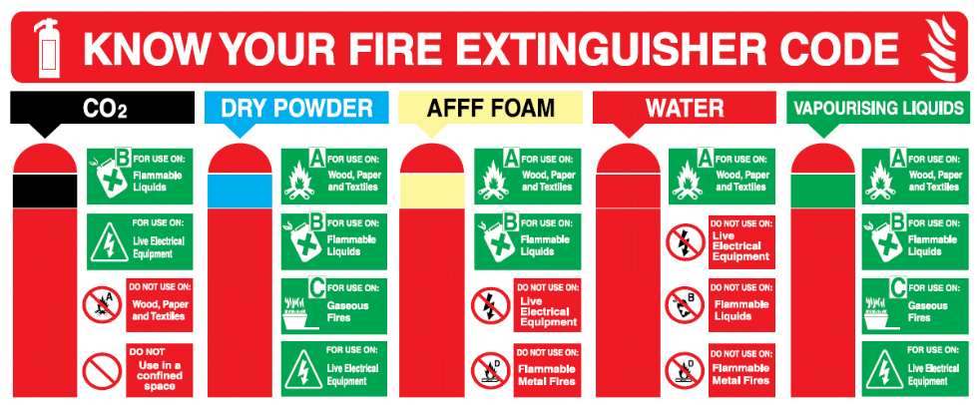
Back to Basics: Fire Extinguisher Types
*https://londoncityfire.co.uk/types-of-fire-extinguishers/

Slide 7



Staff Responsibilities
  TRAC expects the co-operation of all employees with respect to fire safety responsibilities. This includes participation in inductions, fire drills and fire safety training when required.
  Employees and visitors are asked to comply with TRAC safety rules which include only smoking and vaping in external, designated areas.
  All employees should take reasonable care for their own safety and those around them.
  All staff should be
  aware of their responsibility for implementing the safety measures detailed in the site-specific fire risk assessments.
  For more detail on preventative measures for a particular premises speak to the HSEQ team.
  To reduce the likelihood of a fire, it is imperative all staff are aware of the importance of good housekeeping.
  Ensure all waste is disposed of sensibly.
  Ensure all appliances are switched off and unplugged
  when not in use.
  Do not bring in electrical devices from home.
Co-operation
Awareness
Housekeeping

Slide 8
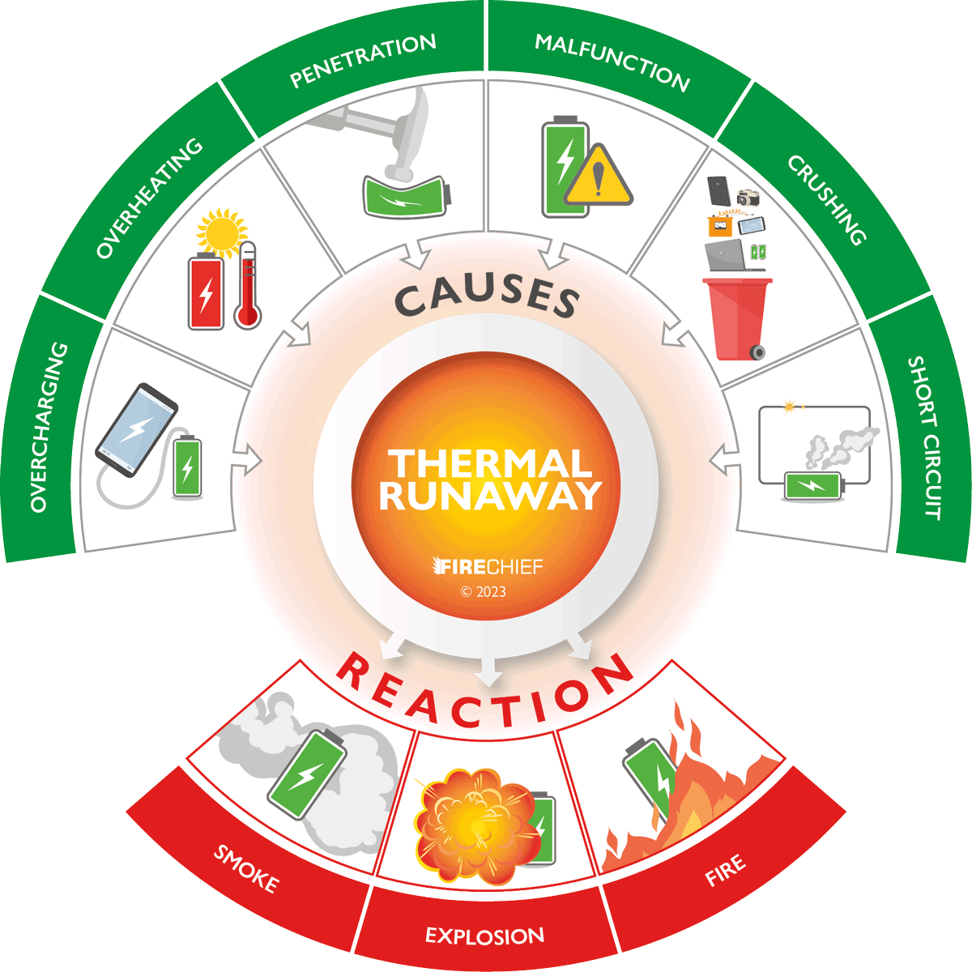
Fire Safety Focus: Lithium-Ion Batteries
Lithium-ion batteries power a wide range of devices at work and at home; from smartphones, laptops to electric vehicles. They are generally very safe but there are things you can do to reduce the chance of fire starting:
Don’t fully charge your device. Unplug at around 80%.
Do not all allow your device to overheat and never charge if it feels hot.
Only charge using the manufacturer supplier charging cable
Charge device on a hard surfaces away from soft furnishings.
Dispose of battery-operated items as hazardous wate.
If a lithium-ion battery fire does break out rapid cooling is the most
effective control method for small devices. A water-based fire extinguisher
(hydrospray, foam or water) may be used*. In all instances the emergency services
should be alerted.
*https://chubbfs.com/uk-en/how-to-tackle-lithium-ion-battery-fires/

Slide 9

Fire Safety Focus: Electric Vehicles
There are now many electric vehicles on our roads and in our communities (cars, vans, scooters, e-bikes etc.) While EV fires are not a common occurrence (239 EV fires were recorded in the UK from July 2022 to June 2023*) it is important to highlight some simple things you can do to reduce the risk:
Don’t charge your car immediately after a long journey. The battery will be hot!
Never use a charging point unless you are sure it is compatible with the make of your car.
If you are charging from a 13A mains socket in your home, ensure the wiring in your property has modern wiring.
Where possible, charge your vehicle outdoors in designated charging areas (not blocking fire exits). Fit a smoke detector in your garage if this is your primary charging location.
For cars, have your home charge point installed by a qualified and maintained by a competent person.
Never use a damaged charge cable or charge point. If these are public points, report them to the provider.
If you have any accidents, even small bumps that only appear to cause cosmetic damage, have the vehicle battery inspected by an EV specialist. Even the smallest dent to a battery pack can cause it to catch fire!
*https://www.autocar.co.uk/car-news/electric-cars/how-much-fire-risk-are-electric-vehicles

Slide 10
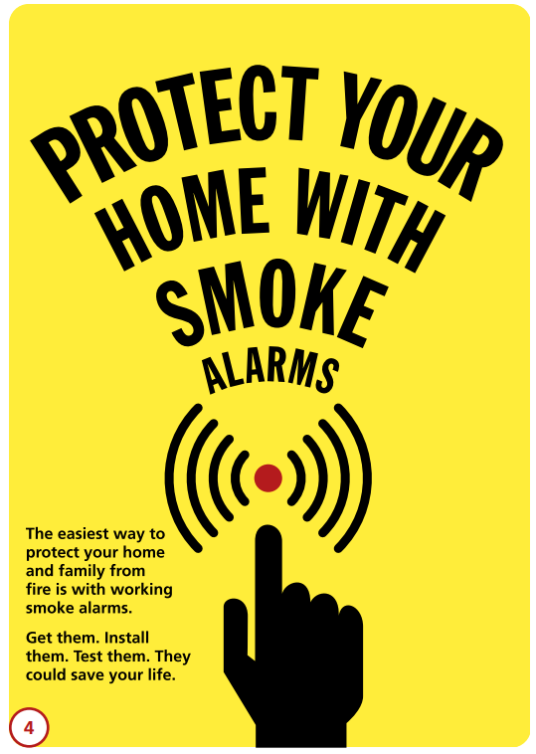
Fire Safety at Home: Useful Links
Tools such as the London Fire Brigade’s Home Fire Safety checker can help provide guidance on home fire safety.
Most regional fire services offer free fire safety home checks. They will also assist you in creating an at home fire safety plan.
The UK Government’s Fire Safety In the Home Guide contains lots of useful, practical information.
If you are worried about the risk associated with building cladding The UK Government’s Building Safety Fund provides funding to fix safety fire risks associated with cladding in buildings over 18 metres high.

Slide 11
THINK SAFETY!!
0
Fatalities
How are we doing?
0
LTI
Summary of Incidents 2024:
January – Present
0
RWD/MTC
0
First Aid
0
Near Miss
* RWD = Restricted Work Day, MTC = Medical Treatment Case

Slide 12
THINK SAFETY!
Look After Yourself
Look Out For Others
Use Safety Equipment
Follow Safety Procedures

