Slide 1
Women’s Health

Slide 2
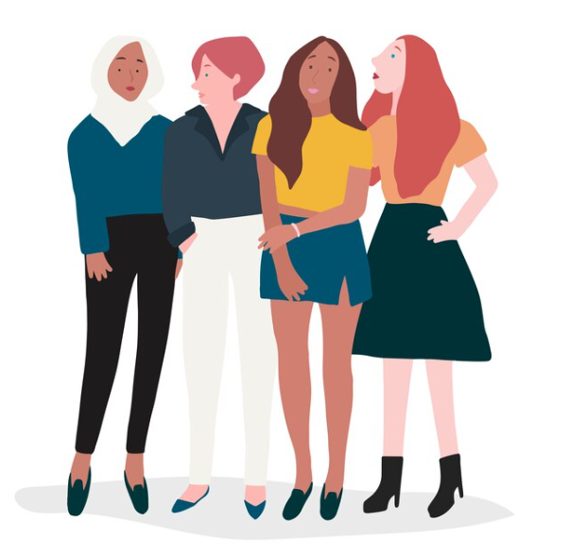
Women’s Health
In the past women’s health has focused on reproductive and maternal issues. However, it is now being recognised that it extends way beyond this. Women’s health encompasses numerous issues including mental health, cancer, management of chronic conditions, autoimmune diseases (…the list could go on).
A global study found that women tend to live longer than men but, suffer more illness throughout life.
Only around 5% of women’s health issues are related to gender specific maternal and gynaecological conditions.
47% of female health issues relate to non-gender specific conditions that affect women disproportionately.
Over 45% of the female health issues are experienced be women aged 20 – 64 years old.
Women’s health is complex, interconnected and not yet fully understood. What is clear is that maintaining a healthy lifestyle and keeping stress level lows are important factors in promoting good overall health.
*Closing the women’s health gap | McKinsey
*https://www.bmj.com/content/385/bmj.q999

Slide 3
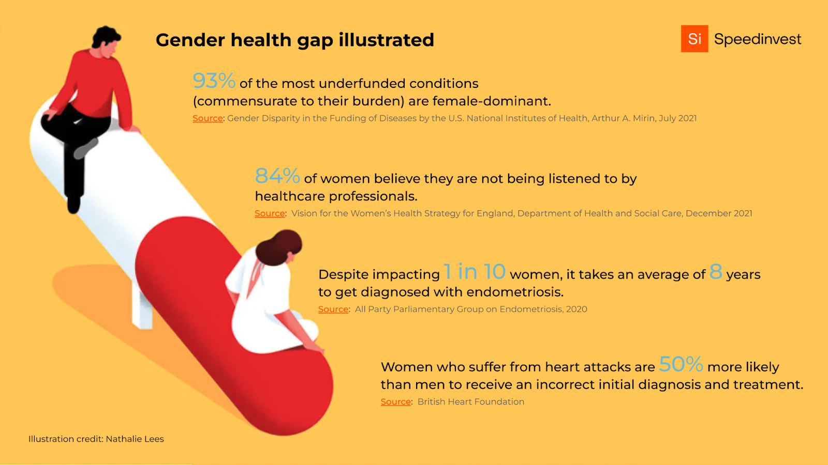
The Gender Health Gap
Gender has a significant impact on your health. It affects your risk of developing certain diseases, your access to and uptake of health services and the treatment you receive.
There has been a lack of research placed on women-specific issues and an under representation of female participants in clinical trials. This has led to a lack of knowledge about how conditions specifically affect women and how they should best be treated.
For this reason, there is a call for more reporting data on females to enable a change in approach to health and care.

Slide 4
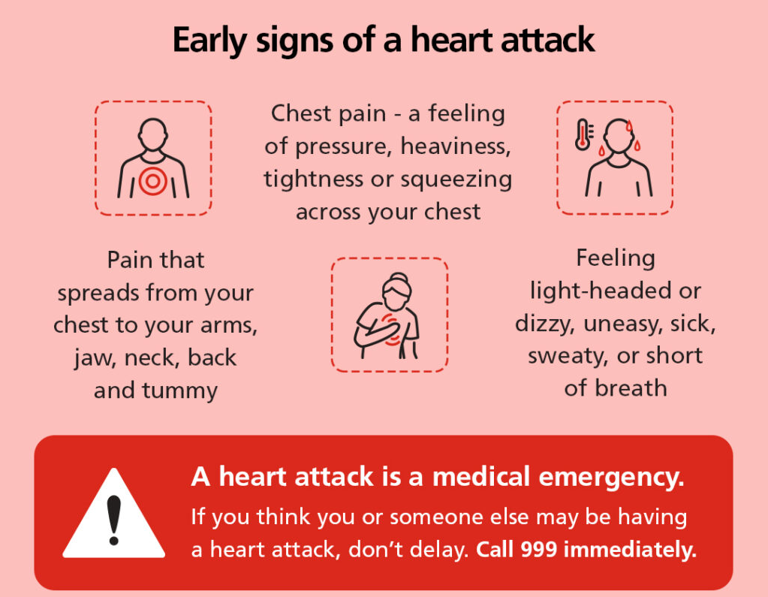
Women’s Heart Health
Coronary heart disease, the main cause of heart attacks, kills more than twice as many women as breast cancer in the UK every year, and was the single biggest killer of women worldwide in 2019.
Women suffer around half as many heart attacks as men. However, research by the British Heart Foundation found that the health outcomes for female sufferers are poorer than their male counterparts. This is partly due to coronary heart disease being seen as a ‘man’s disease’.
It is important to be aware of your risk factors and take action to lower them. The risk of heart attack increases for women post menopause.
For more on the risk factors and other information visit The British Heart Foundation.
*https://www.bhf.org.uk

Slide 5
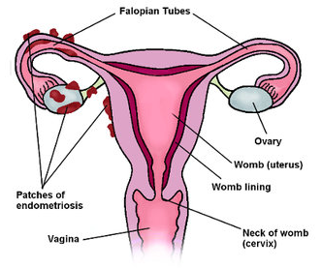
Endometriosis
Endometriosis is the name given to the chronic condition where cells similar to the ones in the lining of the womb (uterus) are found elsewhere in the body.
Each month these cells react in the same way to those in the womb, building up and then breaking down and bleeding. Unlike the cells in the womb that leave the body as a period, this blood has no way to escape.
10% of women worldwide are currently living with the condition. The symptoms can include:
Severe pain during periods, sex and bowel movements and urination.
Bloating
Infertility
Depression
The general symptoms make it difficult to get a diagnosis. This condition can affect a woman from puberty to menopause, although the impact may be felt for life.
Support can be found - https://www.endometriosis-uk.org/get-support and https://www.endometriosis-india.com/

Slide 6
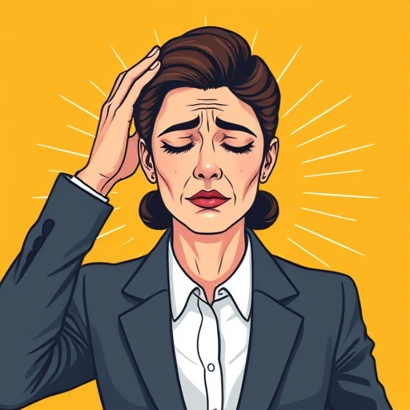
Menopause
Menopause is when your periods stop due to lower hormone levels. It usually affects women between the ages of 45 and 55, but it can happen earlier. Some describe it as ‘puberty in reverse’. On average menopause symptoms go on for four years after the last period. These are wide ranging, can be unpredictable and for some, are debilitating.
1 in 4 of women suffer extreme physical, emotional or psychological symptoms.
44% of women said their ability to work had been affected, 10% of women leave the workplace altogether.
69% of women experience difficulties relating to depression and anxiety.
85% of women have trouble sleeping
61% had lost their motivation and 52% lost their confidence.
In the past many women felt isolated. Menopause was viewed as a ‘taboo’ subject and treated as a medical problem rather than a natural stage of life. Attitudes are now changing with increasing public awareness, improved medical understanding and shifts in workplace policies. Most women now spend a third of their life ‘post-menopause’ so reframing the narrative is important.
*https://www.health.com/menopause-overview-7485701

Slide 7
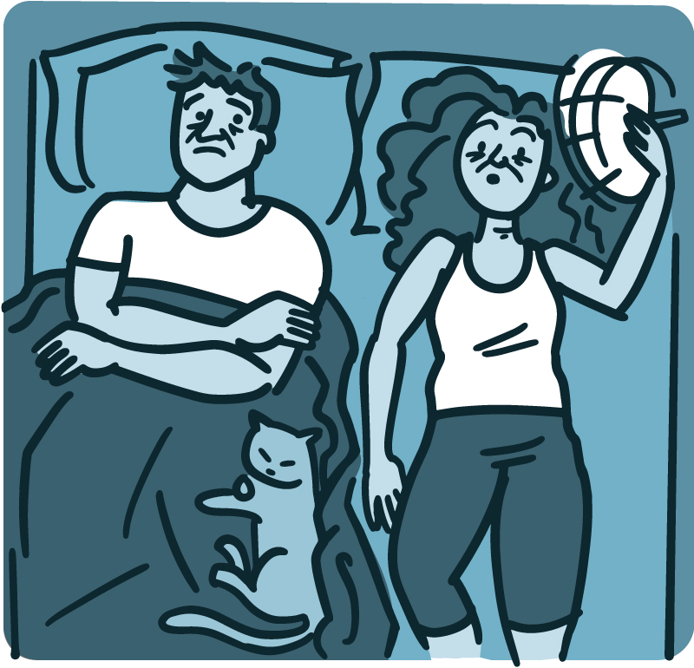
Helping Someone Through Menopause
Menopause does not only affect those experiencing it first-hand. Men may not experience menopause in the same way themselves, but they can feel the effects on the relationship and home life.
Be patient and listen – Do not avoid the subject.
Educate yourself - Knowledge is power!
Give space – Your partner might need time alone. Try to remember that that this is not aimed at cutting you out (although it may feel like that).
For help and advice on how to help someone you know, that is experiencing symptoms, NHS Inform is a good place to start.
*https://newsinhealth.nih.gov/2018/07/preparing-menopause
*https://www.health.com/menopause-overview-7485701

Slide 8
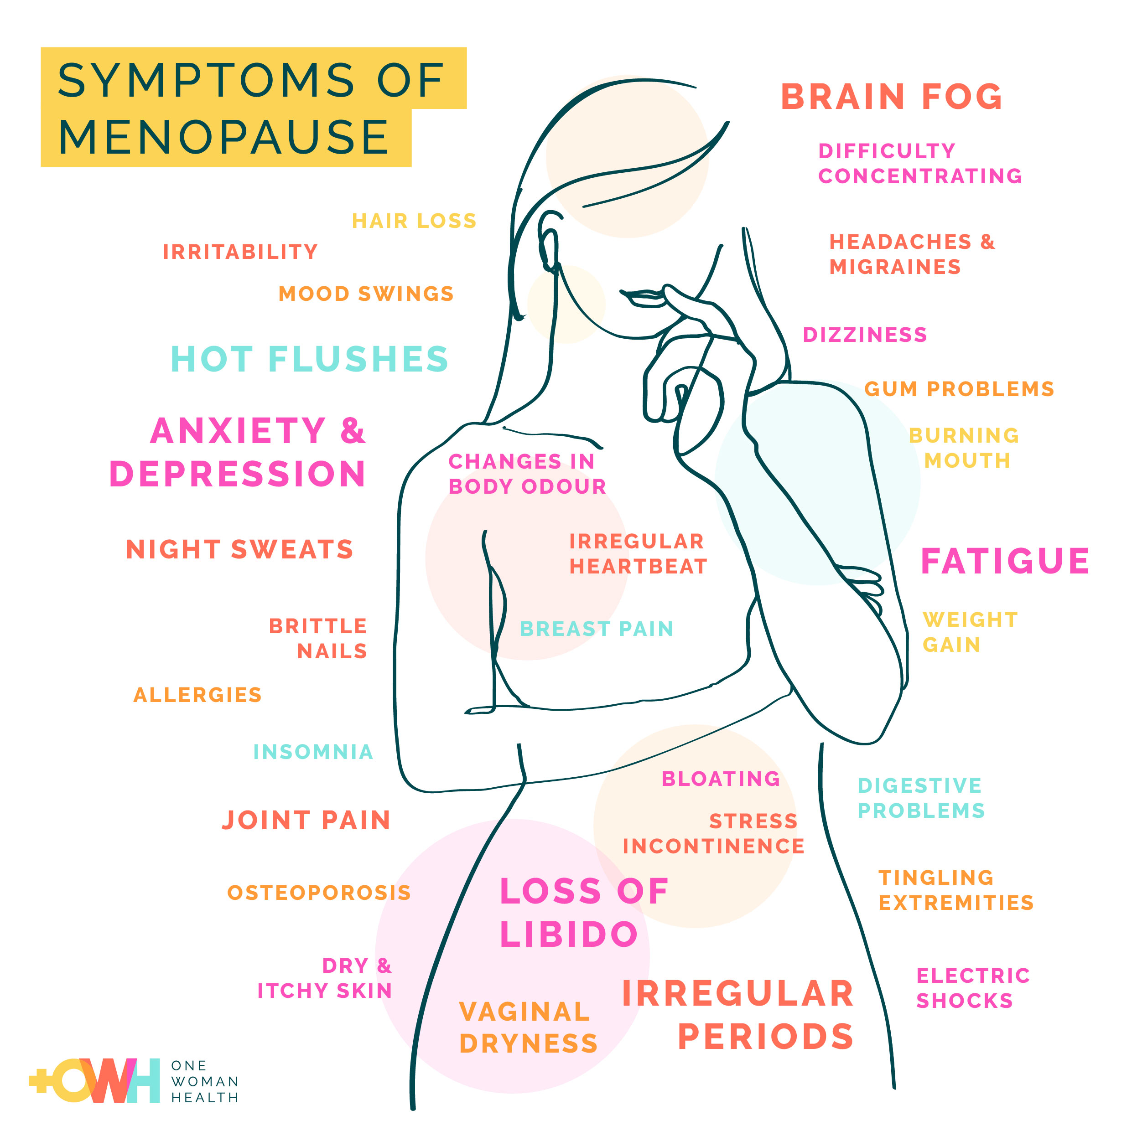
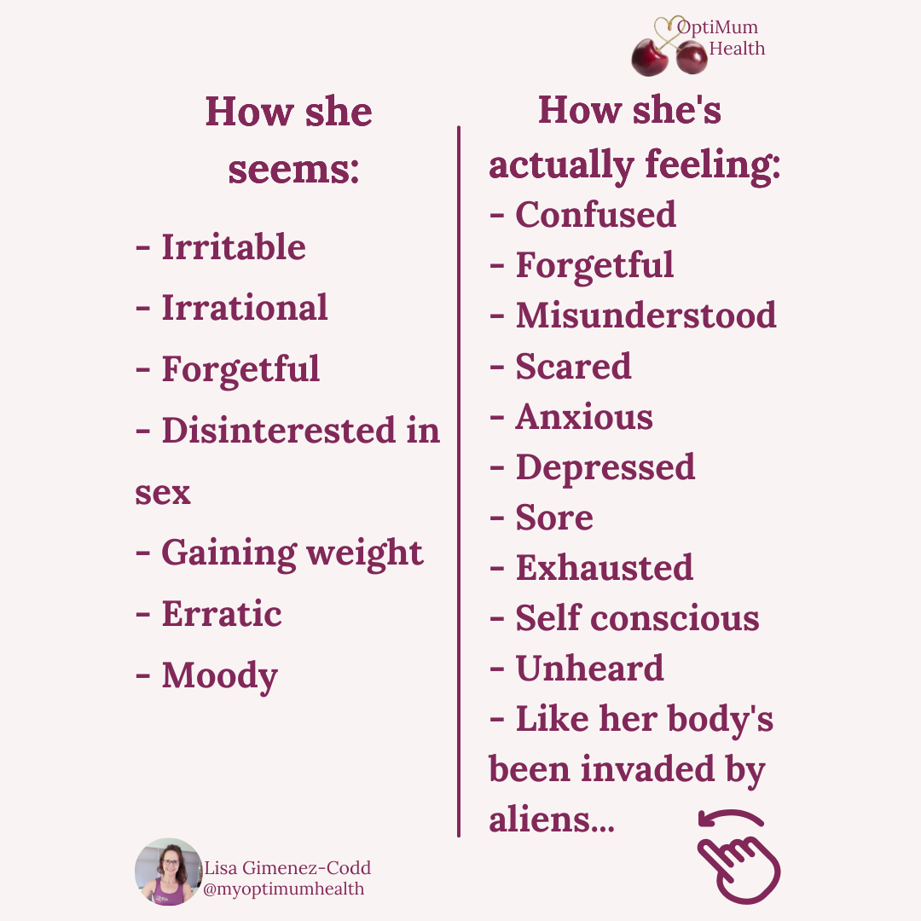

Slide 9
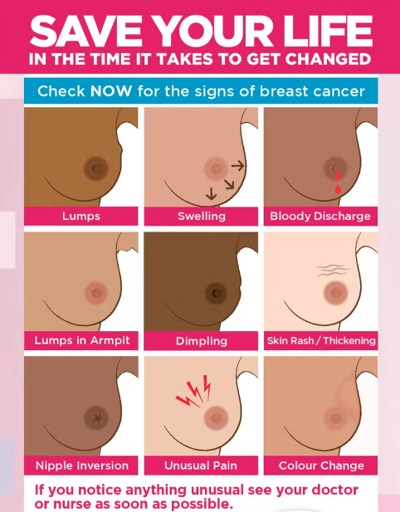
Breast Cancer
Breast cancer is a disease in which abnormal breast cells grow out of control and form tumours. If left unchecked, the tumours can spread throughout the body and become fatal. It is a leading cause of death for women under 50.
It is important to check your breasts at least once a month.
Over half of women in the UK do not currently do this!
CoppaFeel Breast Cancer Awareness has lots of useful resources including a breast checking reminder tool. Just sign up with your details to receive an email or text reminder every month - https://self-checkout.coppafeel.org/get-a-reminder

Slide 10
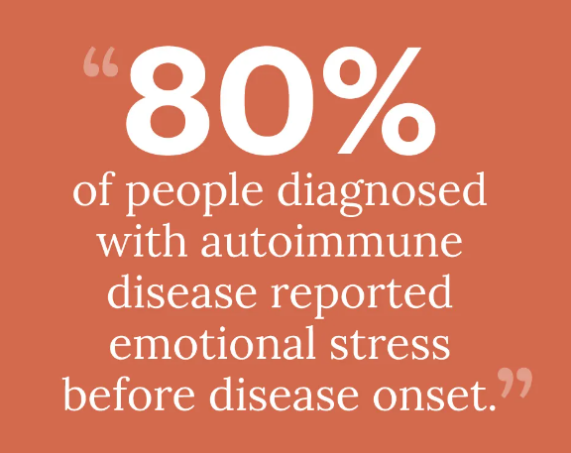
Autoimmune Diseases
Autoimmune disease occurs when the immune system mistakenly attacks its own healthy tissue. This includes conditions such as:
These diseases disproportionately affect women (particularly those of child bearing age). It is believed that the immune systems response to attacks is more exaggerated in women. This is results in faster clearance of pathogens but greater chance of autoimmunity*.
The exact reason for this is unknown but it is thought that the X chromosome, gut health and environmental factors play a part.
Stress has been found to be a trigger. This is another reason to try and keep your stress levels as low as possible.
Rheumatoid arthritis
Thyroid disease
Inflammatory bowel disease
Multiple sclerosis (MS)
Type 1 diabetes
Crohn’s disease
*Sex differences in immune responses | Nature Reviews Immunology

Slide 11
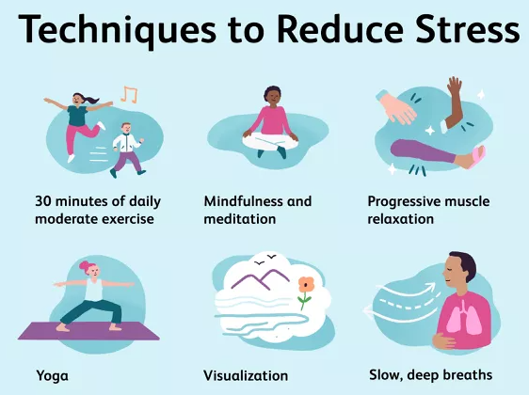
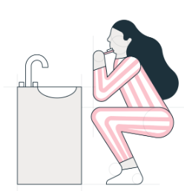
Healthy Lifestyles
Maintaining a healthy lifestyle reduces the risk of getting ill. It can also help you to deal with the symptoms of illness.
Reduce stress - Many women are juggling working with looking after children and/or parents, the home, pets etc. This can lead to high stress levels which drastically impact health. Reducing stress lowers blood pressure, improves your immune system, reduces muscle tension and improves heart health.
Be active – According to Sport England three quarters of women do not take the recommended 30 minutes of exercise 5 times a week.* Getting your body moving improves mental and physical health, reduces the chance of illness and boosts motivation and self-confidence.
If time is an issue, try to build exercise into your daily life e.g. walk whenever you can, choose to take the stairs. Why not multi-task and exercising while brushing your teeth! https://davidevansdds.com/blog/8-exercises-can-brushing-teeth/
*https://activewomenandgirls.org.uk/why-we-exist
*https://www.bhf.org.uk

Slide 12
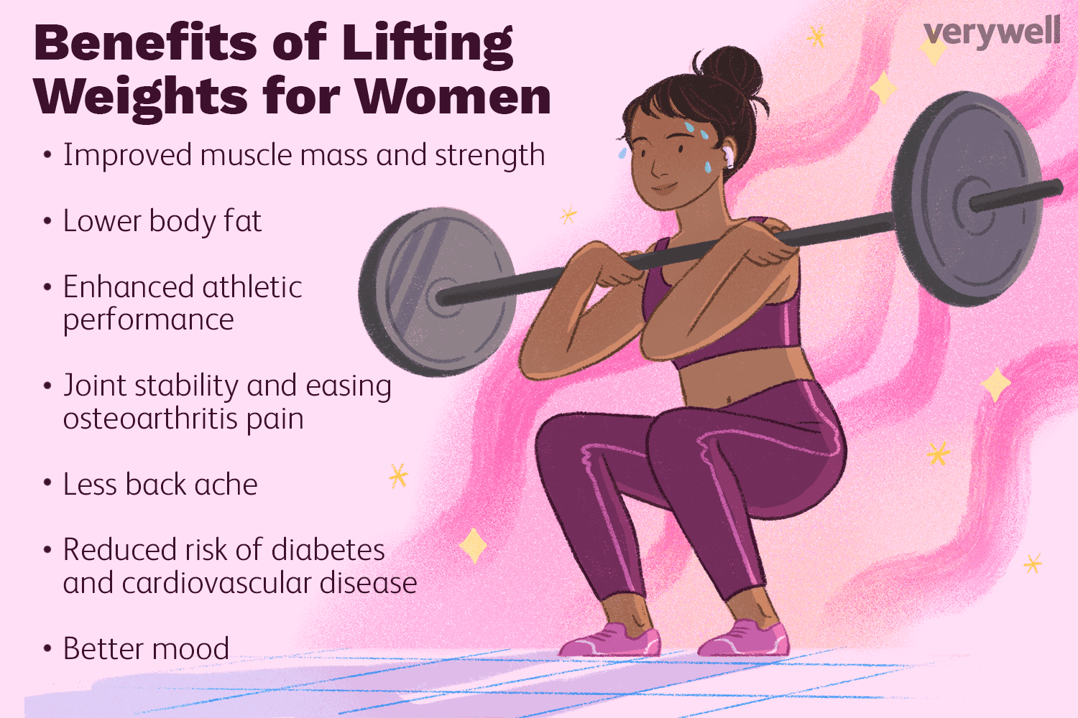
Healthy Lifestyles

Slide 13
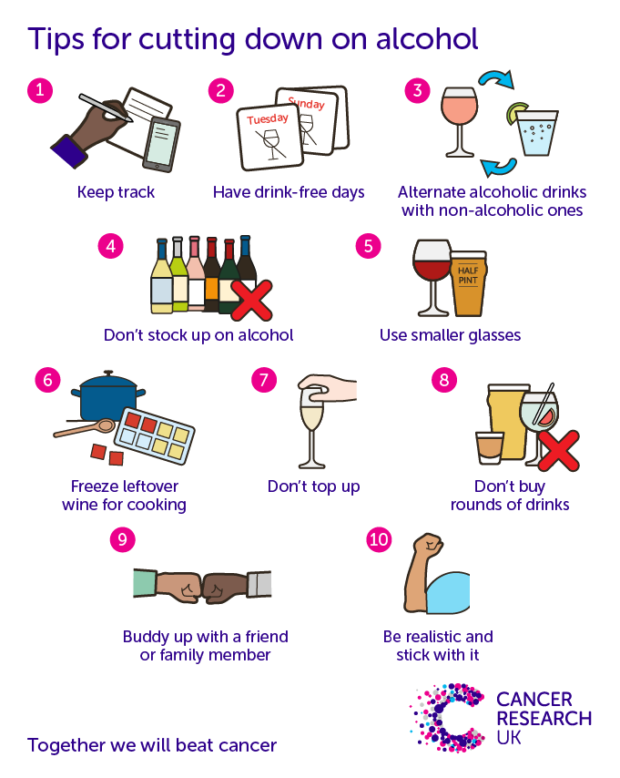
Healthy Lifestyles
Eat a Mediterranean diet – Plant based foods, lean proteins and healthy fats. This reduces the risk of heart disease by 30%. A handy healthy eating guide for women can be found here.
Limit alcohol – unchecked alcohol consumption in women can have serious effects. Women should be particularly aware of this as they are physically more vulnerable to health conditions associated with alcohol than men.
Drinking is often a by-product of stress. Learning to recognise this can help you to deal with the stress differently.
Helpful resources for cutting back on alcohol can be found at https://www.drinkaware.co.uk/ and https://drinkcoach.org.uk/drinkcoach-app
*https://activewomenandgirls.org.uk/why-we-exist
*https://www.bhf.org.uk

Slide 14
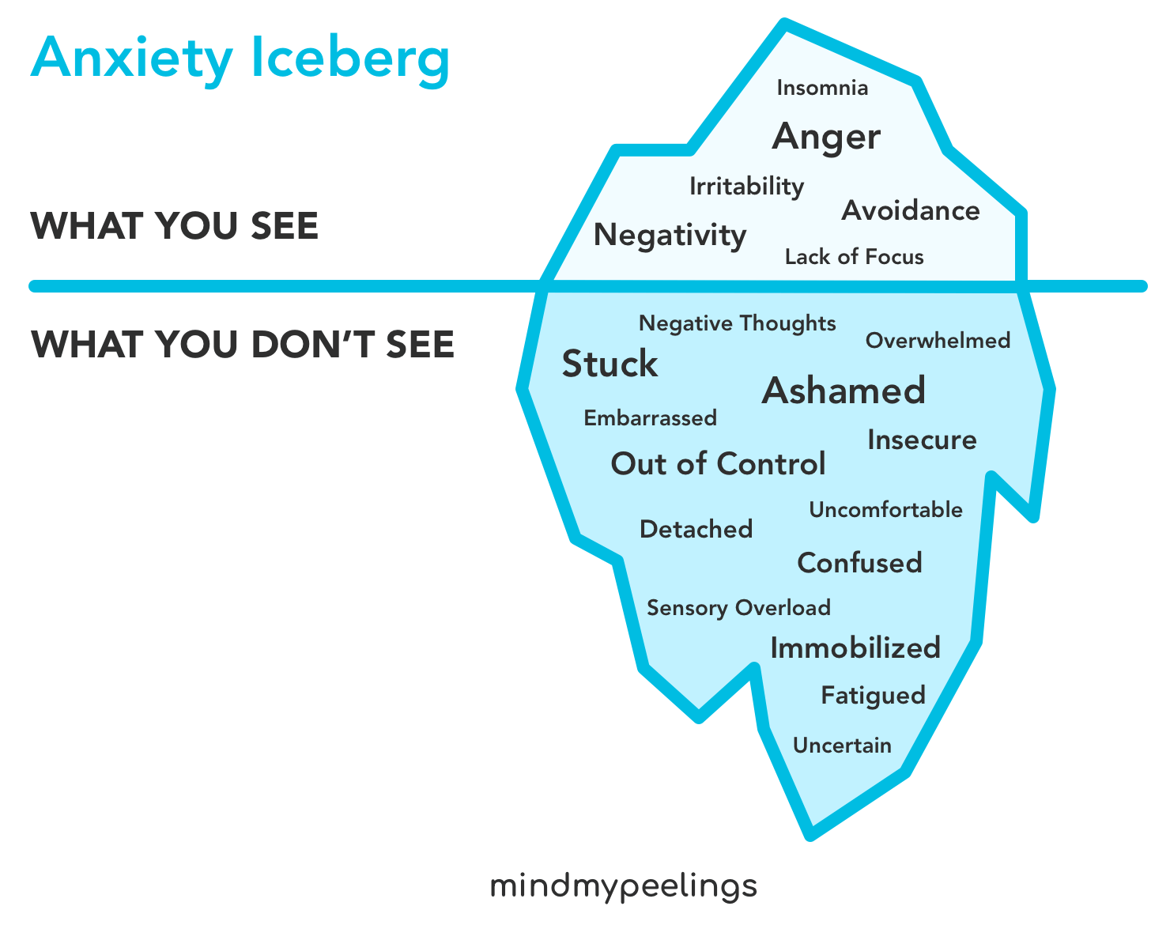
Anxiety
7% of women globally are thought to have an anxiety disorder. Symptoms include panic attacks, social withdrawal, irritability and general feelings of dread.
Women go through various life stages and experiences which can cause or exacerbate anxiety. This include things like illness, fluctuating hormones, stress, body image issues, caring responsibilities and societal expectations.
Self-care is important for helping you to feel less anxious. Help on strategies for dealing with anxiety can be found on the NHS website.

Slide 15
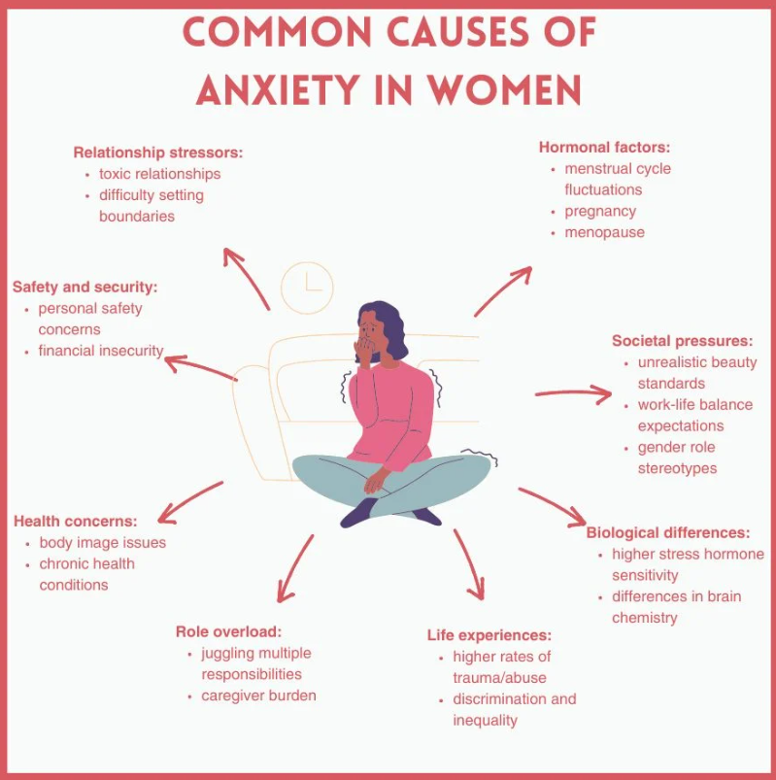

Slide 16

Useful Resources
NHS Inform has a range of resources relating to women’s health Women's health | NHS inform
The Scottish Women’s Institute promotes healthy lifestyles and friendship https://www.theswi.org.uk/
The National Women’s Register connects women through discussion and activities https://nwr.org.uk/
Fancy getting active? – why not join the ‘The Scottish Women’s Walking Group’ and make friends while walking! https://www.swwg.co.uk/

Slide 17
THINK SAFETY!!
0
Fatalities
How are we doing?
0
LTI
Summary of Incidents 2024 –
January – Present
0
RWD/MTC
0
First Aid
0
Near Miss
* RWD = Restricted Work Day, MTC = Medical Treatment Case

Slide 18
THINK SAFETY!
Look After Yourself
Look Out For Others
Use Safety Equipment
Follow Safety Procedures

