Slide 1
Staff travel data And travel tips
TRAC INTERNATIONAL
NOVEMBER 2024

Slide 2
what is the commuting survey for?
TRAC report on how much greenhouse gas emissions we produce to operate our organisation each year. We publish these reports on our website.
Part of this includes getting everyone to the office – hence we include your commute. It is part of our “scope 3” emissions. These are the emissions that are linked to our business activity but not directly part of it.
Commutes can be complicated and changeable so to keep things simple we take an annual snapshot of how people get to work, just focusing on the part of your journey that is from your home to your place of work, and we apply that across the calendar year. We appreciate that within your journey, you may go to check on relatives, pick up children or head to the gym, but we can’t include that in our data.

Slide 3
Converting the data
In the survey we ask for your fuel type – there are different factors to work out the emissions for fuel type as this does have a big impact on the end result. As use of electric and hybrid vehicles increases we hope to see a reduction in emissions within commuting in coming years.
However, we don’t currently ask about car size - some of you drive large cars and vans, some drive smaller, more efficient vehicles. We anticipate that, on balance, this evens out across the work base so we use an “average car” factor appropriate to the fuel type to work out the emissions for drivers. The decision to use this approach takes into consideration the overall volume of our emissions and resources available to us.
We also ask about how often you work from home, this helps us estimate how many emissions have been saved by using hybrid work patterns.
Many of you don’t use cars at all – DEFRA* publishes factors for bus, train, tram and many other types of journey too and we use the most appropriate factor for your journey type.

Slide 4
the 2024 results
For TRAC International, everyone drives to work.
A few people car share.
The breakdown of emissions and fuel types is as shown here -
However, we also work a hybrid pattern and have saved an estimated 10.4 Tons CO₂e. by working from home.

Slide 5

Making your commute more eco friendly
Buddy up! Where possible, car share with a colleague. If you do not live near anyone at work try online platforms such as Lift share to find someone doing a similar journey to you.
If you only need to commute occasionally a pay-as-you-go car rental can be a good solution. Companies like Co Wheels allow you to hire by the hour.
Get moving! Why not walk to work or park a bit further away and walk part of the journey. This will save you money and helps to boost mental wellbeing.
Choose public transport there are discount schemes available for regular users. Check your transport provider for railcards and monthly passes. If you do not live near a suitable bus stop consider using Park and Ride
EV Salary Sacrifice Scheme – Lease an electric car through the Octopus EV scheme.

Slide 6
What’s next
We’ll repeat the commuting survey in mid-2025 and hope more of you will take a couple of minutes to complete the survey to help us with a more accurate estimate.
The next few slides take you through some tips for efficient and safe driving.
*N.B. DEFRA is a UK Governmental Body – the Department for Environment, Food and Rural Affairs who are responsible for improving and protecting the environment. As part of this, they publish detailed lists of emissions factors every year so that organisations can monitor their emissions and try to reduce them.

Slide 7
Eco-Efficient Driving
Driving technique (not just driving distance and time) affects how much fuel your vehicle uses. Altering the way you drive can save hundreds of pounds every year and can positively impact your carbon footprint.
Drive Smoothly - acceleration, shifting, breaking all require energy. Try to flow with the traffic.
Shift up early to a higher gear - Driving at high revs increases fuel consumption
Avoid speeding – Higher speeds demand more power. In electric vehicles steady driving at motorway speed drains the battery much faster than driving in stop-and-go traffic.

Slide 8
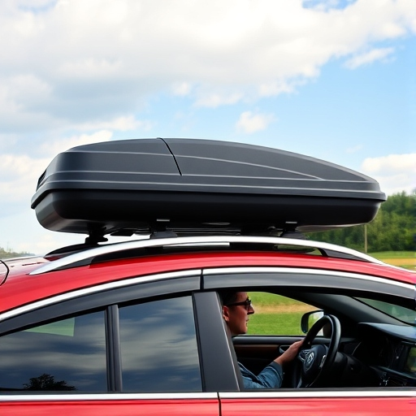
Eco-Efficient Driving
Avoid idling – If your car does not have stop/start functionality then turn the engine off if you are going to be stationary for more than a minute.
Don’t be a drag! – Remove roof boxes and any other excess weight when not in use.
Use Air Conditioning wisely – Try rolling your windows down instead of using your A/C. If you need some cool air, consider using it in short bursts and re-circulate this cool air. At higher speeds open windows will cause drag and use more energy than A/C.
Think about Winter – Colder temperatures mean more energy is required to run your car. Winter conditions can lead to a 15% reduction in fuel economy in petrol cars*. Storing your car in a garage or under a cover, using a windscreen shield and scraping ice off with a scraper rather than using the heater can help reduce this energy spend.
.

Slide 9
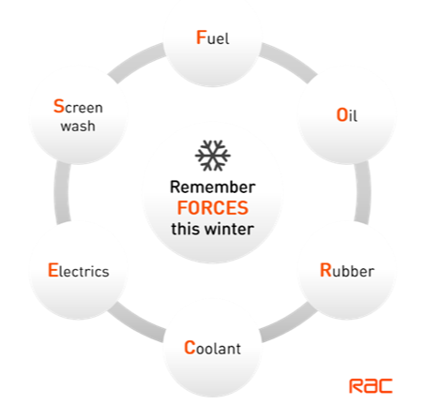
Vehicle Maintenance
Regular servicing helps maintain your engine’s fuel efficiency. Engine parts work closely in tandem and if poorly maintained, sludge and corrosion will build-up making it difficult for the engine to work smoothly. As colder weather creeps in now is good time to ensure your vehicle is Winter ready.
Tyre pressure and tread – at least 3mm is recommended. Something as small as tyre pressure can have a big impact on your ability to stop in an emergency as well as fuel consumption.
Ensure your car battery is healthy. Battery issue are the most common cause of Winter breakdowns.
Check your wipers are fully effective and topped up with 50:50 water and anti-freeze.
Ensure lights are all working and clean.
Top up your engine coolant with anti-freeze.
Keep Winter essentials in the car: de-icer, scraper, high vis, blankets, warm clothing, water and food with a long expiry date.

Slide 10
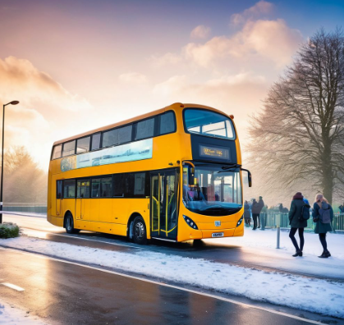
Winter commuting
If extreme weather is expected, think about working from home. Always check with your Line Manager. For TRAC’s policy on inclement weather see the Staff Handbook.
Give yourself a little extra time for each journey. Adapt your driving, cycling or walking pace to suit the conditions.
If in a car allow enough space between you and other drivers. Remember stopping distances increase by up to 10 times in the snow and ice!
Be prepared! Always wear warm clothes and suitable footwear for the conditions outside. You never know when you may breakdown or be stranded on public transport.
Don’t expect public transport to run to schedule in the worst weather conditions.
If you’re walking in the dark, take measures to be visible.

Slide 11
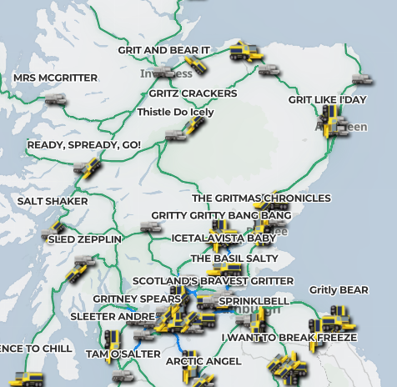
Useful Resources
Aberdeen City Roads - Get ready for winter | Aberdeen City Council
Aberdeenshire Council Roads - Winter roads maintenance - Aberdeenshire Council
Traffic Scotland gritter tracker and Traffic Scotland Internet Radio Service
Car Sharing Schemes - Liftshare, Car club | Aberdeen City Council
Electric Vehicle Lease - Octopus EV scheme

Slide 12


