Slide 1
HAND SAFETY
HSEQ Campaign

Slide 2

Importance of Hands
The hand is one of the most complex examples of natural engineering in the human body. They have a wide range of movement with powerful grip as well as an ability to perform precision tasks. This means that they are exposed to many hazards every day. The anatomy of the hand makes it very vulnerable to injury.
Hands are made up of tendons, nerve fibres, blood vessels and bones. The only protection is from skin and a thin layer of muscle.
Our fingers are more sensitive than our eyes!
Our fingertips contain receptors responsible for sending messages to the brain.
Globally, approximately 20% of all disabling accidents on the job involve the hands*.
* https://www.linkedin.com/pulse/10-interesting-facts-our-hands-more-reasons-appreciate-protect-

Slide 3


Common Hand Hazards
MECHANICAL HAZARDS, MOVING PARTS
HANDLING
Chemicals
WEARING Loose CLOTHING/JEWELLERY
POOR MANUAL HANDLING TECHNIQUES
INCORRECT RISK ASSESSMENT - PINCH POINTS NOT BEING INDENTIFIED
LACK OF SPATIAL AWARENESS
Hand-Arm Vibration (HAV)
INCORRECT/IlL FITTNG PPE
USING THE Wrong TOOL FOR THE JOB
Repetitive MOVEMENTS WHEN USING COMPUTERS OR HAND TOOLS

Slide 4
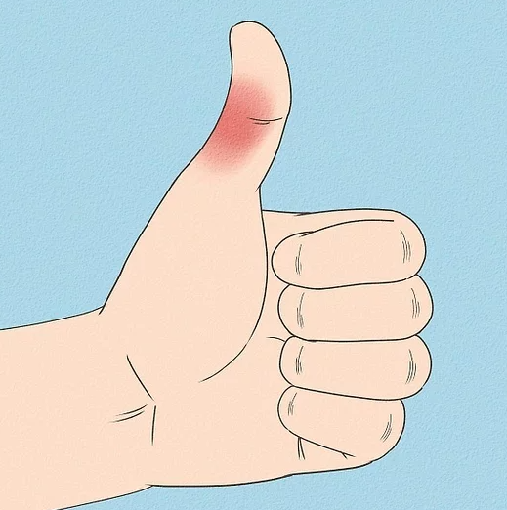
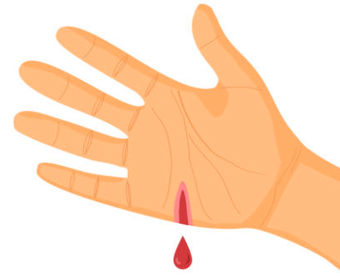
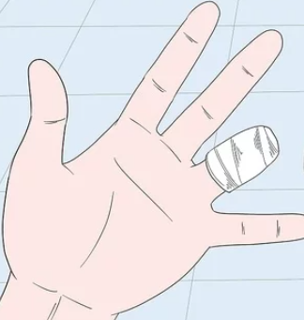
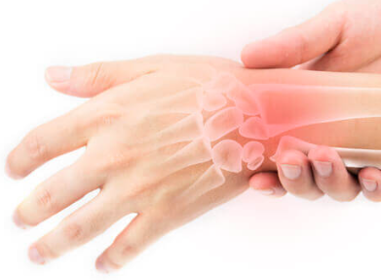
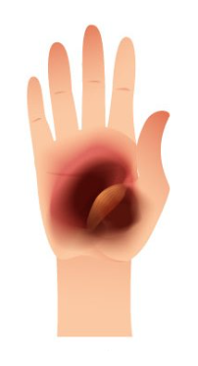
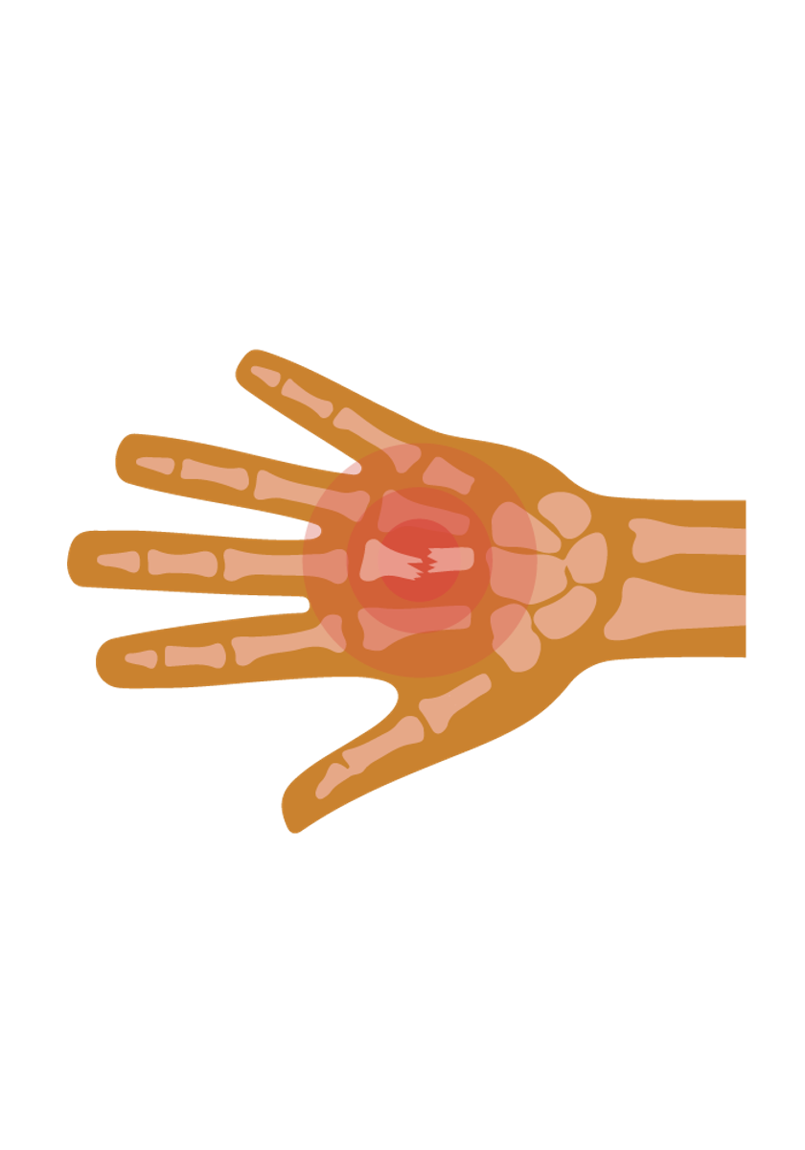
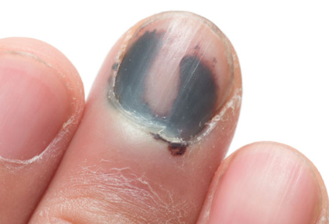
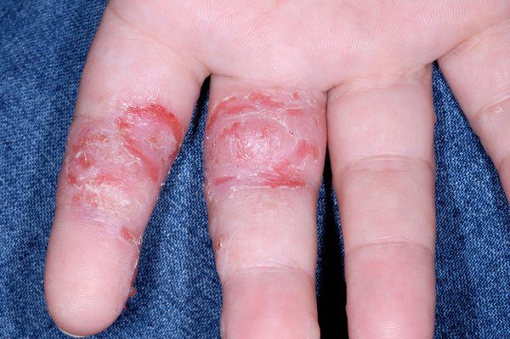
Types of Hand Injury
Thumb Injuries
These are the most common type of hand injury
Cuts
Approximately 122,000 reported cases of cuts in UK workplaces annually.
Amputations
This can include loss of fingers or severed fingertips.
Nerve Issues
Pressure on the nerve. Can be caused by use of hand tools.
Burns
Thermal, chemical and rope burns.
Crushes
Often caused by poor manual handling
Dermatitis
Skin irritation caused by chemicals and other substances
Fractures
The hand is made up of 27 bones. Excessive force can cause these to break.

Slide 5

Hand Safety Controls
ELIMINATION - Try to avoid doing jobs which put hands at risk.
SUSBSTITUTION - Could the job be done using technology, hands-free tools?
ENGINEERING CONTROLS – Physically separate hands from the hazard - safety guards, emergency stop devices, and ergonomic tools.
ADMINISTRATIVE CONTROLS – This could include warning signs, staff training, procedures, permits-to-work and staff rotations.
PPE – Ensure properly fitting gloves appropriate to the task are worn.

Slide 6


TRAC Hand Incidents – Lessons Learnt
Incident - On arrival onsite at a lighthouse the generator was found to be faulty. After seeking advice from an engineer an employee tried to loosen a bolt. The spanner slipped and they caught their finger resulting in a deep cut.
Lesson learnt – While no improper actions had occurred, it highlights the importance of visual checks before starting any work involving tools or machinery.
Incident - After completing an abseil to clean the external of a building, a TRAC employee attempted to climb up onto the adjacent roof canopy. As they had been power washing, the stainless steel roof they were standing on was wet causing them to slip and catch their finger on a sharp edge on the upper roof.
Lesson learnt – Be aware of slip, trip and fall risks and highlight the extra danger involved with slippery surfaces.

Slide 7


TRAC Hand Incidents – Lesson Learnt
Incident - During work at a lighthouse it was noted that a hinge on one of the doors had failed. The door was removed for access. At the end of the day the door was lifted back into place when a gust of wind blew causing the lifter’s finger to be trapped between the door and the doorframe.
Lesson Learnt – In this case there was restricted space which prevented two people from carrying out the lift. However, it highlights the importance of situational awareness and good manual handling techniques.
Incident - During grouting work, an incident occurred involving cement exposure to a person's arm. They had removed their jumper, leaving their arms exposed and the concrete not been washed off right away.
Lesson learnt – Always use the recommend PPE (regardless of weather conditions) and follow the COSHH assessment after any exposure to skin.

Slide 8
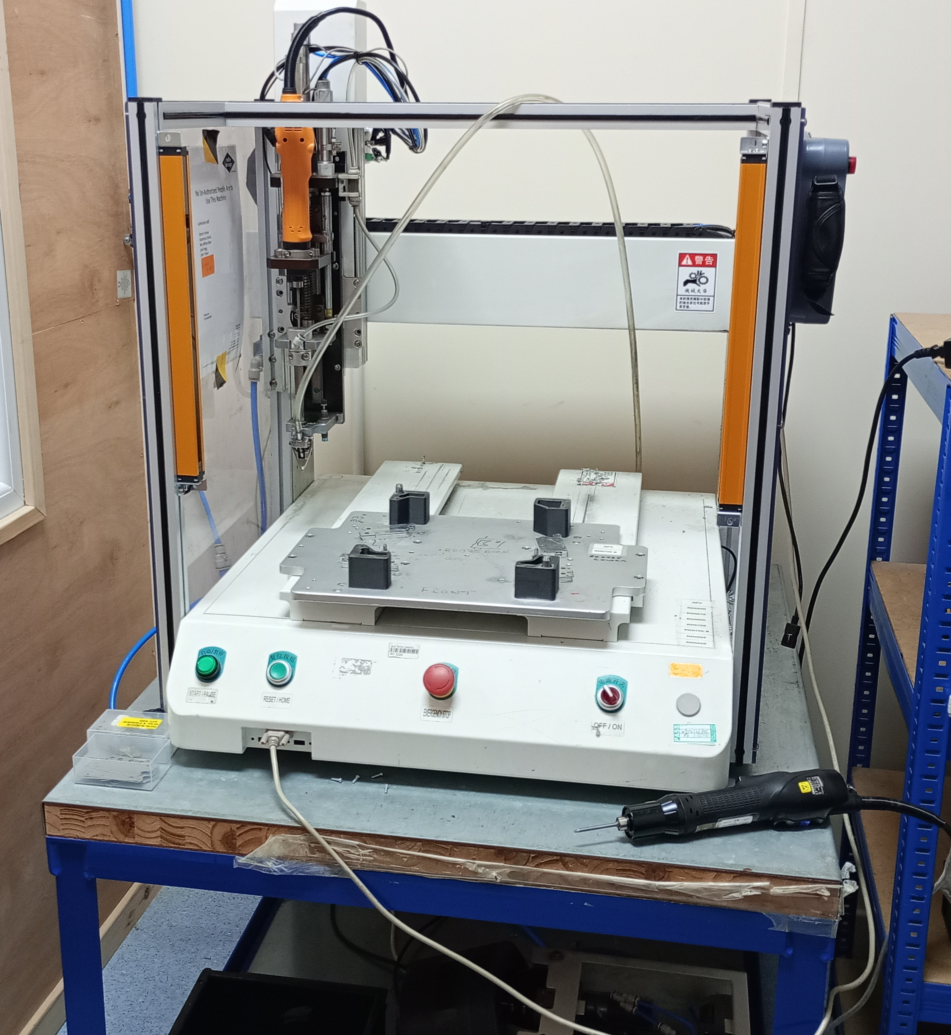
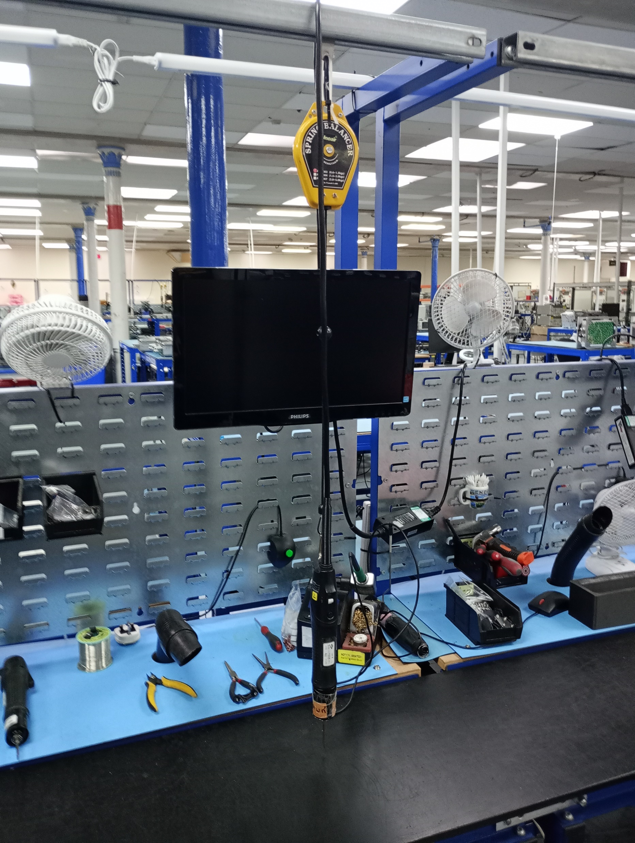

Example of Hand Risk Controls
A good example of using engineering controls can be seen at Radio Design. They use specially designed tools on the production line to reduce the risks to hands.
The picture on the right shows a mechanical screwdriver with an emergency stop.
The picture to the left shows a mechanical screwdriver on a pulley system. This helps to reduce repetitive strain injury.

Slide 9
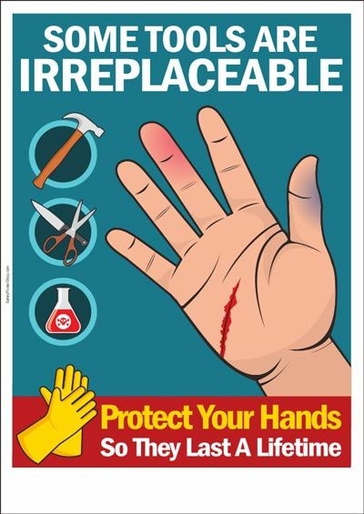
How We Aim to Avoid Hand Injuries
Thorough risk assessment. Always assess each job for site specific hazards.
Risks will be managed, and suitable controls will be put in place.
If activities/conditions change STOP and RE-ASSESS.
Work will only be carried out by competent people with appropriate tools for the job.
Safety gloves will be appropriate to the task.
We maintain a strong and engrained safety culture.

Slide 10
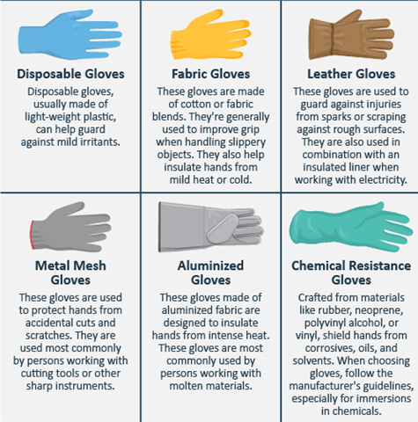
Safety Gloves
Gloves should be worn for any job where a risk to hands has been identified. The Personal Protective Equipment at Work Regulations 2022 state:
They should be a comfortable fit for the wearer.
Gloves or other hand protection should be capable of giving protection from hazards.
The choice should be made on the basis of suitability for protection, compatibility with the work and requirements for the user.
70% of hand injuries occur due to not wearing gloves!
However, it is important to remember that PPE must always be the last line of defence.

Slide 11

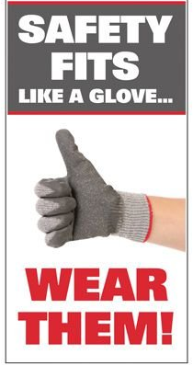
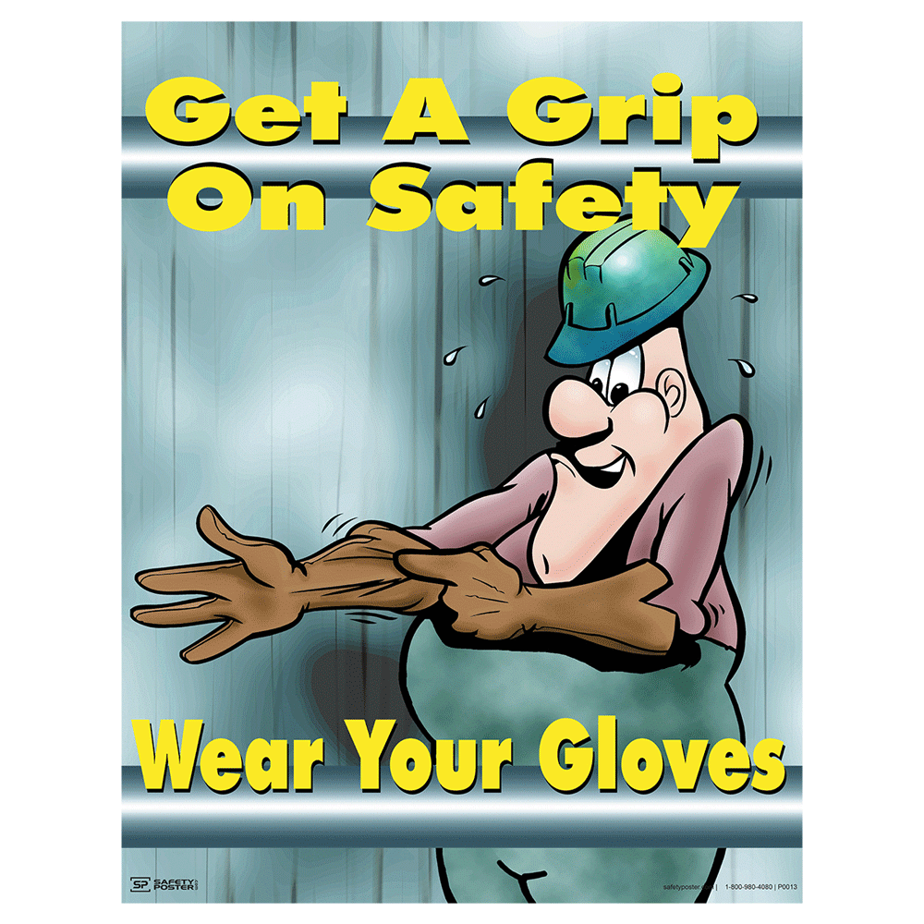

Safety Gloves

Slide 12

Hand Injuries at Home
Hand injuries are common while cooking, gardening and doing DIY. Some top safety tips include:
Ensuring kitchen knives are sharp. A dull blade can be more dangerous than a sharp one.
Be sure to check the date on hand soaps and creams. Expired products can cause rashes and irritation.
Load the dishwasher with sharp blades pointed down.
Use tools for the intended purpose. For example, don’t use a screwdriver as a chisel!
Never attempt to clear jammed tools, lawnmowers or household appliances with your hands.
PPE is not just for the workplace. Wear protective gloves suitable to the task e.g. don’t use a tea towel instead of proper oven gloves.

Slide 13
THINK SAFETY!!
0
Fatalities
How are we doing?
Summary of Incidents YTD 2024 -
0
LTI
0
RWD/MTC
0
First Aid
0
Near Miss
* RWD = Restricted Work Day, MTC = Medical Treatment Case

Slide 14
THINK SAFETY!
Look After Yourself
Look Out For Others
Use Safety Equipment
Follow Safety Procedures

