Slide 1
Sustainable purchasing
TRAC
MARCH 2025

Slide 2

Sustainable purchasing
Sustainable purchasing means buying products and services that cause minimal harm to the environment and society. When choosing to buy sustainably there are various factors to consider:
The environmental impact - Choosing products that have a lower carbon footprint, use fewer natural resources, and generate less waste.
Ethical considerations – Supporting brands and companies that believe in fair labour practices, treat workers well, and uphold human rights.
Resource efficiency - Choosing products made with sustainable practices, like using renewable energy, and that support the circular economy by being reused or recycled instead of being discarded.
Longevity/Circular Economy – Buying products that are durable, repairable and reusable.
Social value – Thinking about the wider social impact of a purchase, such as supporting local communities, encouraging diversity, or selecting brands that back charitable causes.

Slide 3
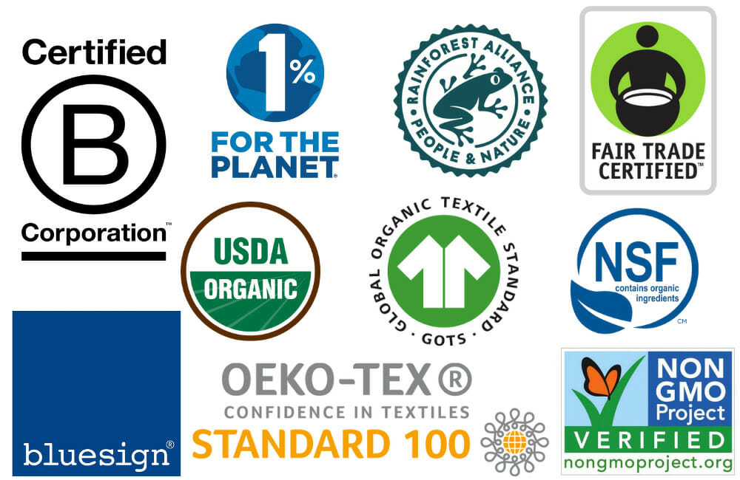
SUSTAINABLE labelling EXAMPLES
You will have seen many labels, specialising in different elements.
E.g. Carbon labels show the environmental impact of a product in terms of the amount of carbon dioxide (CO2) emissions associated with its production, use, and disposal.
They can be found on a wide variety of products across different industries from food and food delivery services, clothing to household products and utilities.
The aim is to make businesses more transparent about their environmental impact and/or sustainability and governance practises so that people can make a choice in the type of business they want to support.

Slide 4

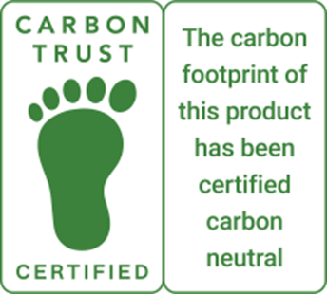

B Lab is a non-profit network transforming the global economy to benefit all people, communities and the planet. A more general certification given to companies that meet rigorous standards of social and environmental performance, accountability and transparency. | The Carbon Trust provide certification, advice, and tools for measuring and managing carbon footprints. When a product has been certified by the Carbon Trust, it means they have measured the footprint of the product and that the company has committed to continue to reduce its carbon footprint. | Established over 20 years ago to rank all types of companies on wide range of issues across 4 categories – environment, animals, people, other. Rankings will also show who is performing poorly. Some companies have gone further by gaining formal ethical accreditation.

Slide 5
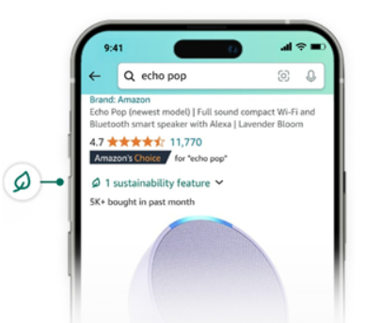
Example – Amazon climate pledge friendly programme
The Climate Friendly Pledge initiative set up by Amazon and The Carbon Trust. This is designed to give customers up front information to allow them to make environmentally-conscious decisions more easily.
Products that meet certain sustainability criteria will be highlighted e.g. being carbon neutral, sustainable sourcing, eco friendly packaging and energy efficiency. The aim is to empower customers to make more sustainable choices and encourage suppliers to do more to limit their environmental impact.
Amazon has included their own devices in this pledge. Capturing this data demonstrates that emissions were reduced across each Amazon device between generations. These carbon calculations will help drive the development of increasingly sustainable product designs - Amazon certainly has the funds to achieve this goal.

Slide 6
What trac do
TRAC is committed to ensuring that goods and services are sourced in a way that is environmentally, socially, and economically sustainable wherever possible. As a result, there may be fewer supply-related risks, better longer-term natural resource availability, less pollution and biodiversity loss, and greater financial rewards.
We have a Sustainable Procurement Policy and aim to develop it as our sustainable buying processes mature.
In addition to the policy, there is the Lifecycle Assessment Form that can help determine the full cost of a product, service or design, in terms of initial cost, ongoing financial and environmental expenses and compare it to other options.
We are signed up to the SME Climate Commitment, part of the UN’s Race to Zero and have had our targets validated by the Science Based Targets Initiative

Slide 7
What trac do
TRAC publish an annual Transparency Statement.
TRAC will not knowingly award business to socially or environmentally irresponsible suppliers.
We have a robust Vendor Approval processes that includes an assessment of a supplier’s corporate social responsibility and ethics. Suppliers are required to confirm compliance to TRAC’s Code of Conduct.
We are committed to compliance with the applicable legislation for all areas in which we operate.
We comply with Section 54 of the Modern Slavery Act 2015 which supports ethical supply chains.
We regularly audit suppliers to ensure compliance.

Slide 8

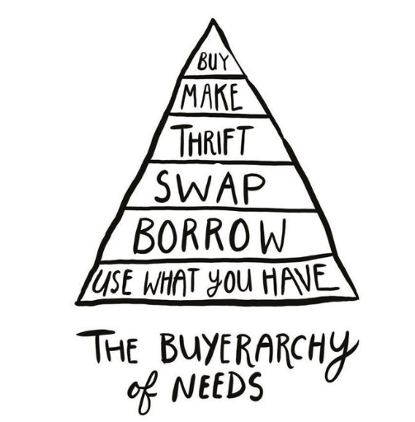
What can you do?
Buy less and choose wisely.
Buy second hand.
Look for ECO-Friendly, ethical labels.
Try to buy local if you can.
Consider packaging when choosing products.
Choose more plant-based options.
Repair and reuse.
Small actions can make a big difference. By prioritising any of the above you can reduce waste, lower your carbon footprint, and support brands that are actively working to protect the planet.

Slide 9
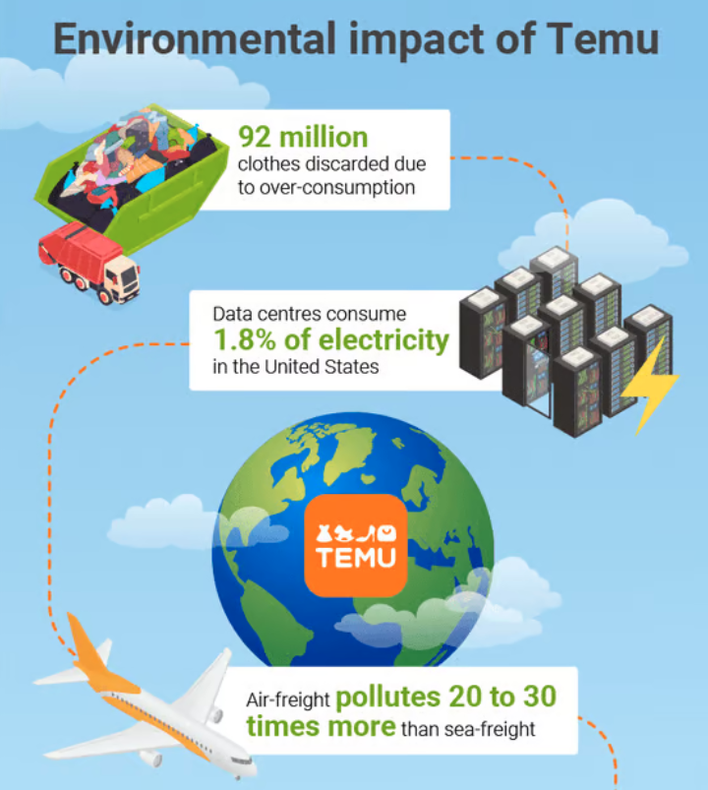
What can you do?
Be a smart consumer and consider sustainability when shopping.
Try to find local suppliers for your fruit and veg. This helps environment, reduces food waste and supports your local community. The Soil Association lets you search your local veg box suppliers.
The Good Shopping Guide gives you an ethical comparison of companies and brands. They cover everything from mortgages and savings to jam.
Look for accreditation such as The Carbon Trust or B-Corp Certified
Avoid unreputable sites promoted via social media such as TEMU and Shein. Low-cost, disposable products usually mean excessive waste, long shipping distances and unsustainable manufacturing practices.

Slide 10
