Slide 1
RESPIRATORY HEALTH
HSEQ Campaign

Slide 2
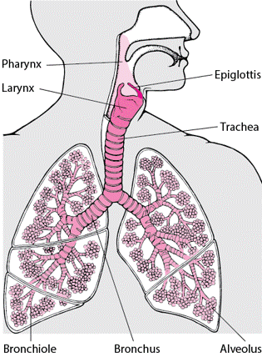
The Respiratory System
The respiratory system is a vital network of organs and tissues that takes up oxygen from the air we breathe and expels the unwanted carbon dioxide.
Air comes in from nose and mouth meets at the pharynx and goes through the ‘epiglottis’, a moveable lid above the larynx.
Air travels down the trachea into the bronchioles.
Bronchioles end in tiny air sacs called alveoli, where the exchange of oxygen and carbon dioxide takes place.
This is known as respiration.

Slide 3

Chronic Respiratory Conditions
These are illnesses affecting the airways and lungs.
Some of the most common are chronic obstructive pulmonary disease (COPD), asthma, occupational lung diseases and pulmonary hypertension.
Chronic Respiratory Disease is now the third most common cause of death globally https://rb.gy/nigezm
Many of these diseases are preventable with the biggest risk factor being smoking. This includes second hand smoke.
Other risk factors include:
  Occupational exposure to dusts, fumes and chemicals
  Air pollution (such as exposure to burning coal)
  Lung development in-utero and passive smoking in childhood
  Genetics – Conditions such as asthma are often hereditary. Recent studies have found a link between specific genes and lung function. It is hoped this will lead to new treatments. https://www.ncbi.nlm.nih.gov/pmc/articles/PMC3085871/

Slide 4
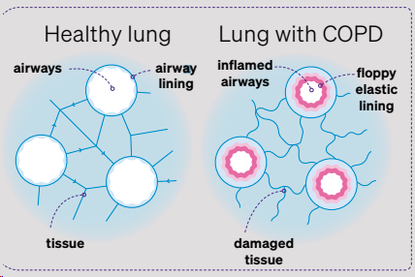
Occupational Respiratory Conditions
Pneumoconiosis is a term for a group of lung diseases caused by breathing in specific dusts in your workplace. The dusts get lodged inside your lungs and cause scarring.
Symptoms include coughing, chest pain, fatigue and breathlessness. However, symptoms often take many years to appear.
Diseases are diagnosed through X-Rays, CT Scan and lung function tests.
The most common conditions are Silicosis, Asbestosis, Chronic Obstructive Pulmonary Disease (COPD) and Asthma.

Slide 5
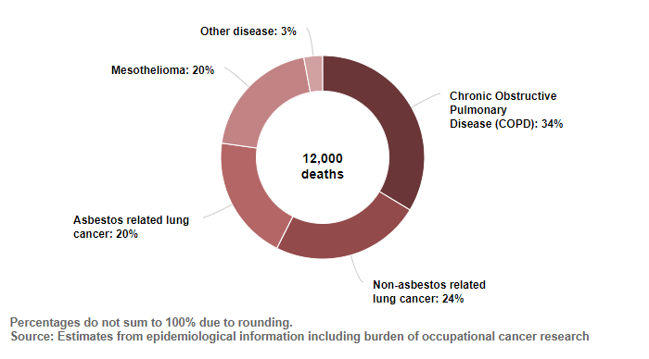
Occupational Lung Diseases Contributing to Estimated Annual Current Deaths
Statistics - Work-related ill health and occupational disease (hse.gov.uk)

Slide 6

What TRAC do to protect respiratory health?
TRAC protect the health of employees by eliminating hazards wherever possible and reducing occupational health and safety risks as far as reasonably practicable.
Part of this is the early detection of ill health effects caused by work or materials used for work. These risks are documented in risk assessments and COSHH assessments.
All staff throughout the company, including those without previous health issues, are also regularly reminded about the importance of notifying TRAC of any changes in their health so that appropriate support can be given. This includes respiratory conditions.

Slide 7

Example works which may affect Respiratory Health
Painting – This is carried out in well-ventilated areas wherever possible. Masks are worn to protect against the inhalation of toxic fumes and workers reminded to take regular breaks.
Rock Drilling – Where possible, workers operate the drilling equipment from sealed cabs instead of using handheld equipment. This eliminates the risk of inhaling silica dust.

Slide 8
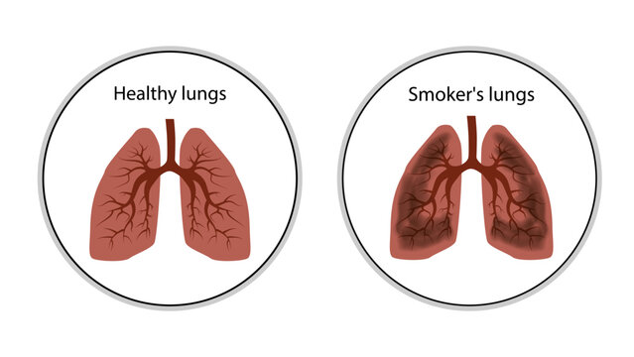
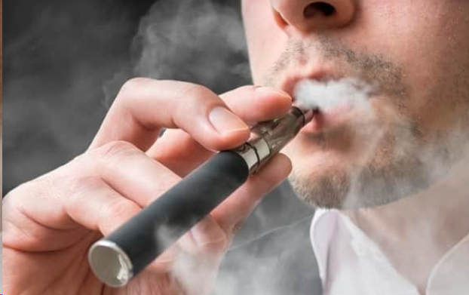
Ways to Improve Respiratory Health
Quit smoking - Particles found in cigarettes cause irreversible damage to the lungs. This can lead to chronic respiratory illness. Other parts of the body suffer because the lungs are unable to supply as much oxygen to the heart as they usually would.
Around 90% of COPD cases are associated with smoking https://cks.nice.org.uk/topics/chronic-obstructive-pulmonary-disease/background-information/risk-factors/
Quit vaping - Despite its popularity, relatively little is known about the potential effects of chronic vaping on the respiratory system. Growing research suggests that vaping is not without risk. Discussions regarding the potential harms of vaping mirror the scientific debates about the effects of cigarette use in the 1940s. British Medical Journal Impact of vaping on respiratory health | The BMJ

Slide 9

Ways to Improve Respiratory Health
Include lots of fruits and vegetables in your diet - fruit, veg and good fats. Try to follow a Mediterranean style diet. Find ideas here!
Stay hydrated - Drink up to 6-8 glasses of water each day. This helps to keep mucus runny and washes out any bacteria therefore reducing chance of infections.
Get Vaccinated - Covid-19, Flu, Pneumonia, Whooping Cough will help keep your lungs healthy.

Slide 10
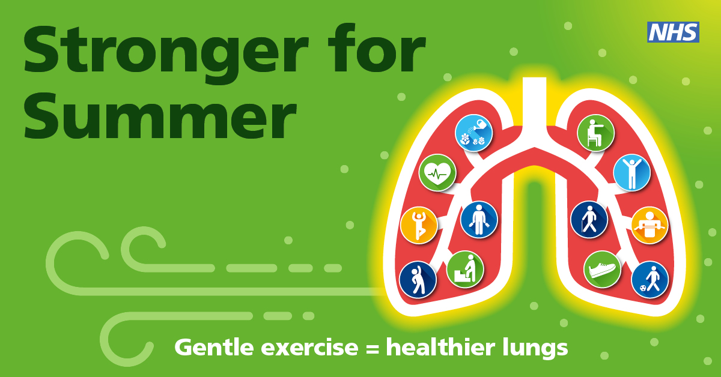
Ways to Improve Respiratory Health
Exercise – Even just a brisk walk or jog can help keep the blood moving and get rid of carbon dioxide in the blood.
Maintain good hygiene - Wash hands frequently and get fresh air. This is increasingly important in recent times due to the coronavirus pandemic. These steps help reduce levels of transmission and reduce the risk of catching colds and viruses.
Use a humidifier - This helps to keep the air moist. Dry air can irritate the lungs and increase the chances of triggering asthma attacks.

Slide 11
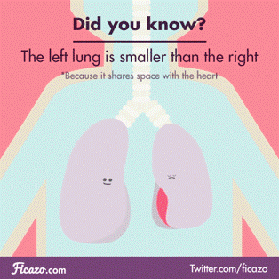

Breathing facts
Men and women have different respiratory rates
70% of the body’s waste is eliminate via breathing
We take around 22,000 breaths a day
Your lungs are one of the largest organs in your body. If they were opened out and laid flat they would cover the surface of a tennis court
Breathing is key to relaxation. Deep, slow exhaling tells your vagus nerve that the heart needs less oxygen, slowing the heart rate

Slide 12
THINK SAFETY!!
0
Fatalities
How are we doing?
Summary of Incidents YTD 2024 -
0
LTI
0
RWD/MTC
0
First Aid
0
Near Miss
* RWD = Restricted Work Day, MTC = Medical Treatment Case

Slide 13
THINK SAFETY!
Look After Yourself
Look Out For Others
Use Safety Equipment
Follow Safety Procedures

