Slide 1
June 2024

Slide 2
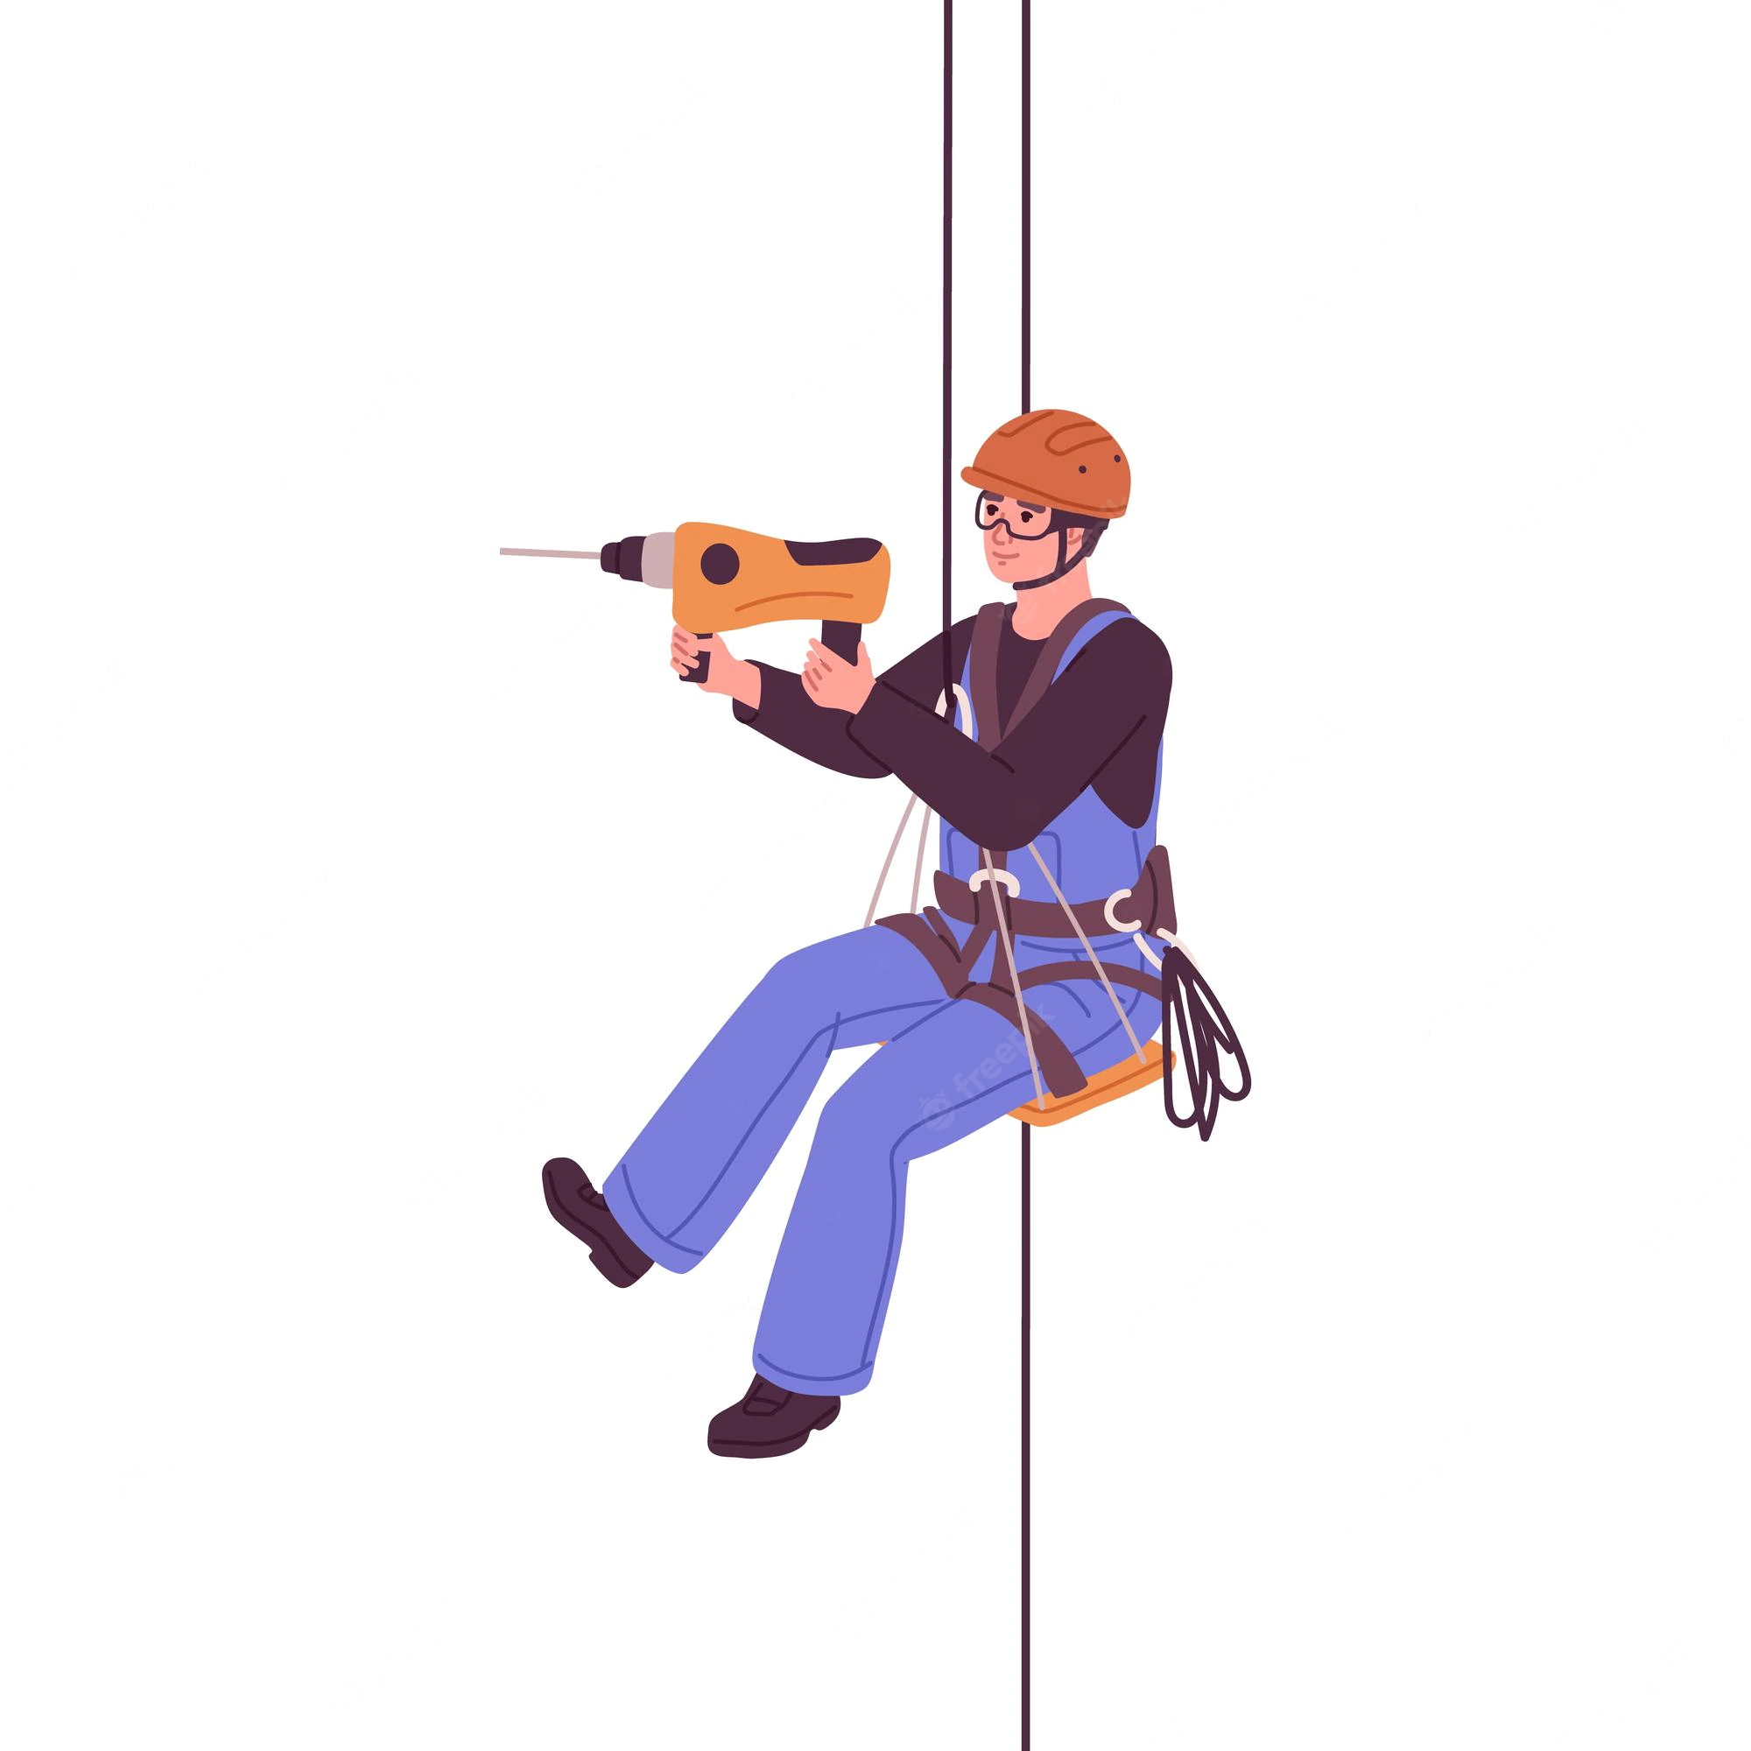

Working at Height
Work at height means work in any place where, if precautions were not taken, a person could fall a distance liable to cause personal injury. This includes:
work above ground/floor level
could fall from an edge, through an opening or fragile surface
could fall from ground level into an opening
TRAC comply with Work at Height Regulations 2005 to ensure all work at height is properly planned, risk assessed and managed and that equipment used for work at height is properly inspected and maintained. This is documented within our:
Work At Height Policy | Rope Access Safe Working Procedure

Slide 3

Working at Height - Dropped Objects
Being struck by falling tools or equipment is a leading cause of injury to workers.
A dropped object is any item that falls or falls over from its previous position that has the potential to cause injury, death or equipment/environmental damage. Dropped Objects may be classified as:
Static - any object that falls from its previous position under its own weight (gravity) without any applied force.
Or…
Dynamic - any object that falls from its previous position due to applied force.

Slide 4
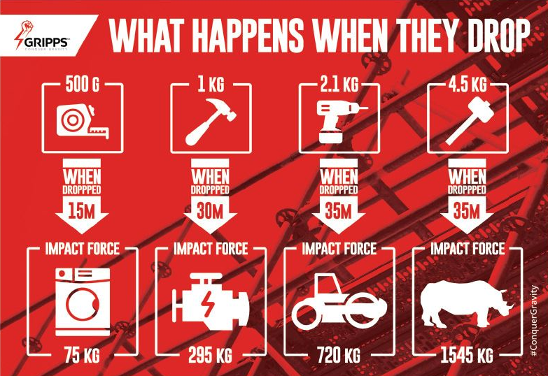
The Impact of Dropped Objects

Slide 5
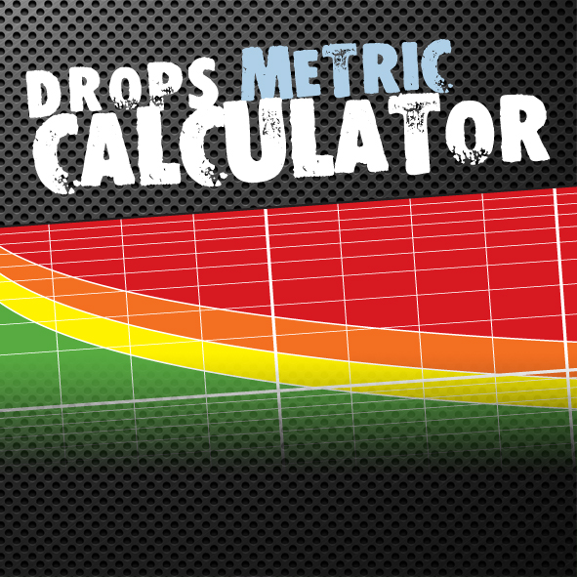
The Drops Calculator
The DROPS Calculator is designed to provide a general indication of the potential consequences of a dropped object, based on its mass and the distance it falls.
It is a useful tool when compiling risk assessments.
https://dropsonline.org/resources-and-guidance/drops-calculator/drops-calculator-metric/

Slide 6
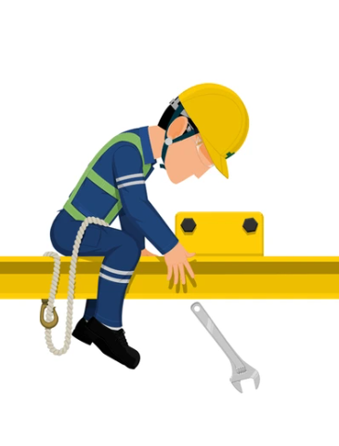
Common Causes of Dropped Objects
Improper risk assessment – failure to address dropped objects hazards.
Human factors – complacency, human error
Inadequate procedures – poor planning, lack of change management
Poor housekeeping
Collisions and snagging of lines and equipment
Insufficient inspection, repair & maintenance
Inadequately stored tools or equipment
Failed fixtures and fittings
Environmental factors – extreme temperatures or wind
*(https://dropsafe.com/dropped-object-prevention)

Slide 7
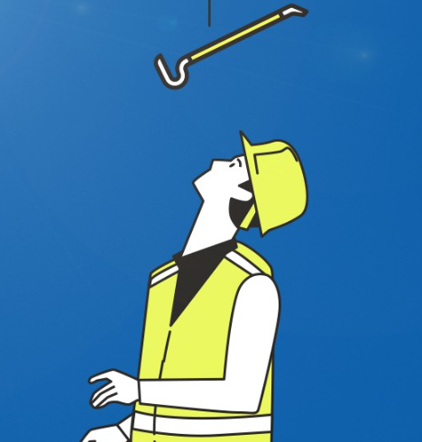
Preventing Dropped Objects
Dropped object awareness
  Ensure everyone understands the hazards and responsibilities.
  Discuss performance, incidents and lessons learned.
Ensure fixed items are correctly installed with nuts, bolts, screws, clamps, brackets, welding etc.
Install secondary retention solutions such as safety netting and toe boards for added protection, where appropriate.
Understand and manage the danger zones while work is being carried out.
Ensure tools and equipment are properly secured while working.
Maintain good housekeeping and traceability of all equipment.
Ensure PPE is worn as a last line of defence.
Remember to report any potential dropped object.

Slide 8
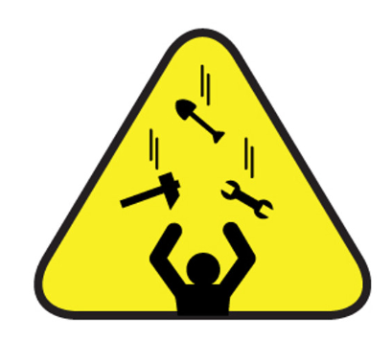
Using Tools at Height
Consider every item carried aloft as a potential dropped object!
Pay special attention to loose items (eg. nuts, bolts, screws, pins etc.) particularly following repair and maintenance tasks.
‘At height’ rules should apply to work at 2 metres or above, or where there is the potential for tools to drop more than 2 metres.
When not in use, tools should be stored securely and in such a way where it is obvious when a tool is missing.
Only take up what is required for the job. All other items should remain at ground level.

Slide 9
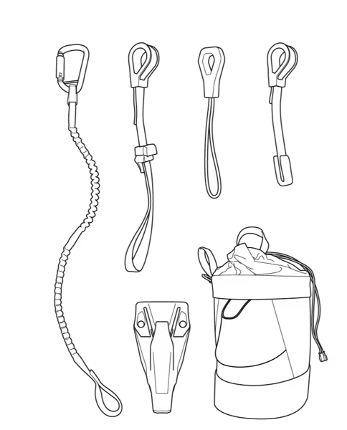
Securing Items
One of the most important aspects of safety when working at height is securing potential drop hazards.
All tooling used ‘at height’ should be lanyard attached to a toolbag, an equipment loop on the harness or a supporting structure.
Carrying pouches can be used for radios and any other portable equipment without certified securing points.
Never attempt to make any modifications to securing equipment.
Ensure karabiners, lanyards and shackles and other equipment have been properly maintained and inspected before use.

Slide 10
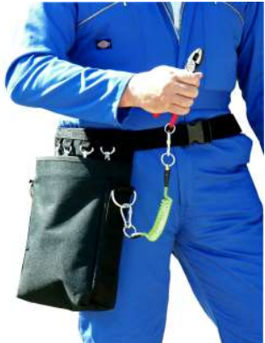
Securing Tools and Equipment <5kg
Use a tool bag or belt with securing loops if carrying multiple tools. Lanyards should be used between the tool and bag/belt.
Belts with snap fasteners are not suitable for securing equipment at height.
Tools lanyards attached to the body should ideally be energy absorbing (fall damper).
Tools heavier than 2kg should not be secured directly to the body.
Lanyard attachment points (moveable, spring clip or fixed) should be selected according to size and weight of tool.

Slide 11
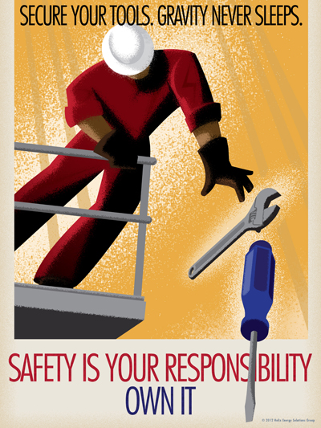
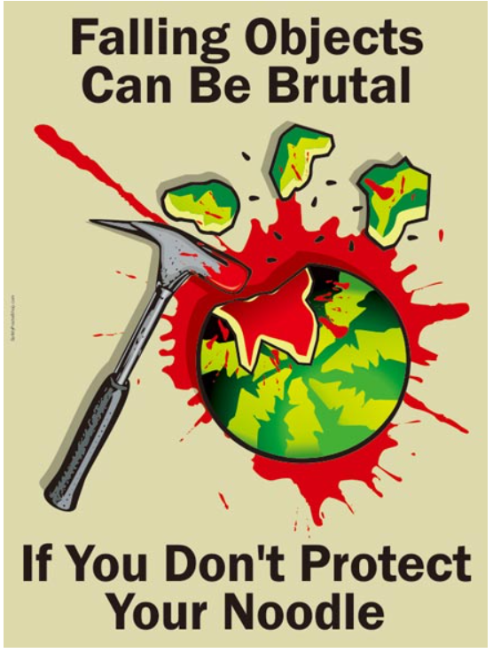

Slide 12
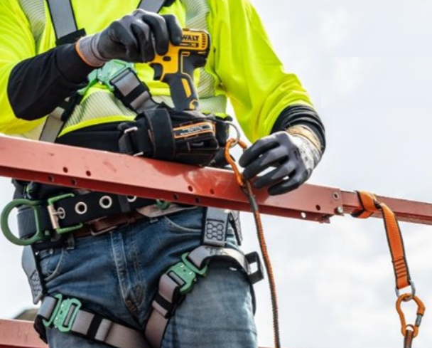
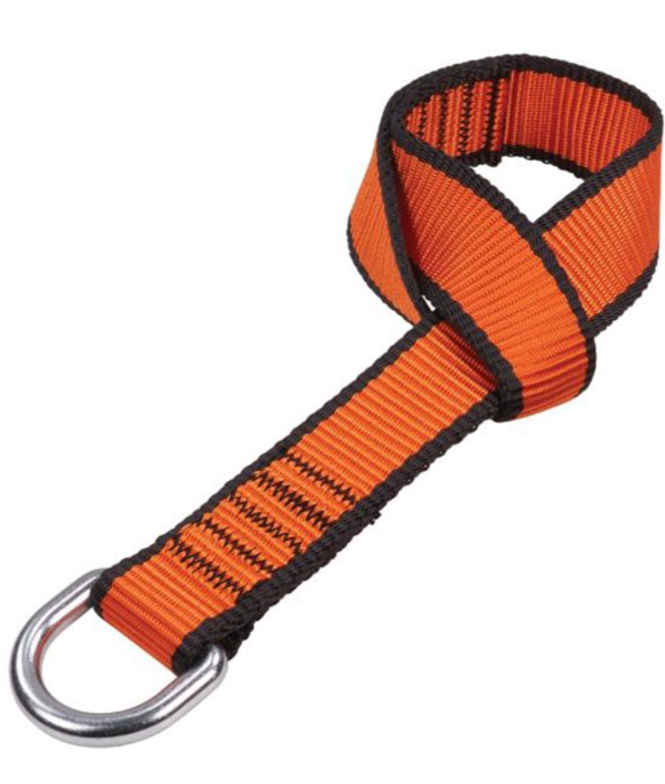
Securing Tools and Equipment > 5kg
    The use of heavy tools and hand-held machinery at height must be specifically risk assessed.
    Anchor heavy tools and equipment to a fixed anchor point - not a person.
    Use weight-rated karabiners.
    Check the weight limit of the tethering point. Do not forget to consider the weight on any tool attachments.
The securing wire should be as short as possible. Energy absorbing lanyards and tethers can stretch beyond the safe drop distance. Use fixed wires where possible.

Slide 13
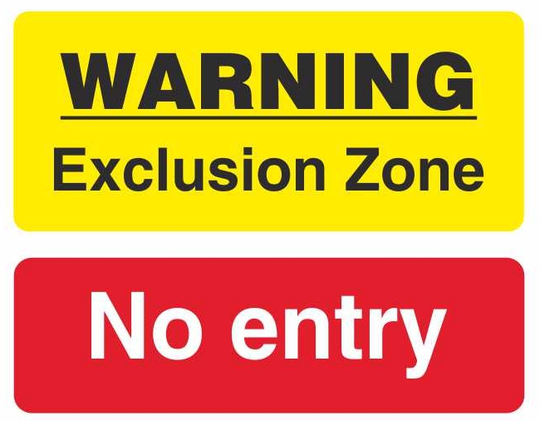
Exclusion Zones
Risk assessment will highlight areas in which a dropped object potential has been recognised (e.g. where personnel are working at height).
These are managed by implementing restricted access areas ‘Exclusion Zones’ in which personnel are not permitted while the hazard is present or active.
Exclusion zones help control the placement and use of tools, ensuring that objects are not accidentally dropped or misplaced.

Slide 14

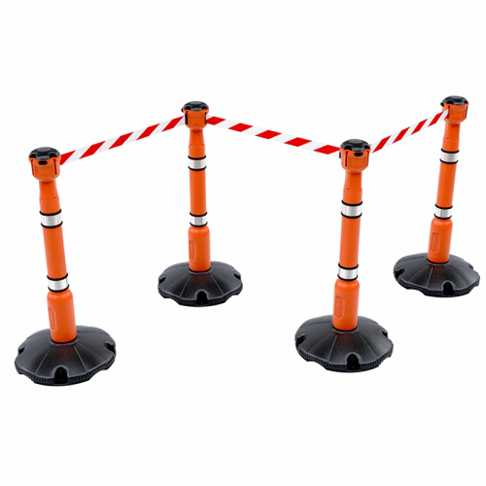
Exclusion Zones
Where possible the width of exclusion zones should be at least equal to the height of the work position. https://www.dropsonline.org/resources-and-guidance/drops-calculator/exclusion-zone-calculator
Zones can be temporary or permanent. These need to be easily identifiable with obvious barriers, markings, signage and alarms.
Access ways and doors leading to the exclusion zones must be controlled.
Each zone should have an assigned authority. Roles and responsibilities should be clearly established, delegated, and communicated.

Slide 15

Useful Links
    Dropped Objects Prevention Scheme Global Resource Centre https://dropsonline.org/about/drops-forums/
    Step Change in Safety https://www.stepchangeinsafety.net/annual-themes-2023-q3-safe-lifting-working-at-height-and-preventing-dropped-objects/preventing-dropped-objects/

Slide 16
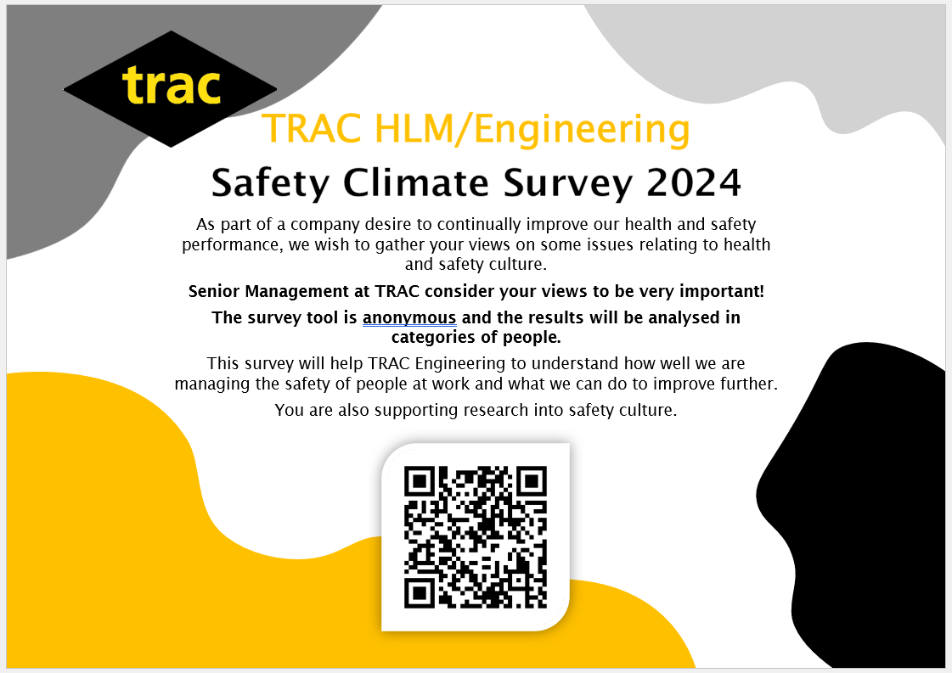
Safety Climate Survey 2024 Launched

Slide 17
THINK SAFETY!!
0
Fatalities
How are we doing?
Summary of Incidents YTD 2024 -
0
LTI
0
RWD/MTC
0
First Aid
2
Near Miss
* RWD = Restricted Work Day, MTC = Medical Treatment Case

Slide 18
THINK SAFETY!
Look After Yourself
Look Out For Others
Use Safety Equipment
Follow Safety Procedures

