Slide 1
Digital Safety
HSEQ Campaign
July 2024

Slide 2

Digital Safety
Our society is increasingly vulnerable to digital attacks due to its reliance on digital infrastructure. The recent CrowdStrike IT fault on 19th July 2024 initiated a series of computer system outages across the world disrupting governments, hospitals, airports along with many others. While this incident was caused by a fault rather than an attack, it exposed the fragility of our IT based infrastructure and shows how quickly it can all fall down.
For this reason, it is important to be vigilant when it comes to digital security. As more and more personal information is shared online, we must recognise and be aware of the risks and take precautions to stay safe. This involves protecting computers, networks and data from digital attacks and unauthorised access.
Digital attacks can target both businesses and individuals with devastating consequences.

Slide 3
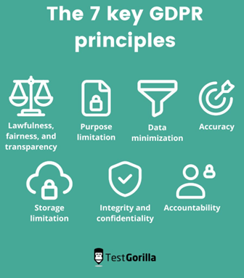
Digital Safety at Work – GDPR
Businesses are targets for digital attacks. Hackers can infiltrate systems with ‘ransomware’ to prevent companies from accessing their devices and the data stored on them. This can cause significant financial loss and damage to reputation through data breaches.
The GDPR requires organisations to make data protection a core part of their operations and processes. GDPR has heightened awareness and focus on cybersecurity practices, encouraging organisations to adopt best practices in securing personal data.
Overall, GDPR have strengthened internet security by establishing clear standards for protecting personal data and ensuring that organisations take proactive steps to mitigate security risks.

Slide 4
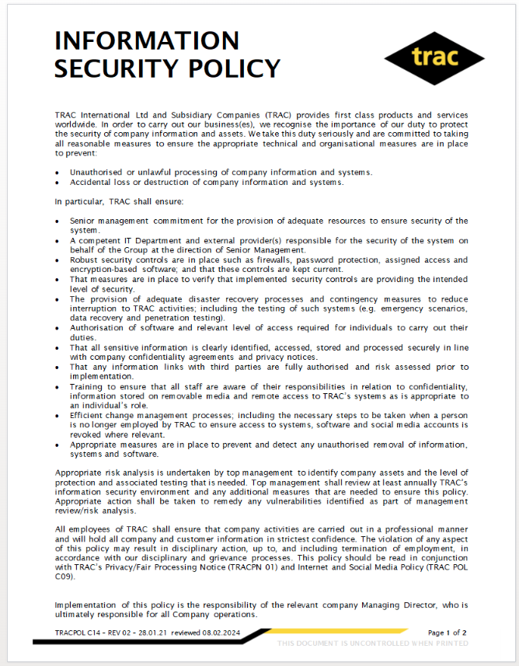
Digital Safety at Work
TRAC is committed to keeping all information protected. Robust security controls are in place such as firewalls, password protection, assigned access and encryption-based software. These controls are kept current (for example, additional software has recently been added to all company laptops). Our ongoing security strategy is documented in TRACPOL C14: Information Security Policy.
We recognise that even with these measures in place, it is important to remain vigilant against evolving digital threats.

Slide 5
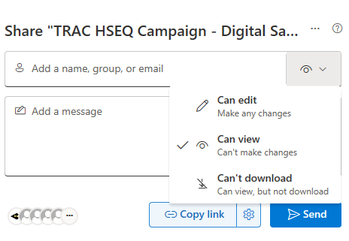
Sharing Digital Information at Work
When sharing work related information it is important to consider who you want to be able to access it.
Avoid sending email attachments.
Share links to files from your One Drive or Wavelength. This gives you more control e.g. the ability to restrict the permissions, add expiry dates and the option to block users from downloading. It also makes collaboration much simpler.
Do not use USB sticks for sensitive information. This allows information to become uncontrolled.
Be cautious with all work documents. Information in the wrong hands could cause a serious negative consequences to the business.

Slide 6
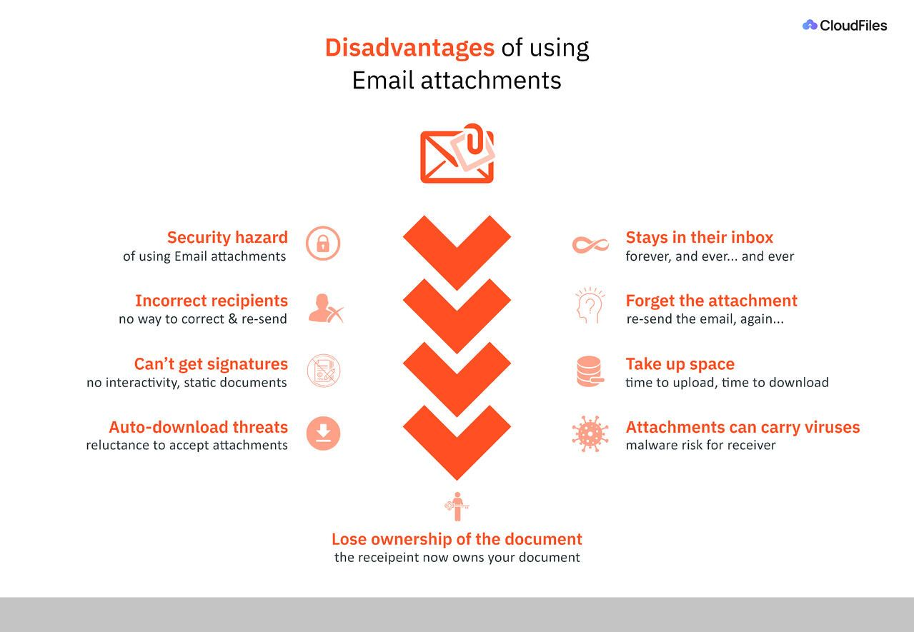

Slide 7
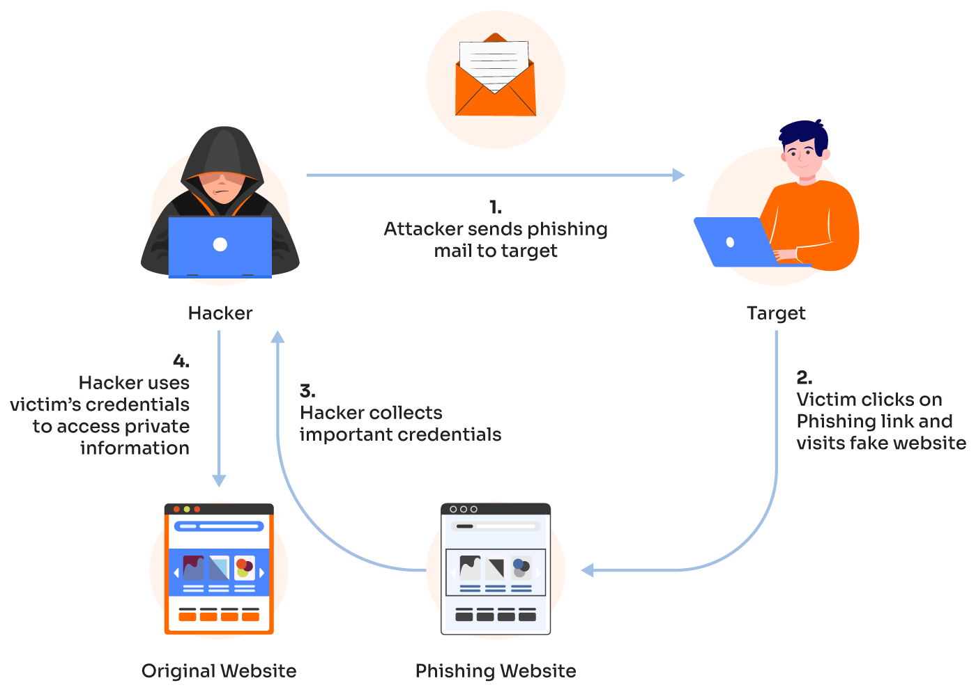
What is ‘Phishing’?
Phishing attacks target both businesses and consumers. These types of digital attack attempt to steal money, or your identity, by getting you to reveal personal information such as credit card numbers, bank information, or passwords. These messages were traditionally emails, but have evolved to now include texts, social media messaging and phone calls.
Phishing attacks are often used in conjunction with malware attacks.
Phishing is the most common form of cyber-crime, with an estimated 3.4 billion spam emails sent every day.
Adults aged 18-34 are the most likely victims.
Over 48% of emails sent in 2022 were spam.
90% of phishing attacks sent via messaging apps are sent through WhatsApp.
Source https://aag-it.com/the-latest-phishing-statistics/

Slide 8
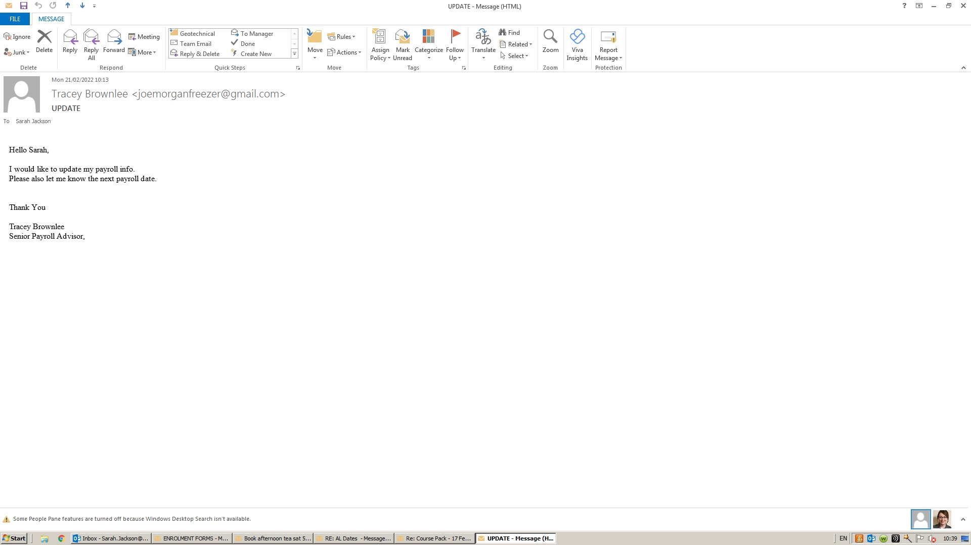
Example of a Phishing Email
Suspicious email address
Strange request? – Always double check any questionable request with the person claiming to have sent the email – in person, on the phone or via their work email.
Does it make sense? – As Tracey is a senior payroll advisor why would she be asking Sarah from HR about payroll?!

Slide 9
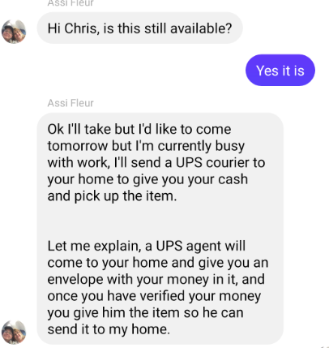
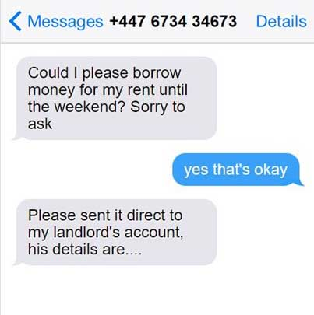
Other Phishing Scams
Online marketplace scams – Facebook, Gumtree etc.
Courier scam - They message the seller and say they are unable to collect the items but will send a courier to the seller's house, with cash on delivery. If the seller agrees they send an email that appears to be from a delivery company which includes a link to pay a refundable insurance fee. The link leads to a website designed to gather personal and banking details.
No legitimate delivery company would offer this service.
“Hi Mum” type
scams
A “hi mum” message scam works by tricking the victim into thinking they’ve been contacted by their child (or other family member). They are asked to save a new number, then convinced to send money to a third party.
The scammer may say their phone is broken, so they can’t pay bills using an online banking app. The reason for the money request can vary however it will always have a sense of urgency.

Slide 10
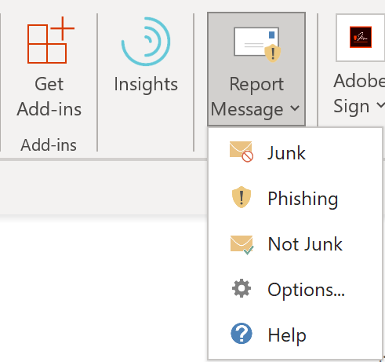
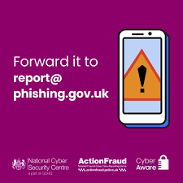
How to Report ‘Phishing’
It is important to fight back against scammers and report all suspicious looking communications.
Emails - You can do this in Outlook by clicking ‘Report Message’ in the top bar. Other email platforms have similar options. Or forward to the National Cyber Security Centre.
Text Messages – In the UK, forward suspicious text messages to 7726 - it’s free. This will report the message to your mobile phone provider.
Adverts - Report scam or misleading adverts to the Advertising Standards Authority. You can report adverts found online, including in search engines, websites or on social media.
If you are worried that you are a victim of a scam visit The National Security Centre will provide guidance on the steps to take.

Slide 11
Personal Digital Footprint
It is also important to protect your digital well-being outside of work. This means being aware of your digital footprint (the trail of data you leave behind you when using the internet). Your footprint includes websites you visit, news you read, emails you send, and information you submit online. It can be collected:
actively – e.g. through posting or participating on social networking sites
passively e.g. social networking sites and advertisers using your likes, shares, and comments to profile you and target you with specific content.
For these reasons, it is worth considering what your digital footprint says about you and do everything you can to safeguard yourself.
You can monitor your own digital footprint by regularly searching your name on search engines, setting up Google alerts for mentions of your name, and reviewing your social media and other online profiles for any unflattering or outdated content. You can reduce your digital footprint by deleting unused accounts, limiting the amount of non-essential personal information you share online and regularly clearing cookies from your browser.

Slide 12
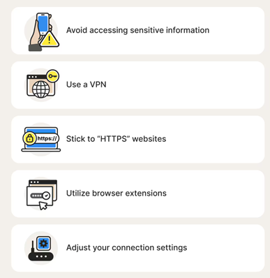
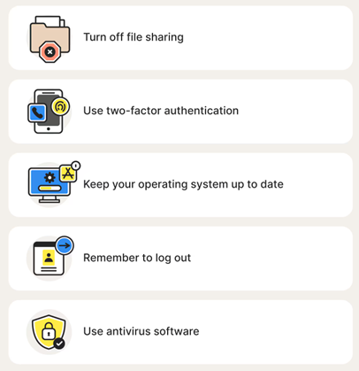
Tips when using free Wi-Fi
Public wi-fi networks are everywhere. These can be very useful, but they leave you vulnerable to attack and should be used with caution.

Slide 13

Personal Digital Safety Tips
Use a strong, unique password for every login. Three word phrases work well. Using a password manager (such as iCloud Keychain) makes this easy.
Delete any online accounts that you no longer use
Use Two-Factor Authentication. This can be inconvenient, but it adds an additional layer of security beyond passwords.
Factory restore old, un-used tech.
Do regular back-ups of your data (from your computer phone, WhatsApp etc).
Update regularly. Install the latest software and app updates.
Change Bluetooth settings to ‘Not Discoverable’ and turn it off as soon as you’ve unpaired from any device. Be particularly mindful of this in public areas.

Slide 14

Personal Digital Safety Tips
Never log into an account (such as banking) by following a link. Always enter via the website or app.
Only visit websites that look and feel reliable. URLS should start with ‘HTTPS’ rather than ‘HTTP’. Avoid websites with multiple pop-ups.
Consider what you post on social media – once something is posted, you no longer have control of it.
Avoid displaying your personal details online. Edit privacy setting and choose to hide your email when possible.
Check default app settings. These might include things like GPS location tracking, public Wi-Fi and camera or chat access.
Check ‘tagging’ settings on social media so that you can review what others are posting about you online.
Be aware of what your children are viewing online and teach them how to protect themselves. 70% of 8-17 years old asked admitted to having seeing images that were not suitable for them.*
*https://www.guardchild.com/statistics/#:~:text=70%25%20of%20children%207%20to,the%20target%20of%20cyber%20bullying.

Slide 15
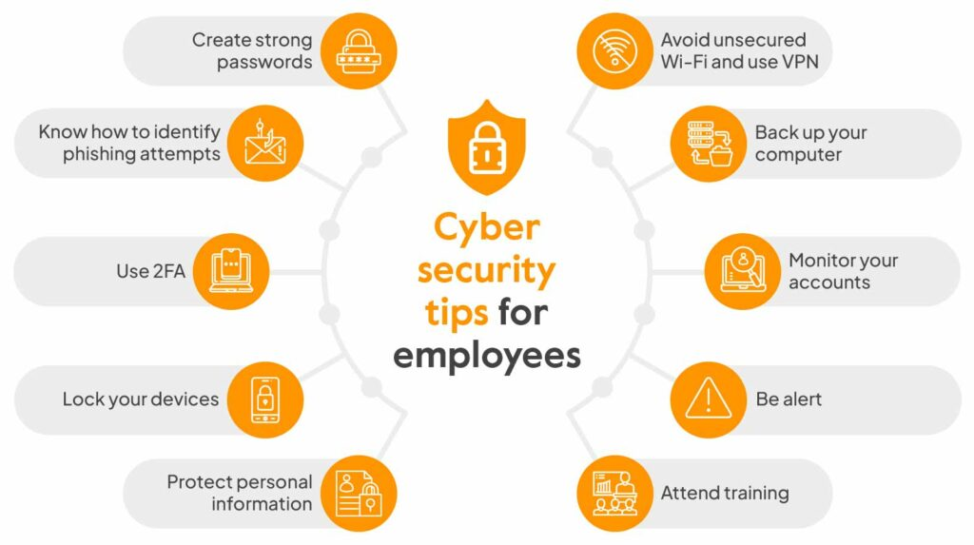
https://sprinto.com/blog/cyber-security-tips-for-employees/

Slide 16
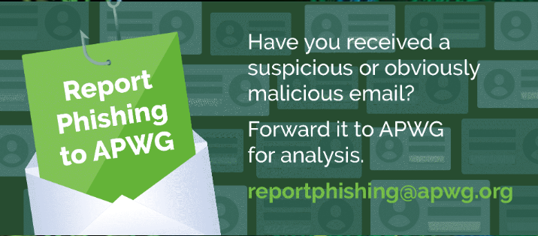
Further info
The Metropolitan Police have put together a series of video guides on internet safety - https://www.met.police.uk/police-forces/metropolitan-police/areas/campaigns/2019/little-guide-preventing-fraud/
National Cyber Security Centre - https://www.ncsc.gov.uk/
Global Anti-Scam Alliance https://www.gasa.org/
How to Stay Safe Online: A Guide For Everyone Who Uses The Internet - https://www.snbsd.com/about/online-safety-guide

Slide 17
THINK SAFETY!!
0
Fatalities
How are we doing?
0
LTI
Summary of Incidents 2024
0
RWD/MTC
0
First Aid
0
Near Miss
* RWD = Restricted Work Day, MTC = Medical Treatment Case

Slide 18
THINK SAFETY!
Look After Yourself
Look Out For Others
Use Safety Equipment
Follow Safety Procedures

