Slide 1
Mental Health Awareness

Slide 2
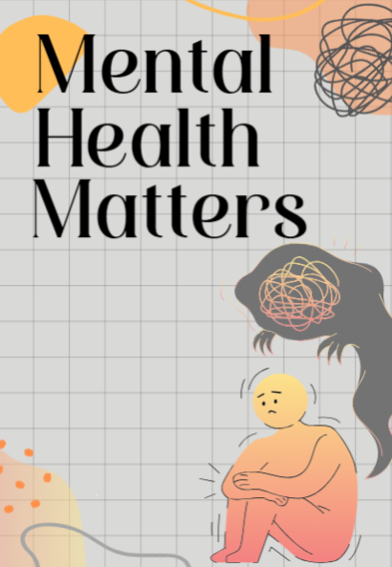
Mental Health
According to the World Health Organisation (WHO) mental health is:
‘A state of mental well-being that enables people to cope with the stresses of life, realise their abilities, learn well and work well, and contribute to their community…Mental health is a basic human right. And it is crucial to personal, community and socio-economic development.’*
We frequently forget that our mental health is just as important as our physical health and, like physical health, can ebb and flow. Taking care of your mental health is crucial, especially in January when the Christmas season is over and the days are cold and gloomy. Look after yourself by staying mindful of your self-care habits, reaching out for support when necessary, and tackling mental health challenges proactively.
*WHO Mental health

Slide 3
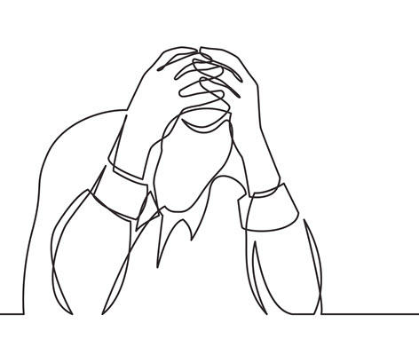
Recognising the Signs of Poor Mental Health
Seeming ‘sad’
Lacking energy
Loss of interest in day-to-day life
Withdrawn
Negative thoughts
Anxious
Low self-esteem
Aggression
Hyperactivity
Forgetfulness
Sleeping too much or too little
Eating too much or too little
Having strict habits or routines around food

Slide 4

Common Mental Health Disorders
Depression is the most common mental illness and is a leading cause of ill health and disability globally (WHO). It affects 1 in 6 people at some point in their lives and can be triggered by factors including lifestyle, hormones and genetics. Growing evidence now suggests that gut health plays a significant role in depression, making diet an important factor to consider in managing the condition. Below are other common mental health issues, which may occur on their own but are often linked with depression.
Anxiety – This is an increasingly common issue, affecting more women than men. The reason for the increase is thought to include the impact of social media, heightened pressure surrounding work, worries about the economy and global uncertainty.
Obsessive-Compulsive Disorder - People who suffer from this engage in repetitive behaviours or mental compulsions as a way of reducing their anxiety. Approximately 2% of people will develop clinical OCD during their lifetime, while 25% may experience obsessive-compulsive behaviours to some extent.
Post Traumatic Stress Disorder (PTSD) – This condition is triggered by experiencing or witnessing a traumatic event, leading to symptoms like flashbacks, anxiety, and emotional issue. The prevalence of this has increased since the COVID pandemic.
Seasonal Affective Disorder (SAD) – ‘Winter Depression’ is a condition linked to lack of daylight. This is common in the UK and can be treated with light therapy.

Slide 5
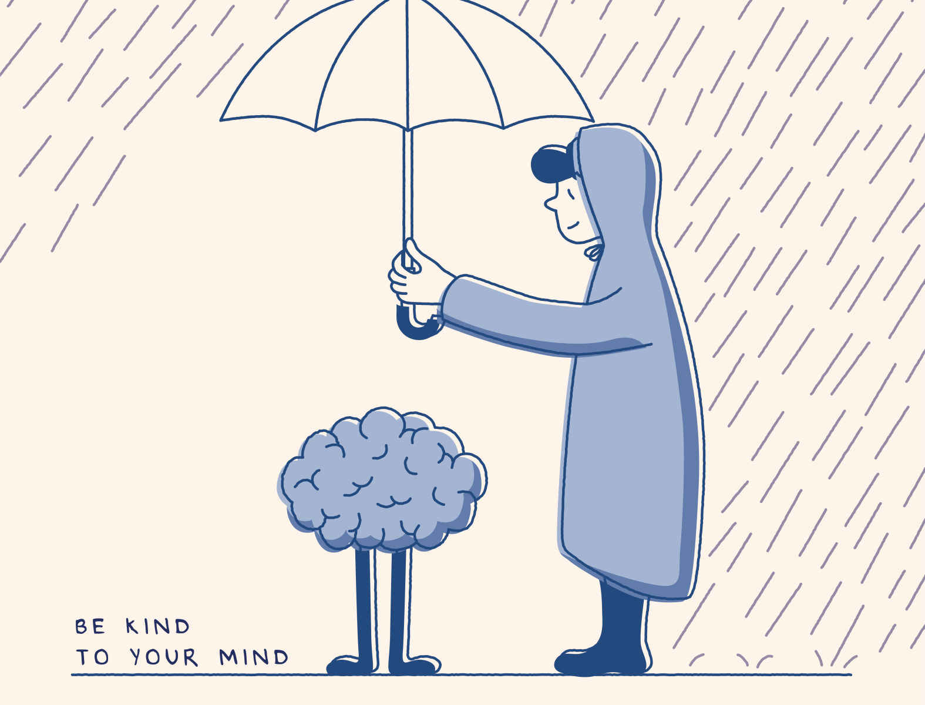
How to Manage Mental Health Conditions
Learn to recognise the signs - Addressing poor mental health early can prevent it from spiralling out of control. Confronting mental health issues and overcoming denial is often one of the most challenging steps.
Reach out for help – This could be your GP, a support organisation, colleague or a friend. Connecting with others will provide you with the support, resources, and guidance needed to manage symptoms and enhance your overall well-being. Do not suffer alone.
Be kind to yourself – Offer the same kindness and compassion to yourself as you would to a friend in a similar situation. Recognise your negative feelings without blaming yourself for having them.
Talk about it – Being open about your problems will make things easier and could help others in a similar position. Overcoming the stigma around mental health means promoting open conversations, correcting misconceptions, raising awareness and creating a welcoming environment for those seeking support.

Slide 6

What TRAC Do To Help
TRAC is committed to ensuring the wellbeing of their staff. TRAC is dedicated to creating an open workplace environment that promotes mental wellbeing, where employees feel comfortable talking openly about their mental health. For more details see TRAC Employee Health Policy (TRAC POL C10).
TRAC do this by:
Supporting staff experiencing mental health problems in the workplace or personally. Any disclosure of issues or concerns will lead to support, not discrimination.
Identifying the causes of work-related mental health problems and when work related and aiming to reduce the risks.
Give employees information on, and increase their awareness of, mental wellbeing and recognising warning signs/potential triggers.
TRAC also support workplace mental wellbeing by providing Mental Health First Aid. The trained mental health first aiders are Kevin Stephen, Linda Stephen, Sarah Jackson and Linda Duncan. Please contact one of these people if you require support.
TRAC are associated with HOPE Counselling, who offer counselling for many areas at a discounted rate of 10% (this is not a paid expense). HOPE can be contacted via:
Website: hope-counselling.org.uk
Phone: 07899 736803
Email: info@hope-counselling.org.uk (initial contact can be made through the Business Support Team if preferred).

Slide 7
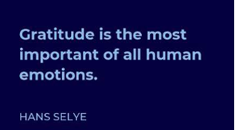
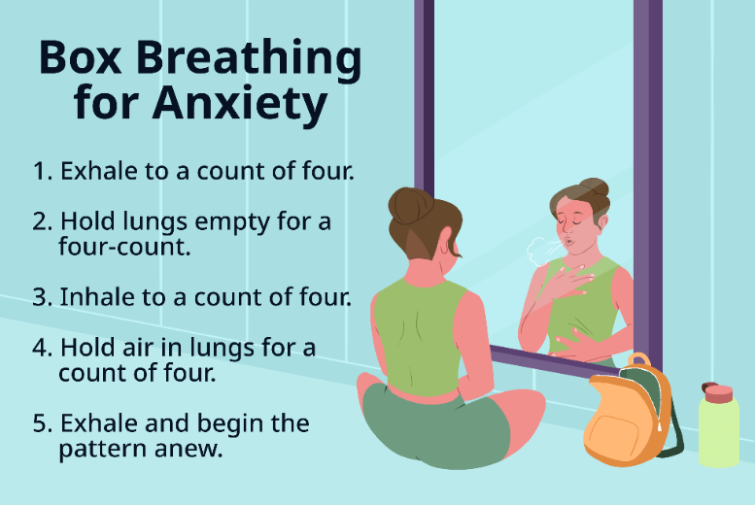
Practical Things You Can Do
Physical Exercise – Movement stimulates the release of endorphins, which improve mood and reduce stress. Additionally, regular physical activity helps regulate sleep, boosts energy levels, and increases overall well-being. Studies have shown exercise to be 1.5 times more effective than medication for the treatment of depression and anxiety*.
Practice Gratitude – While practicing gratitude may sound abstract, it has been shown to be highly effective*. This can be a powerful tool for treating depression, as it shifts focus from negative thoughts to positive aspects of life, creating a sense of hope and contentment. Regularly acknowledging what you're thankful for can help reframe perspective and reduce stress.
Breathing Exercises - Breathwork can significantly reduce stress and anxiety by activating the body's relaxation response, helping to calm the nervous system. Regular practice also enhances emotional regulation, improves focus, and promotes a sense of overall well-being. This simple technique has been recognised as an effective treatment by the NHS.
*(Exercise 1.5 times more effective than drugs for depression, anxiety)
*Gratitude enhances health, brings happiness — and may even lengthen lives - Harvard Health

Slide 8
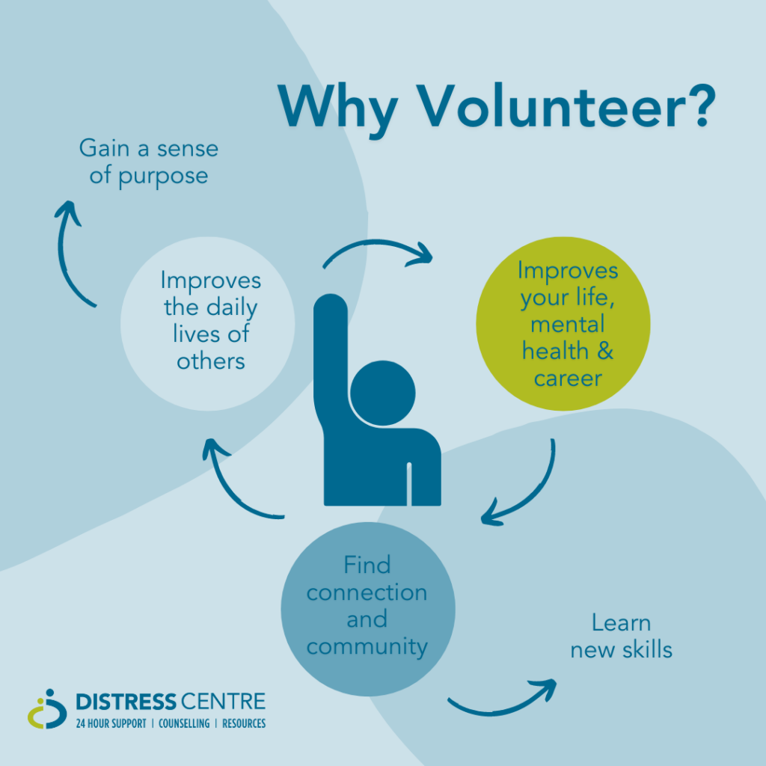
Other Things You Can Do To Help
Volunteer – Volunteering has been proved to increase mental health and wellbeing.* Helping others can give a sense of purpose, empowerment and boosted self- esteem. Many charities are crying out for volunteers, search for a role here.
Prioritise your sleep – 3 out of 4 people with depression do not get enough sleep.* Getting the right amount sleep is crucial for your mental health as it allows the brain to recharge, improves emotional regulation, and enhance cognitive function, helping to reduce stress and anxiety. For information on better sleep visit The Mental Health Foundation.
Take a cold plunge or shower – While this may not sound appealing, cold-water immersion has been shown stimulate the release of endorphins and norepinephrine. This can boost mood and alleviate symptoms of stress or depression. Additionally, it can improve circulation and promote mindfulness, helping individuals manage anxiety and enhance mental clarity.
*https://pmc.ncbi.nlm.nih.gov/articles/PMC10159229/
*Sleep disorders as core symptoms of depression - PMC

Slide 9
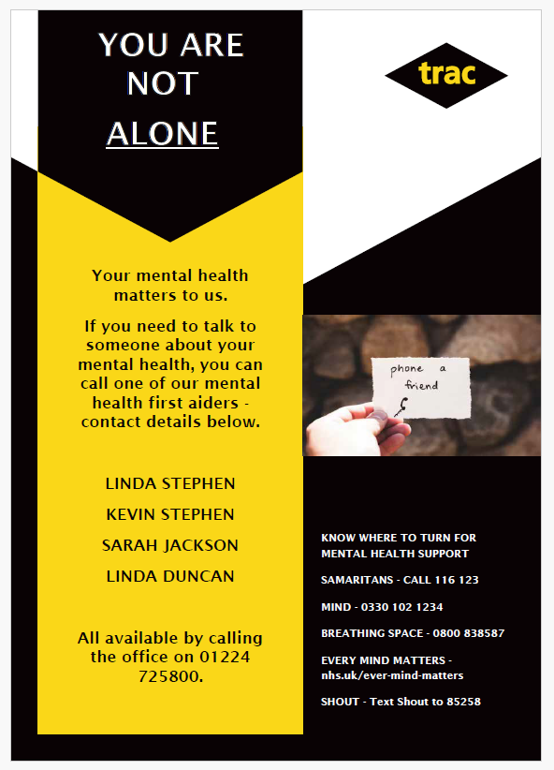
Useful Resources
For both urgent and non-urgent mental health support, visit the NHS Mental Health Services website.
Get help at any time from The Samaritans, call 116 1236
For help with anxiety visit https://www.anxietyuk.org.uk/
For tips and resources on how you can improve your mental health visit Every Mind Matters.
BBC Podcast - The Science of Happiness: How To Practice Gratitude When You're Not Feeling Grateful
Information on breathing exercises for stress and anxiety.
For support with SAD visit Mind.org.uk

Slide 10
THINK SAFETY!!
0
Fatalities
How are we doing?
0
LTI
Summary of Incidents 2025 –
January
0
RWD/MTC
0
First Aid
0
Near Miss
* RWD = Restricted Work Day, MTC = Medical Treatment Case

Slide 11
THINK SAFETY!
Look After Yourself
Look Out For Others
Use Safety Equipment
Follow Safety Procedures

