Slide 1

TRAC & RADIO DESIGN Campaign
January 2024
ENERGY CONSUMPTION

Slide 2

Global Energy crisis
We are currently in the midst of a Global Energy Crisis with record high energy prices and soaring carbon emissions. With the price of natural gas reaching a record high, the cost of electricity has gone up which has put a huge financial pressure on many households, and our planet.

Slide 3
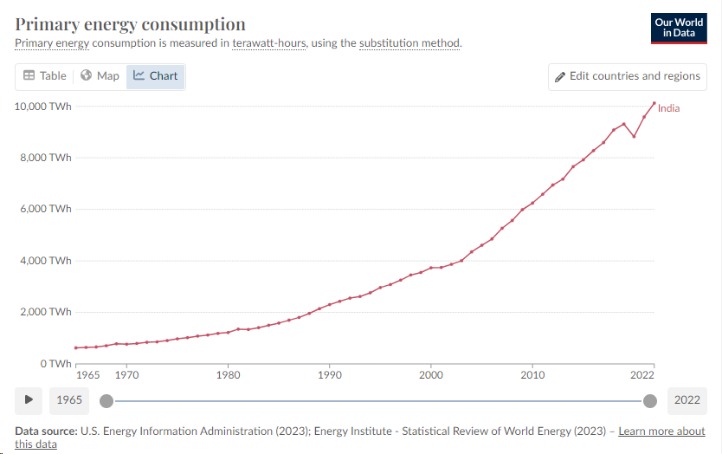



The Demand for energy
Alongside the crisis the demand for energy is growing across many countries in the world, as people get richer and populations increase.
India is an example of this. The graph shows a steep increase in consumption between 1965 and 2022.
The good news is that new innovations in energy seem to be working and the overall global demand is now slowing by 1% to 2% per year.

Slide 4




Global Action on Emissions – what are we doing?
The Paris Agreement
Goal to limit global warming to 1.5°
Emissions must peak by 2025
Aim to reduce Greenhouse Gas emissions by 43% by 2030
Universal long term global climate agreement agreed in 2015
Each country reviews their targets every 5 years….
There is growing concern that these targets will not be met. We must all implement energy saving measures to help achieve these goals.

Slide 5

What can you do? – managing your consumption
Make sure you get the best energy deal. A simple check with your energy supplier for the best tariffs can save you money.
Insulation - Make sure your home has effective insulation. The Great British Insulation Scheme is a government-funded initiative and is applicable to households with an Energy Performance Certificate (EPC) rating of D or lower in Scotland. A range of other UK government led energy saving schemes can be found here.
Adjust your boiler settings to lower the flow temperature.
Smart meters help you monitor your overall usage. Plug-in energy monitors can tell you how much energy each device is using. You can hook up and measure almost anything that has a mains plug.

Slide 6
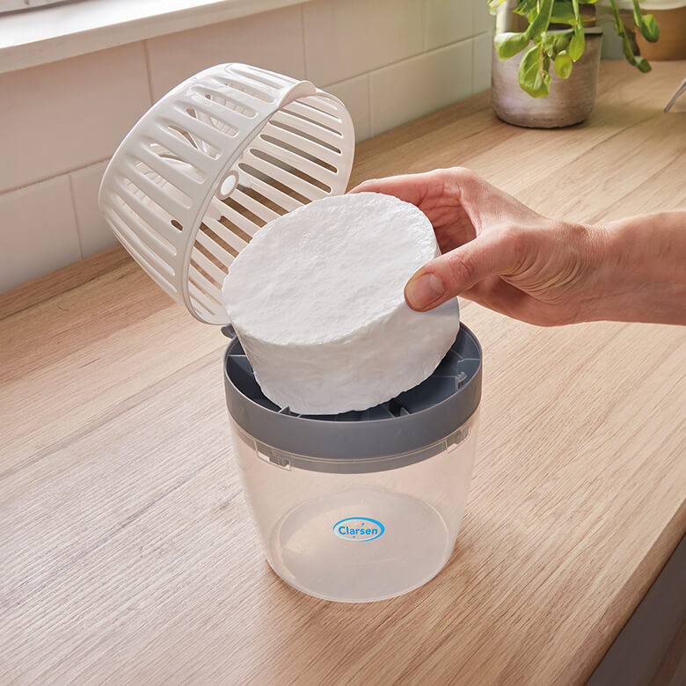
Heating your home
Factors to consider when heating your home:
  Age of the property - newer plasterboard walls will heat up quickly so it may be best to put heating on as and when you need it.
  Underfloor heating - this is more suited to constant heating.
  Condensation – if your home is prone to condensation, it may be better to run your heating on low all day.
  https://www.moneysavingexpert.com/utilities/energy-saving-myths/
A halogen heater can be a good solution when you only need to heat a small space. This is one of the most economical heating methods.
Use a dehumidifier – while this does use energy it helps to reduce the workload for your heating system and protect your home from excess moisture. You can also get reusable non-electric options which can be good for placing on windowsills etc.

Slide 7
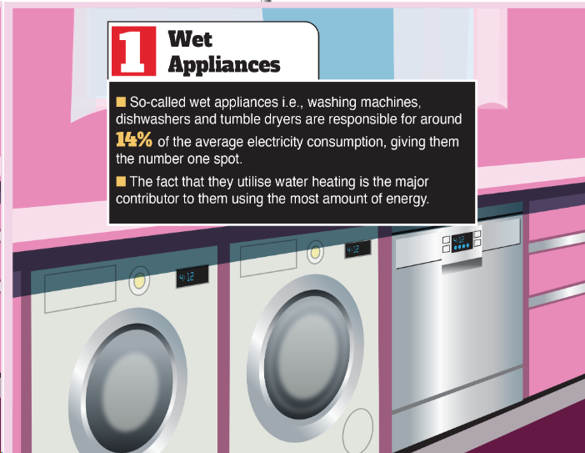
Energy consumption - washing
While washing machines do use lots of power you can minimise this by:
Washing at 30 degrees and try and reduce use by one a week. Most modern washing detergents do not need high temps to get clothes clean.
Think about misting, airing out or spot cleaning garments with a brush instead of putting them in the washing basket.
Use a heated drying rail with a cover instead of tumble drying. This prolongs the lifespan of clothes and uses far less energy.

Slide 8
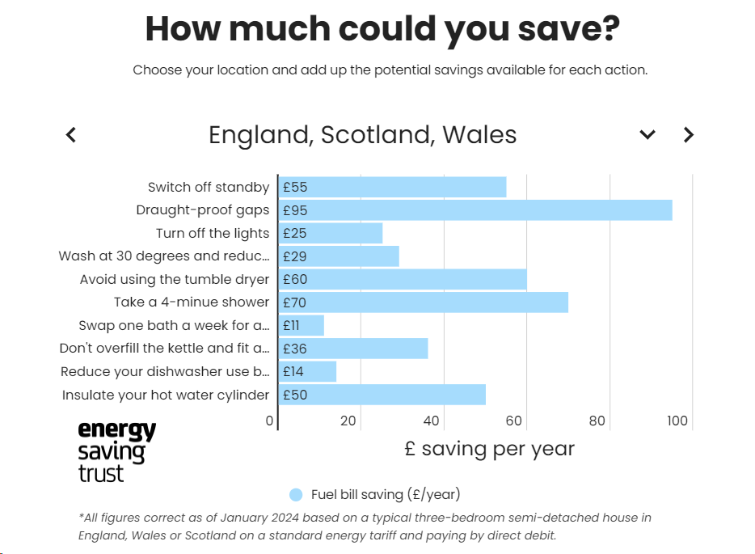
How much could you save?

Slide 9


Consider Non – electric alternatives
The Wonderbag Slow cooker- After bringing a pot of food to the boil and placing it in a thermal cooker the food will continue cooking for up to eight hours without any additional energy source.
Pot in Pot/Zeer Fridge – This is a simple and effective DIY solution for keeping food cool. All you need are 2 clay pots (with the holes in the bottom sealed up), sand and some water.

Slide 10

Consider Non – electric alternatives
Use a French Press to make coffee. Boiling the kettle is likely to use less energy than a coffee machine. Remember to only boil as much water as you need.
Switch to a manual food processor and kitchen beaters. It may be a work-out for your arms but it will save on your energy bill!
Cut down your vacuum use and invest in a rubber broom. They can be used on hard surfaces as well as carpets. They are also very effective in getting hair out of carpets. One of the main benefits is that it is easy to clean and very mobile.

Slide 11
Help is available
Those struggling to pay their energy bills should contact their energy supplier. Suppliers must work with you to agree on a payment plan you can afford under Ofgem rules.
Further help and advice is available here -
https://www.gov.uk/get-help-energy-bills
https://www.citizensadvice.org.uk/consumer/energy/energy-supply/

