Slide 1
COSHH
HSEQ Campaign

Slide 2
What is COSHH?
In 2021, an estimated 12,000 workers in the UK died from lung diseases linked to exposures at work.*
COSHH aims to keep employees out of harm’s way and reduce the number of work-related injuries and health condition across the UK.
COSHH stands for ‘Control of Substances Hazardous to Health’.
COSHH is a set of regulations put in place to protect workers from ill health when working with specific substances and materials.
COSHH was introduced to control the exposure of a business’ employees to hazardous substances in a work-place.
* https://www.hse.gov.uk/statistics/overall/hssh2021.pdf

Slide 3

What is a ‘substance hazardous to health’?
COSHH covers substances that are hazardous to health. Substances can take many forms and include:
Chemicals
Products containing chemicals
Fumes
Dusts
Vapours
Mists
Nanotechnology
Gases and asphyxiating gases
Biological agents
Germs that cause diseases (such as leptospirosis or legionnaires diseases and germs used in laboratories)

Slide 4
What is a ‘substance hazardous to health’?
Any substance with the potential to cause harm can be considered hazardous.
They may be classed as an irritant, corrosive, toxic or a health hazard depending on the danger they present.
Dangerous substances can cause health issues when they come into contact with the skin or eyes and when they are inhaled, swallowed or injected.
Other types of hazardous substances include lead, asbestos and radioactive elements, but COSHH Regulations don’t cover these. These have their own specific regulations that need to be followed.

Slide 5
Employers responsibilities
Employers have a number of key responsibilities regarding COSHH laws.
These include:
Exposure – Employers must prevent or control exposure to hazardous substances. This can include the provision of appropriate PPE where necessary.
Control measures – Implement control measures around hazardous substances and ensure these are maintained and kept up to date, in full working order and clean where appropriate.
Instruction – Provide employees with information, instruction and training around working with hazardous substances.
Procedures – Having procedures in place to deal with accidents and emergencies relating to hazardous substances.

Slide 6
Employers responsibilities
Employers have a number of key responsibilities regarding COSHH laws.
These include:
Surveillance – Ensure employees exposed to hazardous substances are under adequate surveillance.
Risk assessments – Carry out COSHH risk assessments.
Limits – Ensure the use of hazardous substances doesn’t exceed the Workplace Exposure Limit (WEL)
Supervision – Check employees are carrying out tasks as they are supposed to.

Slide 7
Employee responsibilities
Employees have the responsibility to ensure that tasks are carried out safely to ensure no harm comes to themselves or others.
These include:
Safety – Assist fellow employees in creating a safe working environment.
Procedures – Follow procedures put in place to stop accidents and overexposure
PPE – Wear the correct PPE, including eye and noise protection.
Reporting – Report and record all accidents, spillages and breakages
Check-ups - Attend medical check-ups when required to
Cleaning – Use cleaning and showering facilities provided in line with official procedures
Training – Keep up to date with training provided by employers.

Slide 8
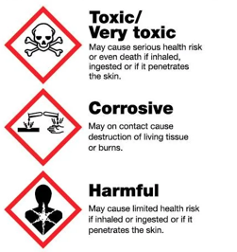
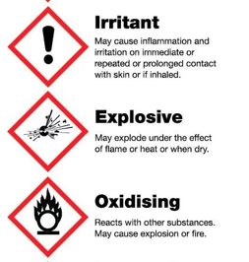
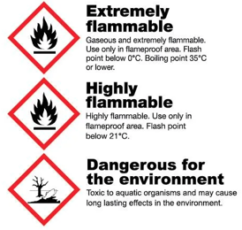
What are the COSHH Symbols?

Slide 9
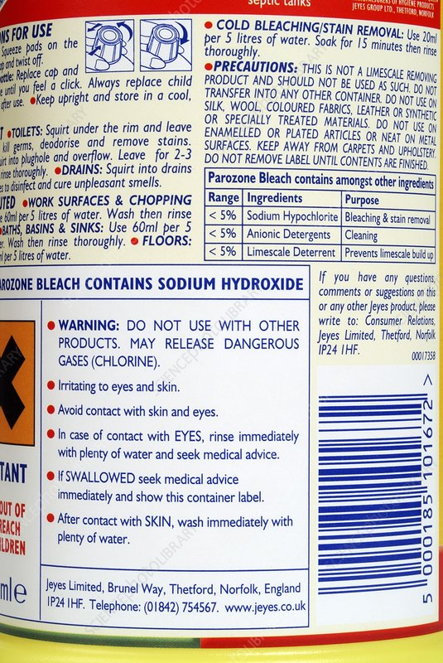
Precautionary Statements
A precautionary statement is a phrase that describes the recommended measure(s) to minimise or prevent adverse effects resulting from exposure to a hazardous substance or mixture due to its use or disposal.
Examples of precautionary statements include:
Wear eye protection
Do not eat, drink or smoke when using this product
Avoid release to the environment
In case of inadequate ventilation wear respiratory protection
Suppliers determine the appropriate precautionary statements based on the required hazard statement.

Slide 10

Reporting
You may worry about reporting an incident – due to:
Fear of blame
No clear procedures
Habit
Belief that there is no point (as nothing gets done about it)
Can’t be bothered - as too much time wasted!
This is not the case!
It is important that we are aware of accidents/incidents that occur,
no personnel will be reprimanded for reporting regardless of fault.
Failure to report an incident may result in disciplinary action.

Slide 11
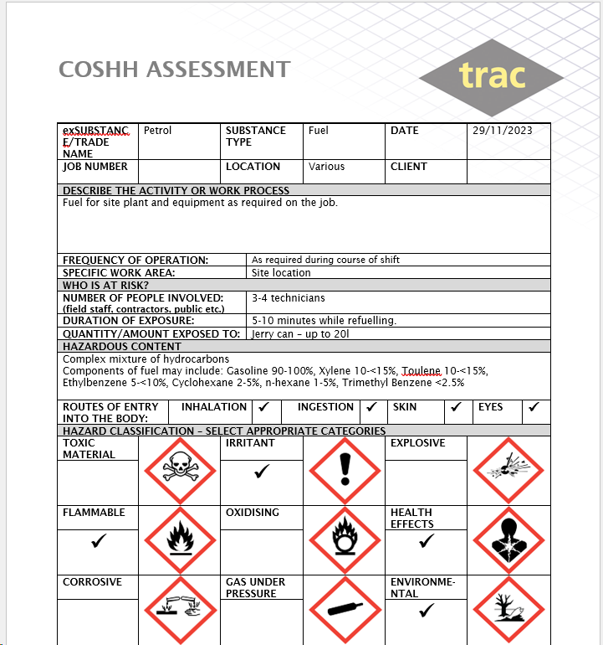
COSHH Assessment
All risks and hazards are managed in accordance with the Risk Assessment Procedure. For hazardous substances we must carry out a specific COSHH Assessment.
These are written using information provided by the substance manufacturer via the safety data sheet and are reviewed periodically.
The COSHH Assessment documents the risks and controls. It includes hazard pictograms, workplace exposure limits, required PPE, and arrangements to deal with accidents, incidents or emergencies such as spills. These are available on all worksites where chemicals are being used.

Slide 12

Chemicals in the home
While COSHH only applies in the workplace remember that many chemical products in your home will carry the same risks; bleach, oven sprays, washing detergents, toilet cleaners etc.
Labels can help you identify the hazardous chemicals, tell you what the dangers are and advise how to use them safely. For this reason, it is important to retain the original packaging.
Children are particularly at risk from household chemicals with under 5s being the most at risk from accidental poisoning*. For this reason, chemicals should be stored securely out of sight.
*https://www.nhs.uk/conditions/poisoning/

Slide 13

Safe disposal of chemicals
Disposing of household chemicals should be done in accordance with manufacturers guidelines.
Pouring some chemicals directly down the drain will have an environmental impact and could damage your pipes. Check your local authority website for information on disposal schemes available in your area.
Plastic cleaning product bottles are recyclable and will be accepted at most recycling points. Rinse and keep the label on and the lid on the bottle.
Do not forget about cloths or rags that have been used with chemicals. These should be washed or disposed of safely to avoid fire risk.

Slide 14
THINK SAFETY!
Look After Yourself
Look Out For Others
Use Safety Equipment
Follow Safety Procedures

