Slide 1
Heart Health

Slide 2
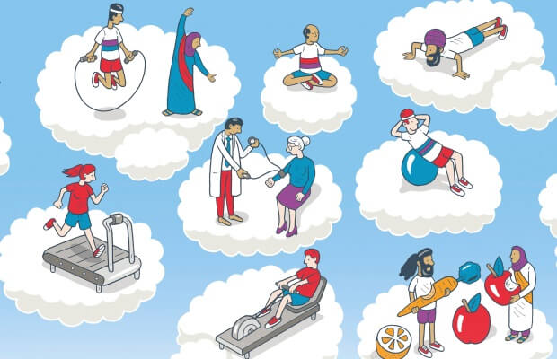
Heart Health
Maintaining good heart health is crucial for overall well-being, as the heart is responsible for pumping oxygen and nutrients throughout the body. A healthy heart reduces the risk of cardiovascular diseases (CVDs) including strokes and heart attacks, improving quality of life and longevity.
Cardiovascular diseases (CVDs) account for approximately 32% of all global deaths (WHO). Making healthy lifestyle choices and taking steps to actively prevent heart disease is crucial for keeping your heart fighting fit.
It is also important to be aware of reactive measures which can help to save a life in the event of a cardiac arrest or heart attack.

Slide 3
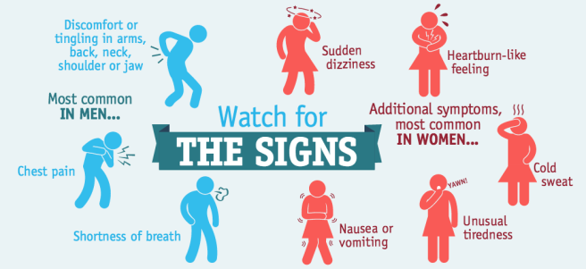
Heart Problems - Common Symptoms
https://www.sujyotheartclinic.com/symptom-of-heart-disease-in-adults/

Slide 4

Healthy Heart Checks
Cholesterol - essential for building cell membranes, producing hormones, and supporting overall bodily functions, but an imbalance - especially high levels of LDL (bad) cholesterol - can increase the risk of heart disease. To test this your doctor may carry out a blood test but some pharmacies also offer this as a pin prick test.
Blood pressure – a key indicator of heart health as it measures the force of blood against the walls of arteries. Consistently high blood pressure (hypertension) can strain the heart and increase the risk of heart disease. This can be checked by your GP. Most pharmacies also offer this service. You can check your reading using the online NHS tool Check your blood pressure reading – NHS.
Pulse Checks – help to monitor the heart's rhythm, rate, and strength. Abnormalities in pulse like irregular rhythms or unusually fast or slow rates can be a sign of heart issues.
Tracking Your Fitness – note any shortness of breath, chest discomfort or fatigue. Tracking devices, like an Apple watch, can be helpful for giving you an idea of your heart rhythm.
If you are at all concerned always consult your doctor.

Slide 5
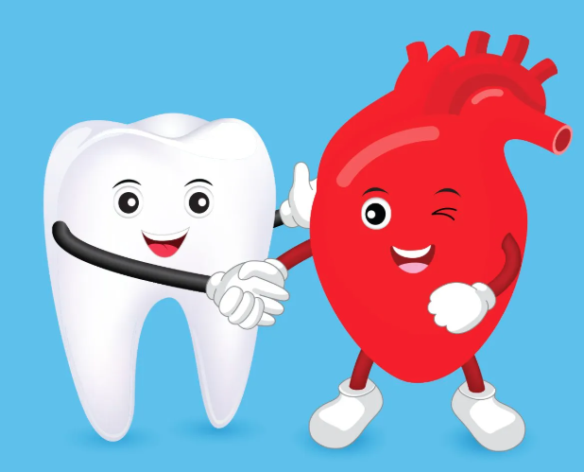
Healthy Lifestyle
Heart function naturally declines with age, but prioritising exercise, proper nutrition, and other healthy lifestyle habits can preserve cardiovascular health.
Staying active is crucial - Exercise helps to strengthen the heart muscle, enhances circulation and regulate blood sugars. Exercise is also great for reducing stress and improving your sleep quality. Something as simple as going for a walk or taking the stairs can make a big difference.
Consuming nutrient-rich foods – Foods containing healthy fats, fibre, and antioxidants and opting for heart-friendly cooking methods like grilling and steaming can protect heart health. The BHF recipe finder contains hundreds of heart healthy recipes with full nutritional analysis.
Try to limit your alcohol consumption - This can increase your blood pressure. Over time heavy drinking can also weaken the heart muscle.
Keep your teeth clean - Dental health is closely linked to heart health. Bacteria from gum infections can enter the bloodstream, triggering inflammation and contributing to the buildup of plaque in the arteries.
.

Slide 6
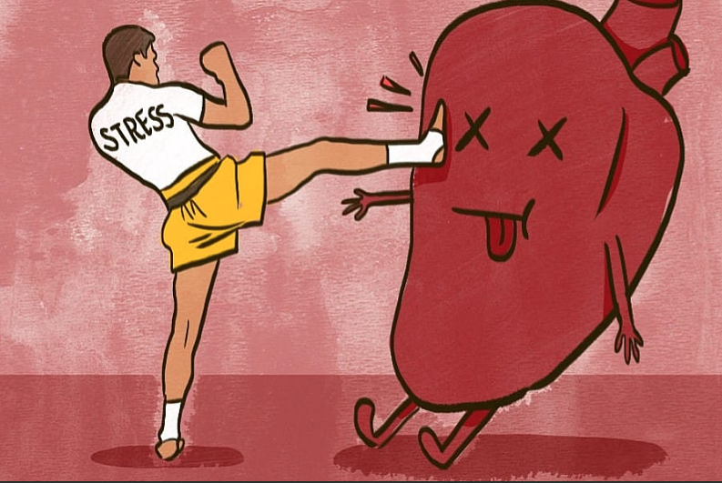
Healthy Lifestyle - Stress
Stress can have a big impact on your heart health.
When you're stressed, your body responds by releasing stress hormones like adrenaline and cortisol. These can lead to an increased heart rate and raised blood pressure.
Elevated cortisol can interfere with heart function, metabolism. Over time this can lead to chronic heart issues.
Stress can trigger unhealthy behaviours (such as drinking or smoking).
Managing stress levels is an important part of keeping your heart healthy. Getting good sleep, engaging in physical activity and deep breathing are helpful. The Stress Management Society is full of good resources for this.
.

Slide 7
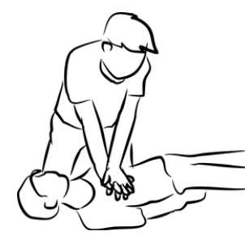
Cardiopulmonary Resuscitation (CPR)
When a person is in cardiac arrest their heart stops pumping blood, which means their brain gets no oxygen. Performing CPR means giving someone chest compressions. Without this the person will die in minutes. CPR keeps the heart pumping blood around the body until emergency help arrives.
How to do CPR on an adult
Check for a response. Firmly shake the person’s shoulders and loudly ask if they’re okay.
Call 999. If the person is unconscious and not breathing, or not breathing normally, start CPR.
Start chest compressions. With the heel of your hand in the centre of their chest, press down smoothly and firmly at a rate of 2 per second. Try pushing to the beat of Stayin’ Alive by the Bee Gees. Rescue breaths are optional. Hands-only CPR is very effective and is the recommended way to give CPR.
Use a defibrillator as soon as you can. Follow its instructions carefully while you continue to give CPR.

Slide 8
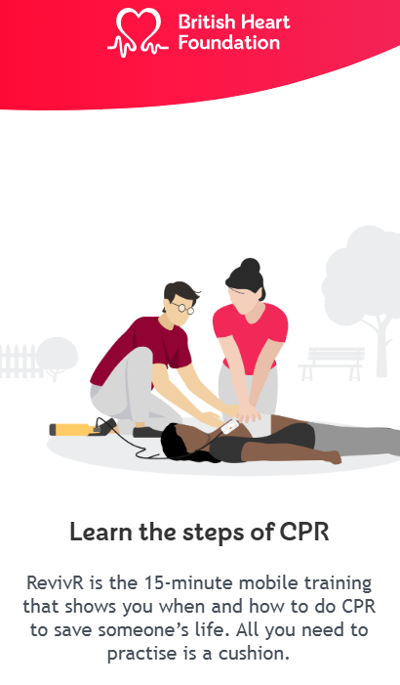
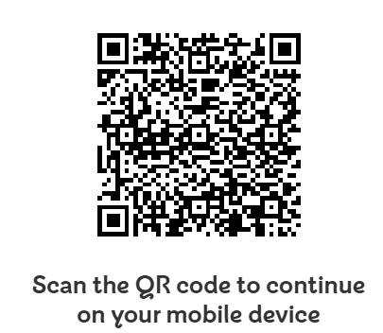
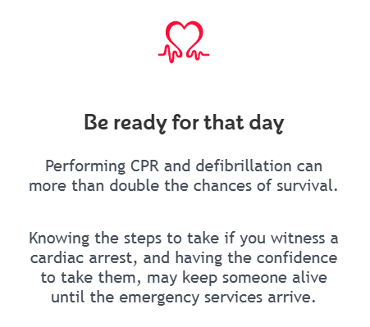
Online CPR Training

Slide 9
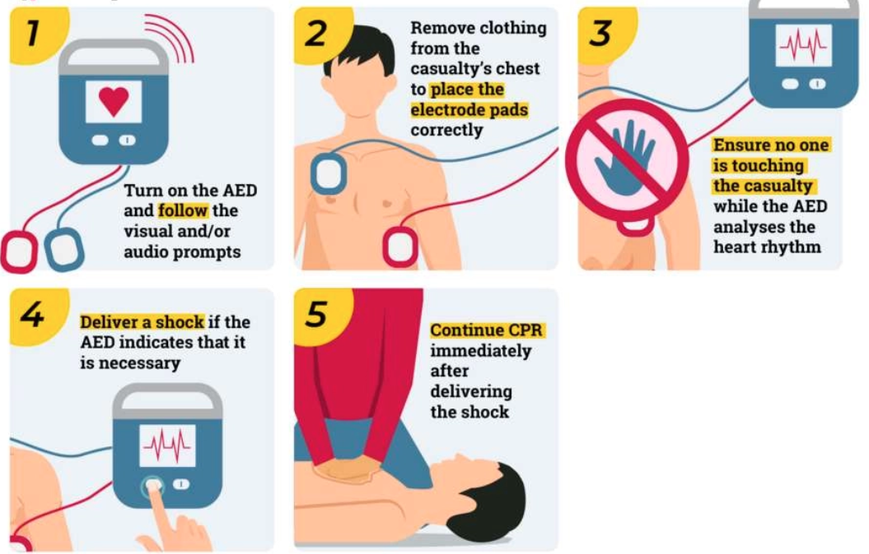
Defibrillators
A defibrillator (defib or AED) is a device that gives a jolt of energy to the heart. It helps get the heart beating again when someone is in cardiac arrest and their heart has stopped.
Anyone can use one. You do not need training. Once you turn it on, it will give clear step-by-step voice instructions. The device checks the person’s heart rhythm and will only tell you to give them a shock if it’s needed. You cannot shock yourself or someone else accidentally.
Important: If you're on your own, do not interrupt CPR to go and find a defibrillator. If it's possible, send someone else to find one. When you call 999, the operator can tell you if there's a public access defibrillator nearby.
https://www.australiawidefirstaid.com.au/resources/glossary/aed

Slide 10
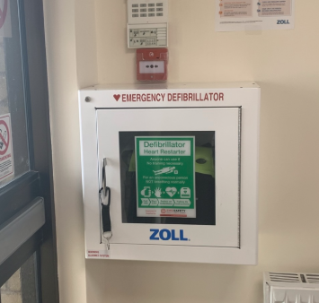
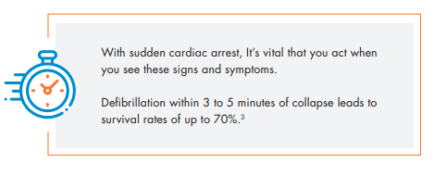
Defibrillator Locations
At the TRAC Aberdeen office we have a defibrillator located at reception.
To find other defibs near you https://www.defibfinder.uk/.

Slide 11
THINK SAFETY!!
0
Fatalities
How are we doing?
0
LTI
Summary of Incidents 2025 –
January – Present
0
RWD/MTC
0
First Aid
0
Near Miss
* RWD = Restricted Work Day, MTC = Medical Treatment Case

Slide 12
THINK SAFETY!
Look After Yourself
Look Out For Others
Use Safety Equipment
Follow Safety Procedures

