Slide 1
Healthy Living

Slide 2
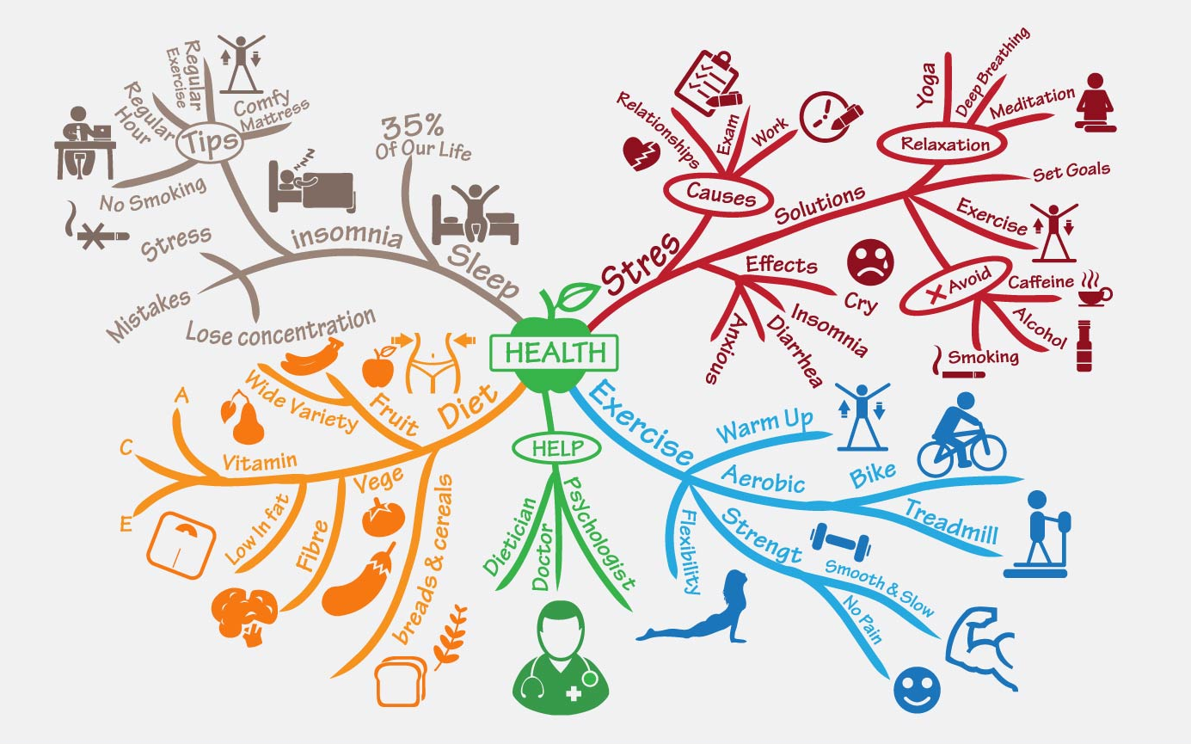
Healthy Living
A healthy lifestyle is essential for maintaining overall wellbeing and enhancing your quality of life! There are many factors contributing towards overall health
including:
Diet
Activity Levels
Hours of sleep you get
The way you handle stress
Keeping these things in check will help you
thrive and live life to your fullest potential.
Healthy Mind Map 102616 Vector Art at Vecteezy

Slide 3
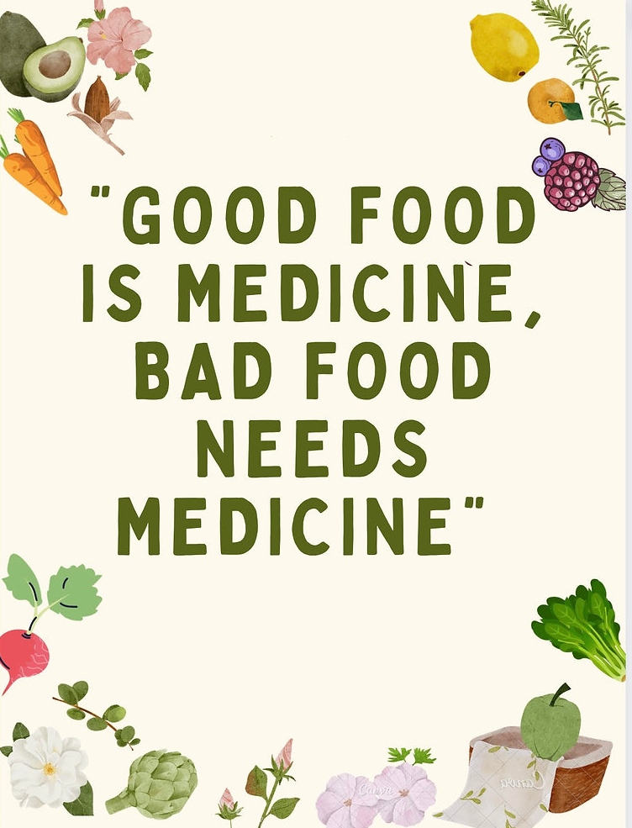
Balanced Diet
Opting for a balanced and varied diet is an important step towards a happy and healthy lifestyle. A balanced diet:
Is vital for boosting immunity and development.
Can protect you against a range of diseases such as obesity, diabetes, cardiovascular diseases, some types of cancer and skeletal conditions.
Contributes to a healthy body weight.
Can help protect your teeth.
Keeps energy levels high.
Promotes happiness!
Dr. Marcus Ranney: Article Review

Slide 4

Healthy Eating Tips
Plan – Plan your meals in advance and only buy what is on your list. This is good for your health and budget.
Cook at home – Cooking at home gives you control over what goes into your food. Cooking (and eating) helps bring families and friends together, encourages communication and improves mental wellbeing.
Shop seasonally - This will give you a better flavour, improved health as well as positively impacting your community and the environment.
‘Half Plate’ rule – This is a simple rule for staying healthy. All you need to do is fill half your plate with fruit or veg at any given meal.
Eat the rainbow - The best way to get all the required nutrients is to eat a variety of foods in different colours.
Remember that small changes can make a big difference to your diet and overall health. If you are interested in finding more information, the NHS Eat Well page is a good place to start.

Slide 5
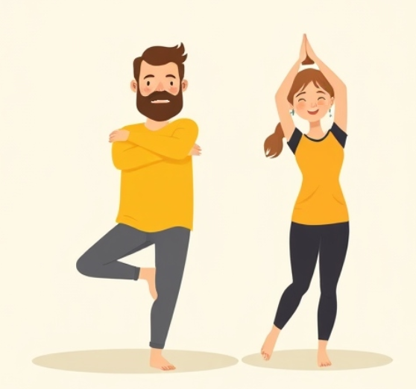
Keeping Active
Staying physically active offers numerous benefits for the body and mind.
Strengthens heart health and improves cardiovascular health.
Helps with weight management.
Creates stronger muscles and bones.
Boosts your immune system – Regular activity enhances your body’s ability to fight infection.
Enhances flexibility and balance - This is especially important as you age.
Reduces stress – Exercise releases endorphins.
Helps to regulate sleep.
Activity can come in many forms – going to the gym, planned group sports
or just being up on your feet. Even a short walk is enough to have a positive effect on your body and mind.

Slide 6
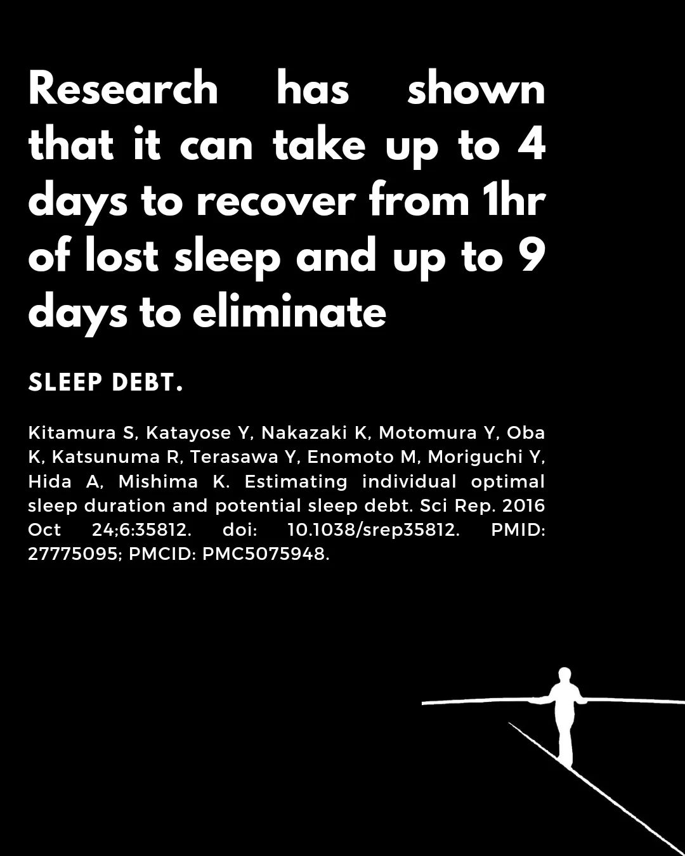
Sleep
Sleep impacts every system in your body. The way you feel while you are awake depends in part on what happens while you are sleeping.
A good night’s sleep:
Restores and repairs the body.
Lowers blood pressure and supports heart health.
Affects cognitive function. Proper sleep helps to prevents cognitive decline and reduces the risk of dementia.
Boosts your immune system.
Has a positive effect on your emotions.
Sleep deprivation can increase cortisol levels which can cause a range of problems including stress, anxiety and irritability. In short, poor sleep leads to a poorer quality of life.
*mhwithkanishka.com

Slide 7
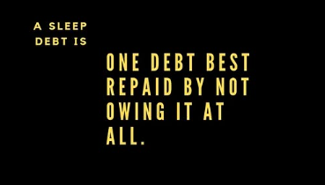
Better Sleep
The average adult needs at least 7 hours of sleep a night.
Routine - Stick to a consistent sleep schedule.
Pay attention to what you eat and drink before bedtime. Avoid stimulants like alcohol and caffeine.
Create a restful environment in your bedroom.
Limit daytime naps.
Include physical activity in your daily routine.
Manage worries and find ways to deal with stress.
Avoid use electronics and blue light at least an hour before bed.
If you struggle with sleep, you can find advice and support from The Sleep Charity.
*mhwithkanishka.com

Slide 8
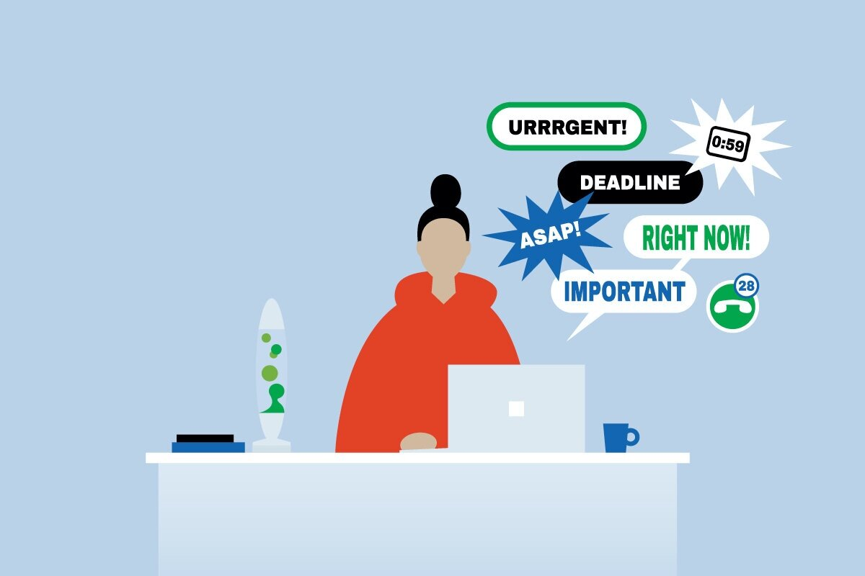
Stress Factors
According to the World Health Organization (WHO), stress has been classified as the health epidemic of the 21st century. Money, family life, work, constant use of technology and lack of community can all be stress factors in the modern world.
Whilst some stress is inevitable, there are ways in which lifestyle contributes to the problem. Given that we are all time-poor, it’s easy to see how looking after our health can fall by the wayside as we;
Rely on caffeine and sugar to pick us up, and alcohol to wind down.
Scrimp on exercise because the ‘To Do’ list wins that battle.
Make poor nutritional choices because you ‘deserve’ a treat given how hard you work.
Stay up past your bedtime because it’s the only moment of peace that you have.
Neglect enjoyable or rejuvenating self-care activities such as connecting with friends or enjoying hobbies because there are other things that need to be done.
https://www.eudaimonicbydesign.com/resilience/stress-mindset

Slide 9
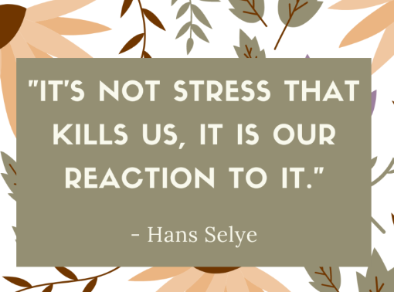
Dealing with Stress
Healthy eating, being active and getting good sleep are the main building blocks to reducing stress. However, there are other aspects to consider:
Force yourself to be social – do not wait to be ‘in the mood’ or wait for the ‘right time’ to meet up with friends or join a new group. Instead, just commit to doing it.
Go slow… practice mindfulness, get into nature, or just do something you find relaxing. An activity that forces you to slow down will help lessen stress.
Reframe stress - Learn to recognise when you are feeling stressed. Pause, then shift your mindset to what you can do to grow from it.
If you commit to being consistent the habit will eventually form.
*https://uk.pinterest.com/pin/53339576825566733/

Slide 10
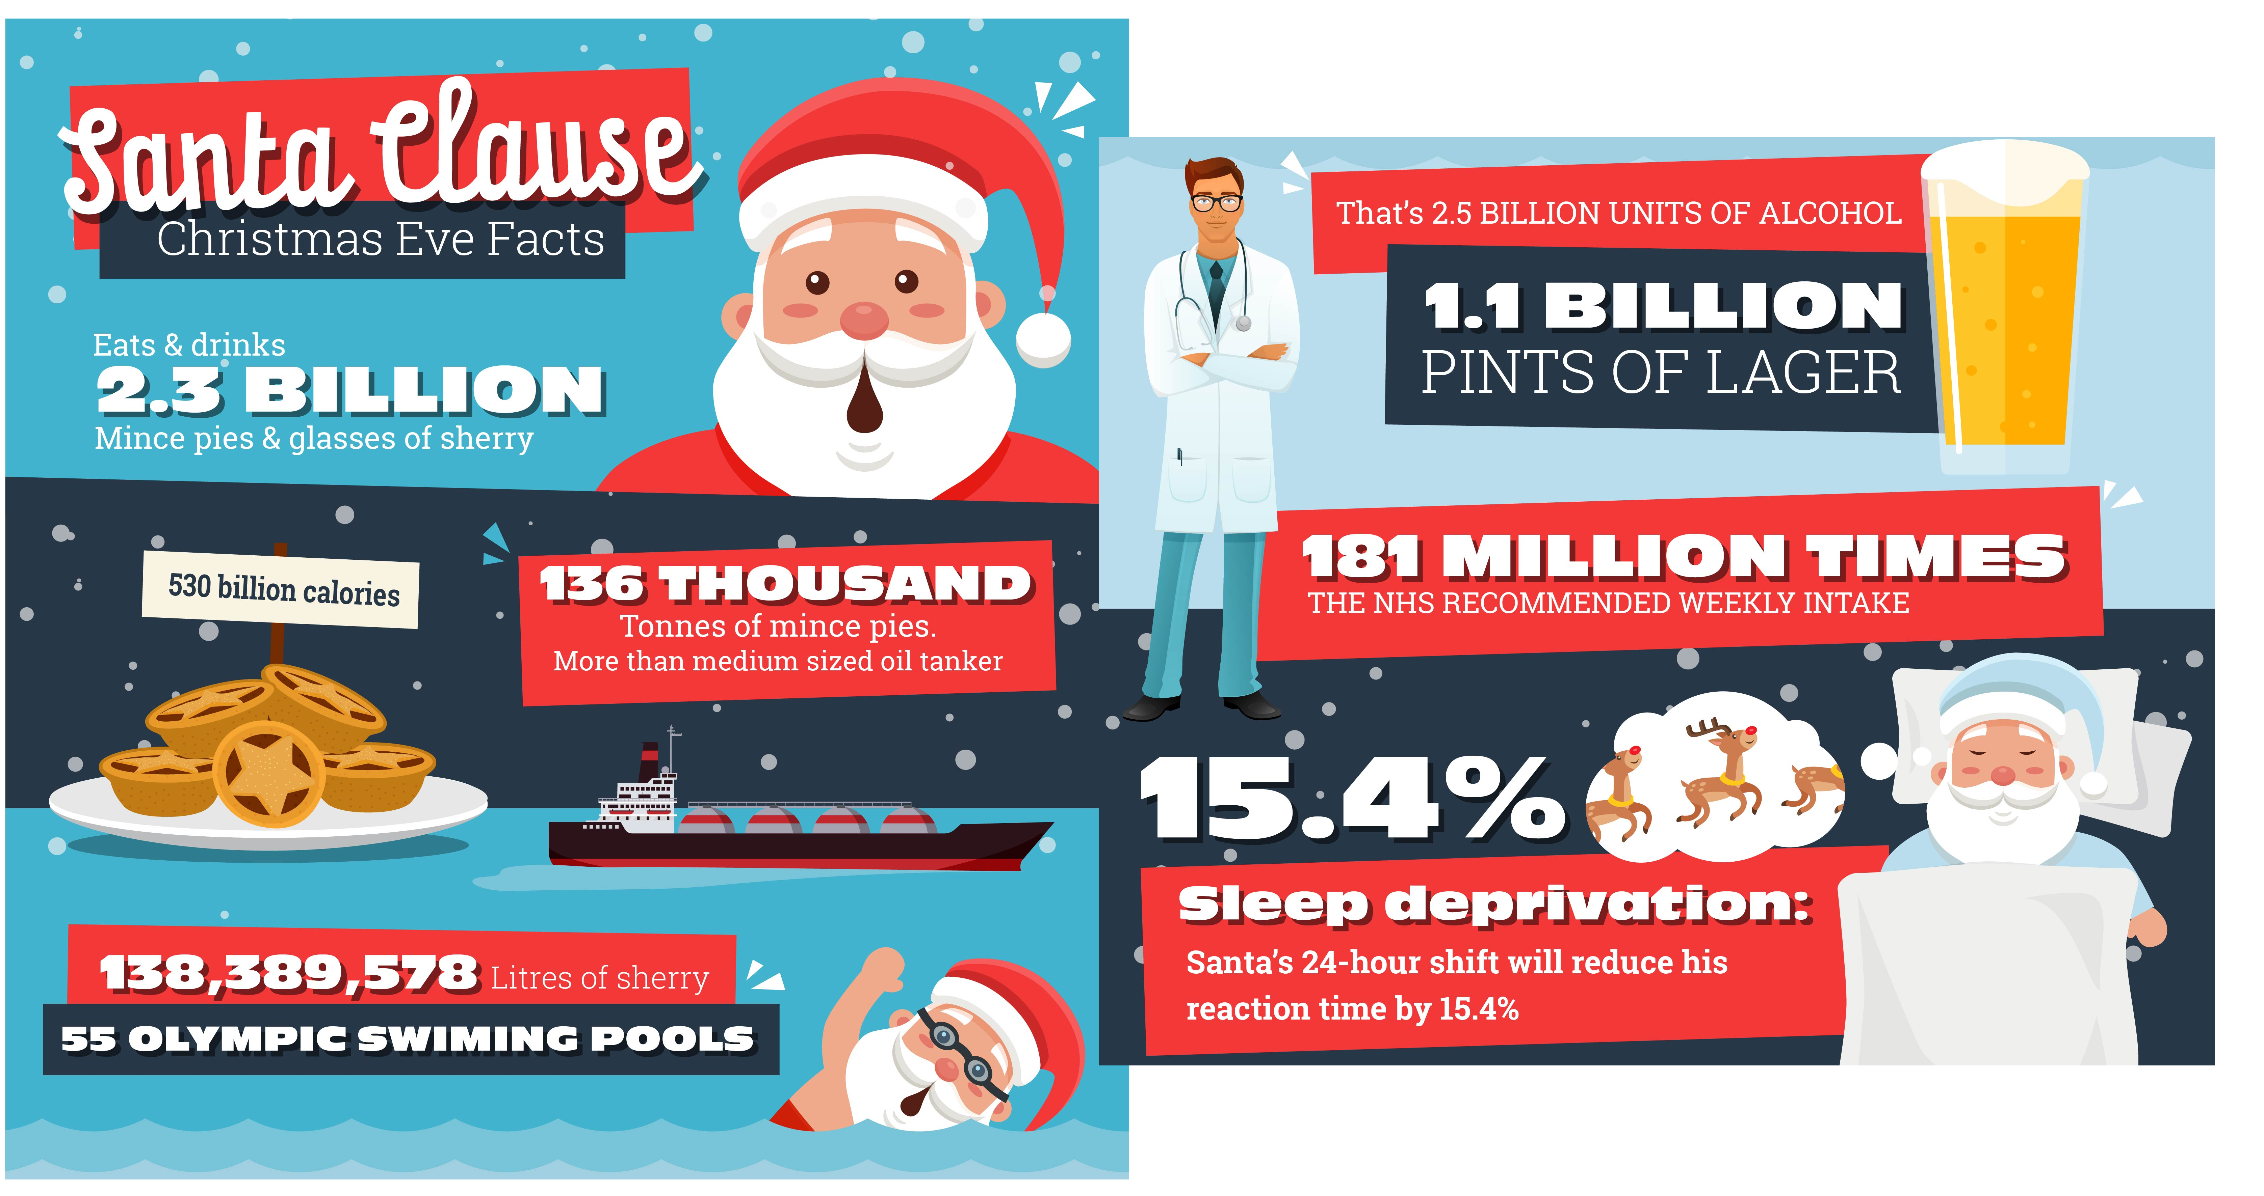
Festive Pitfalls
https://www.time4sleep.co.uk/blog/santas-festive-check-up-the-health-risks-of-santas-all-nighter

Slide 11
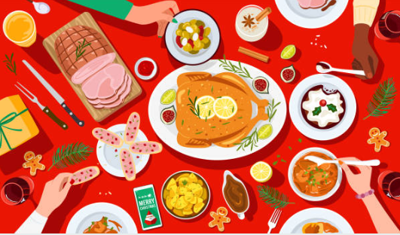
Staying Healthy at Christmas
Don’t be like Santa! Try to limit the impact Christmas has on your health.
Enjoy your mulled wine but remember to drink plenty of water and be mindful when driving the next day.
Fill up on veg while you are feasting.
Snack on some Christmas favourites – Satsumas, chestnuts and dried fruit.
Enjoy some Winter walks with family and friends to help build up an appetite.
Experiment with healthy recipes using your Christmas leftovers.
Late nights are an inevitable part of the Christmas season but that shouldn’t be a worry. Regardless of how late you go to bed, aim to get up at the same time each morning.
Use time off work to start a new hobby you can take into the New Year.
Try volunteering to benefit your community and give yourself a ‘feel good’ boost!

Slide 12
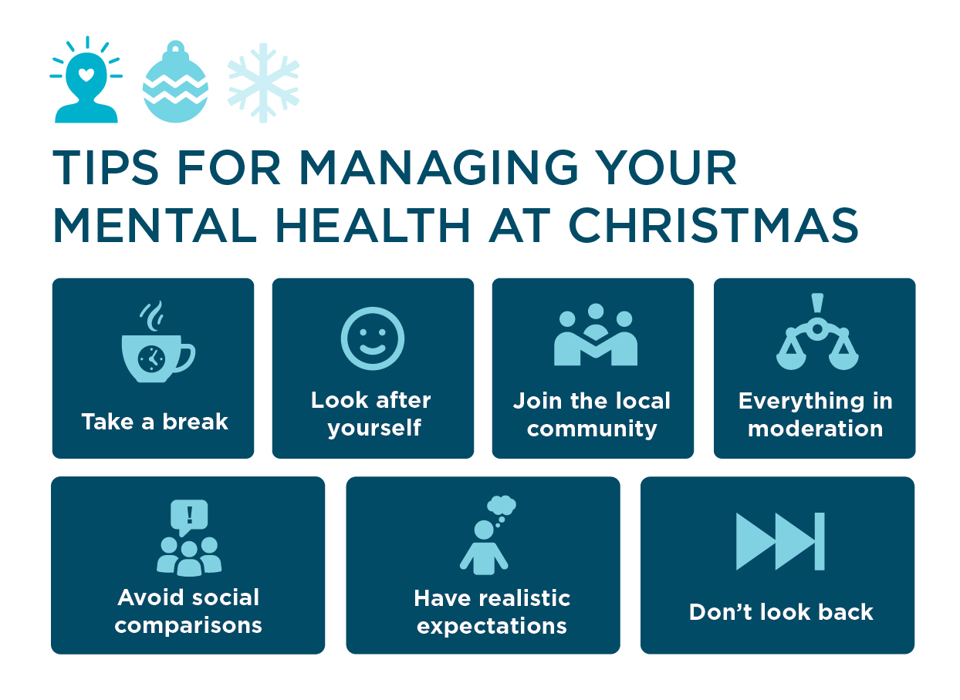
Useful links
The WHO Illustrated Guide On Techniques For Dealing With Stress
NHS Every Mind Matters website
NHS Live Well website
The Sleep Charity
https://www.priorygroup.com/mental-health/christmas-and-mental-health

Slide 13
THINK SAFETY!!
0
Fatalities
How are we doing?
0
LTI
Summary of INT Incidents 2024 –
January – Present
0
RWD/MTC
0
First Aid
0
Near Miss
* RWD = Restricted Work Day, MTC = Medical Treatment Case

Slide 14
THINK SAFETY!
Look After Yourself
Look Out For Others
Use Safety Equipment
Follow Safety Procedures

