Slide 1

Tipping points and update on Science based targets
Environmental Campaign
August 2024

Slide 2
3 | TRAC/RD and Science-Based Targets
4 & 5 | Tipping Points
6 | Refresher – What are Science-Based Targets
6 | Refresher – Net Zero
8 | Benefits of setting Science-Based Targets
9 & 10 | How are we doing?
11 & 12 | What You Can Do?

Slide 3
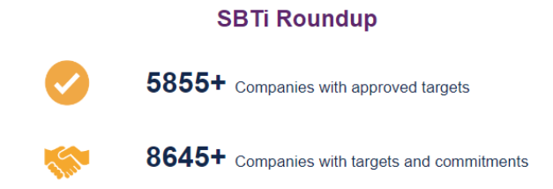
Trac and science based-targets
TRAC & Radio Design had our science-based target approved by the Science Based Targets Initiative in 2022, joining over 1000 other SMEs worldwide in tackling climate change and being a responsible business.
The Science-Based Targets Initiative aims to mobilise the private sector to play their part in combating the climate issues. In recent years, the number of companies participating has grown exponentially and today the SBTi boast the following figures:
Galvanising industry in this way is critical to beginning a movement that will encourage governments to take much needed action, perhaps reaching a tipping point…

Slide 4
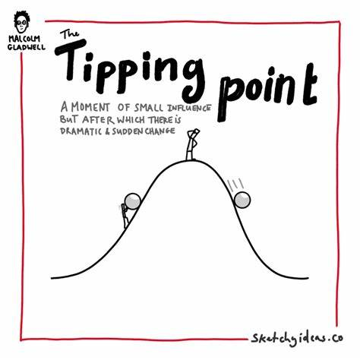
Tipping points - example
Climate experts refer to ‘tipping points’. These are critical thresholds which once passed lead to a huge, irreversible changes. We are all aware of negative tipping points relating to climate.
If we flip that idea on it’s head we find positive tipping points. These are cumulative, self-perpetuating changes in social, economic, technological and political behaviour that combine to create a more positive, sustainable state.
For example, small policy interventions to promote electric cars, green fertilisers, and plant-based alternatives to meat could make low-carbon solutions the obvious choice over old CO₂ producing alternatives leading to rapid emissions cuts.
The speed at which these changes could snowball should not be underestimated, particularly as new innovations in technology develop.
Source - Executive summary – Global EV Outlook 2024 – Analysis - IEA

Slide 5

Tipping points
The effects can already be seen in electricity generation - we are on track to see demand for all fossil fuels peak before 2030.
As renewable energy becomes cheaper and more accessible, investments are shifting away from fossil fuel and towards renewables. In turn the increasing demand for energy storage will lead to further innovation which will help to decarbonise electricity systems.
Dramatic change is occurring through the adoption of electric vehicles. In 2020, one in 25 cars sold was electric; in 2023, this was one in 5*. In Norway Import taxes and car registration duties for EVs have been waived, and parking is free. This has led to mass uptake and a move away from traditional engines.
Identifying and fostering positive tipping points is key to addressing climate change. Some academics suggest that these changes will trigger an unstoppable wave of decarbonisation.
*Source - https://www.iea.org/reports/global-ev-outlook-2024/trends-in-electric-cars

Slide 6

REFRESHER - What are science-based targets?
Science based targets (SBTs) are business targets that provide a clearly-defined pathway for companies to reduce greenhouse gas (GHG) emissions.
Targets are considered ‘science-based’ if they are in line with what the latest climate science deems necessary to meet the goals of the Paris Agreement – limiting global warming to well-below 2°C above pre-industrial levels and pursuing efforts to limit warming to 1.5°C.

Slide 7


Refresher – net zero
Net Zero refers to the balance between the amount of greenhouse gases that are produced and the amount removed from the atmosphere.
Net Zero is reached when the amount we add is no more than the amount taken away.
This is important as it’s the best way we can tackle climate change by reducing global warming.
What we do in the next decade to limit emissions will be critical to the future, which is why every country, sector, industry and each one of us must work together to find ways to cut the carbon we produce.
SBT’s help tackle this.

Slide 8
Benefits to setting science-based targets?
Company reputation
Resilience against regulation
Increased innovation
Economic savings
Competitive Edge
So do they do this?
Our client base regularly requests details of our aims, system and action taken. It also helps with certification and memberships that our company holds.
We must keep producing ideas and projects that will reduce our emissions or enhance our environment in other ways, which can be challenging.

Slide 9



highlights of our carbon reducing activities over the last couple of years
Carbon Reduction Reports published | Staff training/refresher training completed | Switching to Hydrotreated Vegetable Oil (HVO) fuel for some equipment and vehicles. | Finding ways to be “circular” in supply chain e.g. recycling of paint and use of recycled paint. | Lighting projects to use energy saving technology in Aberdeen and Shipley
New Sustainable Procurement Policy and Tool - to consider lifecycle of purchases fully. | Donations of rope, wood etc. for reuse by Charities and Community projects | Scope 3 inclusion of emissions streams not previously covered: commuting, flights, upstream and operational shipments (Radio Design) Volunteering - Beach cleans and litter picks | Carbon Offsetting Researched Sustainable alternatives – fabric maintenance projects don’t replace like for like if a more sustainable alternative is available, e.g. Accoya vs Oak | Ongoing project to eliminate single use plastics in India Revised and republished revision 02 Carbon Reduction Group Strategy and Plan 2024
Radio Design – Salts Mill Zero Waste Facility | Octopus EV Scheme – 5 schemes have been taken up by staff so far | Volunteering - Beach cleans and litter picks | Radio Design – Ecovadis rated system – currently Bronze award | Car charging stations installed at TRAC-owned locations.
100% renewable energy contracts at all company-controlled sites | Smart Meters installed at our Clydeside premises. | Electric vehicles purchased. | India – Factory Thermal Management Project | Hybrid working in most parts of the company saving emissions related to commuting

Slide 10
What can you do?
When shopping, consider the sustainable options available to you for whatever you’re purchasing.
Change to renewable energy electricity contracts for your home.
Add some plant-based meals into your diet regularly, it's good for you too.
Get your information from reliable, unbiased, knowledgeable sources.
If you’re fortunate enough to be able to invest the money, consider solar panels, heat pumps etc to reduce your impact. Grants are still available.
Try not to become apathetic about environmental issues, find reasons to be hopeful e.g. try the Anti-dread Climate Podcast
What we do right now makes the biggest impact by the time 2050 is reached.
And the actions of individuals can contribute towards all kinds of “tipping points”.

Slide 11

We want to hear from you!
Do you have any ideas about how to save energy in your part of the business? Perhaps you have identified a more eco-friendly way of working?
Please pass any ideas on to your manager or get in touch with a member of the HSEQ Team.

Slide 12
“Adapting to the climate challenge facing us requires us believing we can”.
- Marcy Franck
Source

