Slide 1
MODERN SLAVERY
HSEQ Campaign

Slide 2
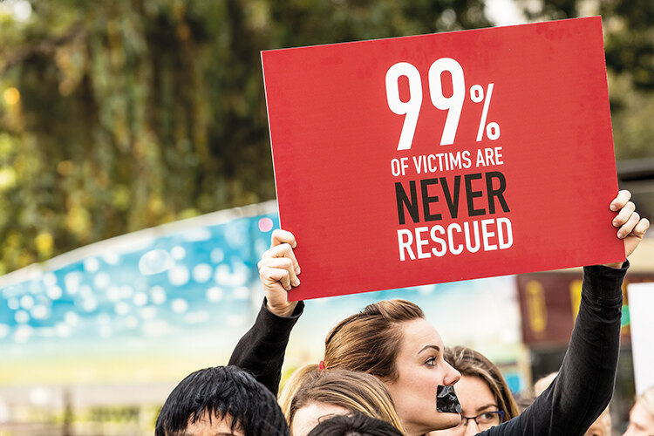
What is Modern Slavery?
Modern slavery is when a person is exploited by others for personal or commercial gain.
It is estimated that around 49.6 million people are affected globally*. Reports of modern slavery have increased since 2018. This is due to worldwide conflicts, environmental degradation, migration, a global rollback of women’s rights and the impact of the COVID-19 pandemic.
It is hard to get an accurate figure as it is often a hidden crime. Women, children and minority groups are most at risk.
*https://www.antislavery.org/slavery-today/modern-slavery/#:~:text=Modern%20slavery%20takes%20many%20forms,criminality%2C%20marriage%20or%20organ%20removal

Slide 3
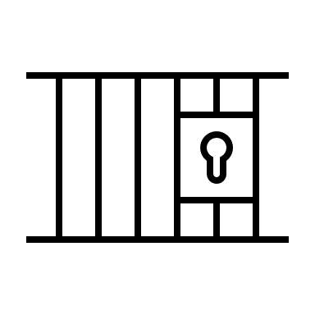

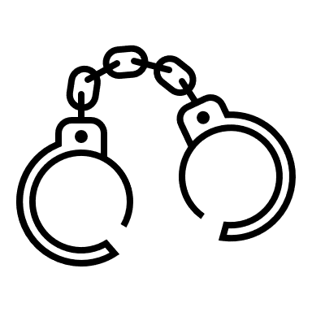


Types of Modern Slavery
Forced labour
Most forced labour occurs in the lowest tiers of supply chains; that is, in the extraction of raw materials and in production stage.
Debt Bondage
Where people trapped in poverty borrow money and are forced to work off their debt with no control as to when it ends.
Child Slavery
A quarter of slaves today are children.
Forced Marriage
22 million people are in forced marriages.
Domestic Servitude
A live-in employment arrangement where the employee cannot leave of their own free will.

Slide 4
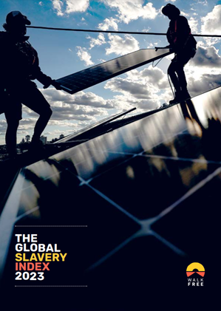
Industries linked to Modern Slavery
Construction - The dynamic nature of construction work can mean workers join and exit throughout a project without scrutiny.
Cleaning - Often carried out by female migrant workers who carry out the work without being seen.
Food Production - Due to the nature of the work involved in the production, processing, packaging and transport of food and produce, these supply chains have a high risk of modern slavery.
Tobacco - According to HMRC around 2.5 billion illegal cigarettes were smoked in the United Kingdom between 2019 and 2020. This is made possible through modern slavery.
Electronic and Clothing Manufacturing - Almost 20% of the world’s global cotton production is linked to forced labour in China.
Renewables – Reports show that the rush to decarbonise global energy systems is giving rise to modern slavery with the production of solar panels and lithium-ion batteries.

Slide 5
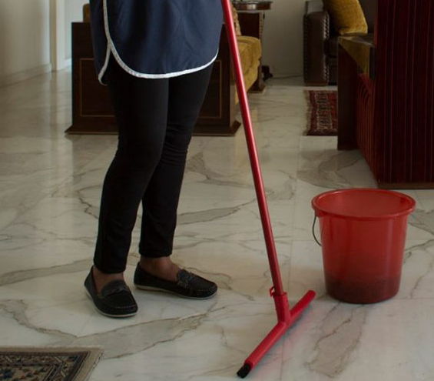
Signs of Modern Slavery in a workplace
The following may be signs of someone who is working against their will:
They show signs of psychological or physical abuse.
They are always accompanied by someone.
They are transported to and from work, perhaps with a number of people in one vehicle.
They lack protective equipment, suitable clothing or training to safely do their job.
They lack access to their own documents, such as ID or passport.
They work unusually long hours.
They stay in accommodation provided by their employer.
Their earnings are paid into a bank account with a different name.

Slide 6
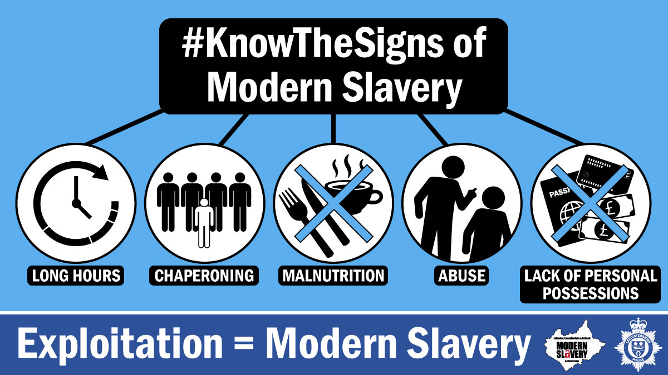
Modern Slavery
For help and advice on reporting modern slavery visit:
https://www.modernslaveryhelpline.org/

Slide 7
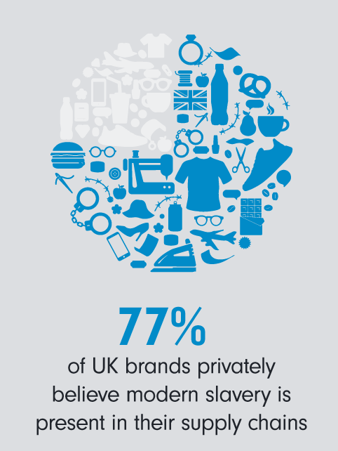
Modern Slavery in the UK
Modern Slavery is present in every part of the UK. It is likely that you have had interactions with victims without even realising it.
In 2015 the UK passed The Modern Slavery Act. Section 54 entitled 'Transparency in Supply Chains' requires many businesses to disclose a ‘Slavery and Human Trafficking Statement’ and challenges them to root out exploitation from supply chains.
This act has since been widely criticised for being a ‘tick box’ exercise and not going far enough to change corporate behaviours.
*https://www.fidelityinternational.com/editorial/blog/rooting-out-modern-slavery-5a7f4b-en5/

Slide 8
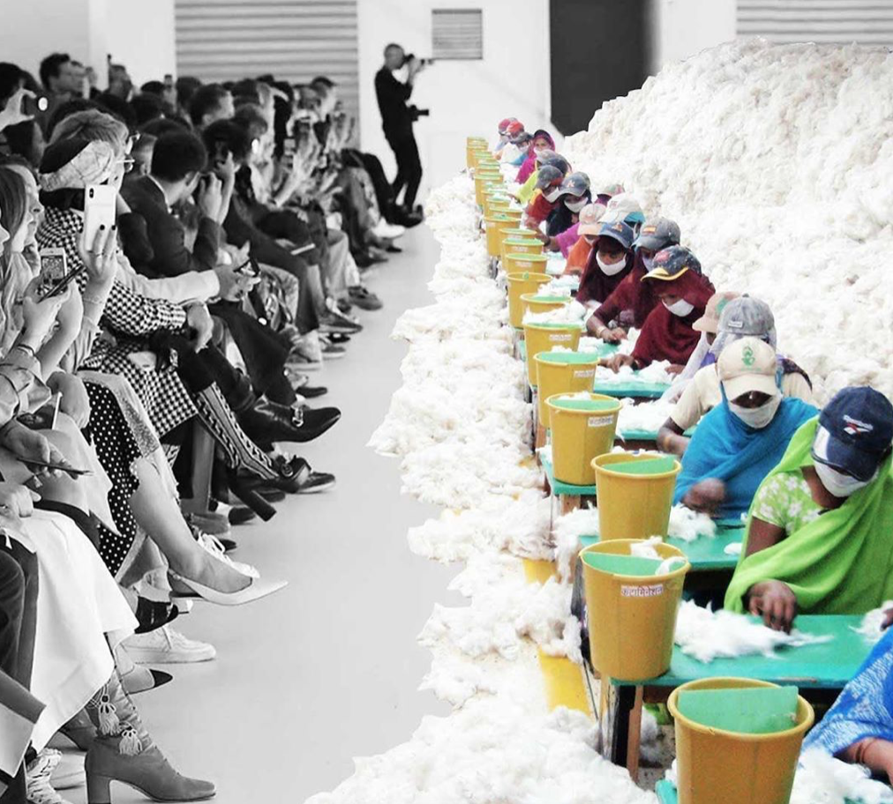
Modern Slavery Around the World
North Korea had the highest rate of Modern Slavery in 2023. 104 out of every 1000 people within the population were victims.
China operates state sponsored forced labour against Uyghurs and other minority groups. Labour transfers relocate people from rural areas to urban areas to work in factories. This is a systematic abuse of human rights.
India has the largest number of working children in the world.
Russia reintroduced compulsory labour as a form of criminal punishment in 2017. Prisoners perform forced labour for over 1700 commercial organisations.
Global cooperation across governments, societies and the commercial sector is required to put a stop to modern slavery. Companies need to go further to find modern slavery in their supply chains and keep the issue at the top of corporate agendas.
*https://www.fashionroundtable.co.uk/news/2020/10/6/1uyghur-crisis-why-is-the-fashion-industry-repeatedly-implicated-in-modern-slavery-scandals

Slide 9
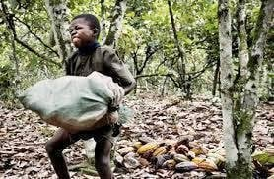
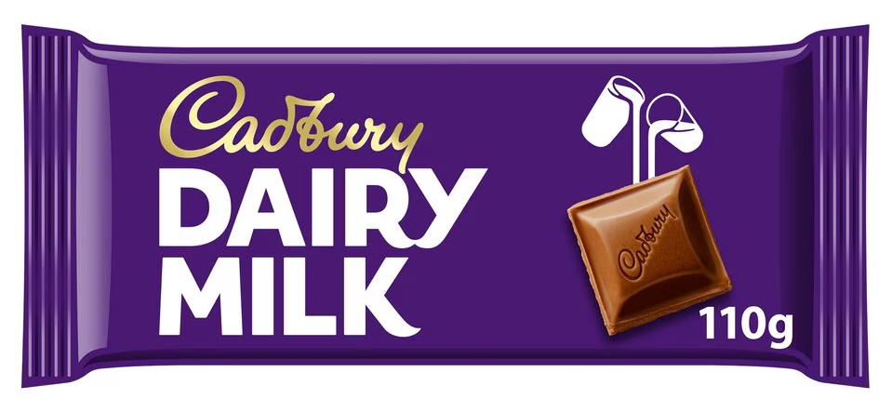
Example – Cadbury Chocolate
In 2022 an investigation claimed Children as young as 10 were found working in Ghana to harvest cocoa pods to supply Mondelēz International, which owns Cadbury. Under Ghanaian law, it is illegal for children under 13 to work on cocoa farms. There is also a ban on anyone under 18 being involved in hazardous labour.
Despite the company making extensive profits from chocolates, it was revealed that the chocolate farmers make less than two pounds per day, leading them to hire children instead of adults.
* https://www.theguardian.com/law/2022/apr/03/cadbury-faces-fresh-accusations-of-child-labour-on-cocoa-farms-in-ghana

Slide 10

What TRAC/Radio Design do
We recognise that Modern Slavery is an abhorrent abuse of human rights.
We publish an annual Transparency Statement.
We will not knowingly award business to socially or environmentally irresponsible suppliers.
All suppliers are required to fill out an HSEQ Questionnaire detailing their Corporate Social Responsibility policies in addition to question on ethics, employment conditions and labour laws (included forced/bonded labour).
We have a robust Vendor Approval processes that includes an assessment of a supplier’s corporate social responsibility and ethics. This includes information on employment conditions and labour laws (including forced/bonded labour).
Suppliers are required to confirm compliance to TRAC’s Code of Conduct.

Slide 11
What TRAC/Radio Design do
We are committed to compliance with the applicable legislation for all areas in which we operate.
We comply with Section 54 of the Modern Slavery Act 2015 which encourages organisations to investigate and report on their own supply chains.
We regularly audit suppliers to ensure compliance.
We remain committed to ensuring due diligence in procuring conflict-free minerals. We retain conflict mineral statements from any supplier who uses tin or lead in their processes.

Slide 12



What can you do?
Be a smart consumer and consider sustainability when shopping.
Think of every pound spent as a vote.
Avoid dubious looking sites/social media posts selling cheap products. There is lots of speculation surrounding sites like TEMU, SHEIN regarding forced labour.
The Good Shopping Guide gives you an ethical comparison of companies and brands. They cover everything from mortgages and savings to jam.
Look for accreditation such as The Global Organic Textile Standard (GOTS), B-Corp Certified or ‘Living Wage’ employers.

Slide 13
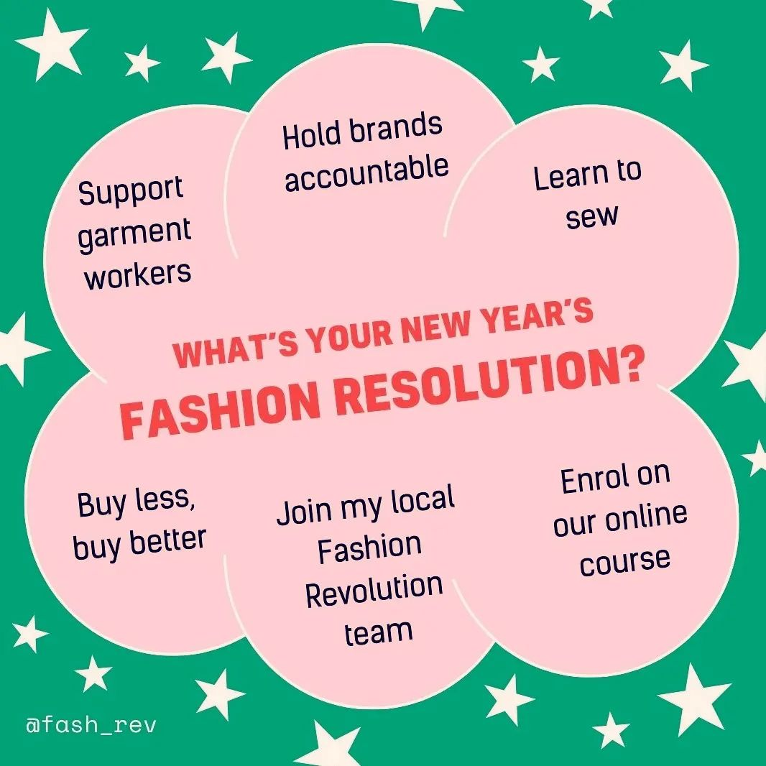
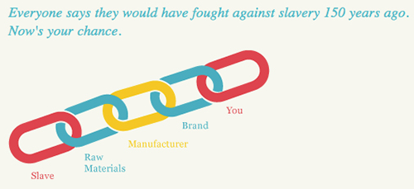
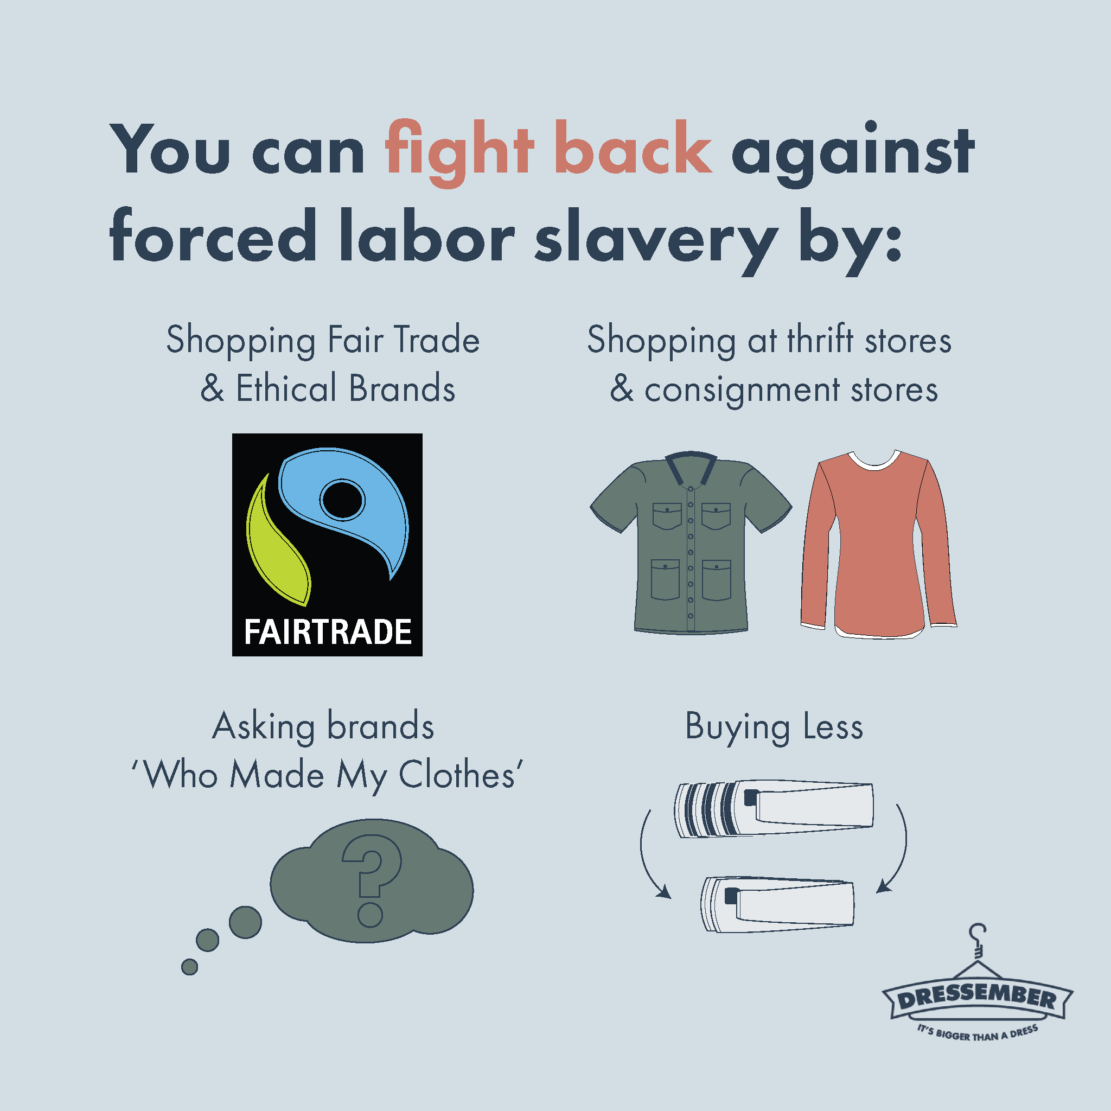
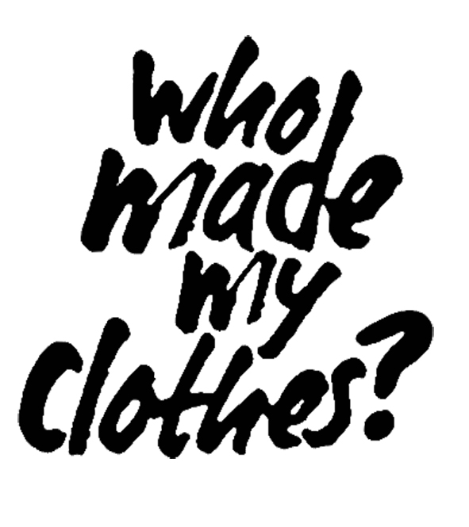
What can you do?

Slide 14
THINK SAFETY!!
0
Fatalities
How are we doing?
Summary of Incidents YTD 2024 -
0
LTI
0
RWD/MTC
0
First Aid
0
Near Miss
* RWD = Restricted Work Day, MTC = Medical Treatment Case

Slide 15
THINK SAFETY!
Look After Yourself
Look Out For Others
Use Safety Equipment
Follow Safety Procedures

